Slide 1
sPHENIX status
Kin Yip
sPHENIX Director of Operations
Time Meeting
June 17, 2025

Slide 2
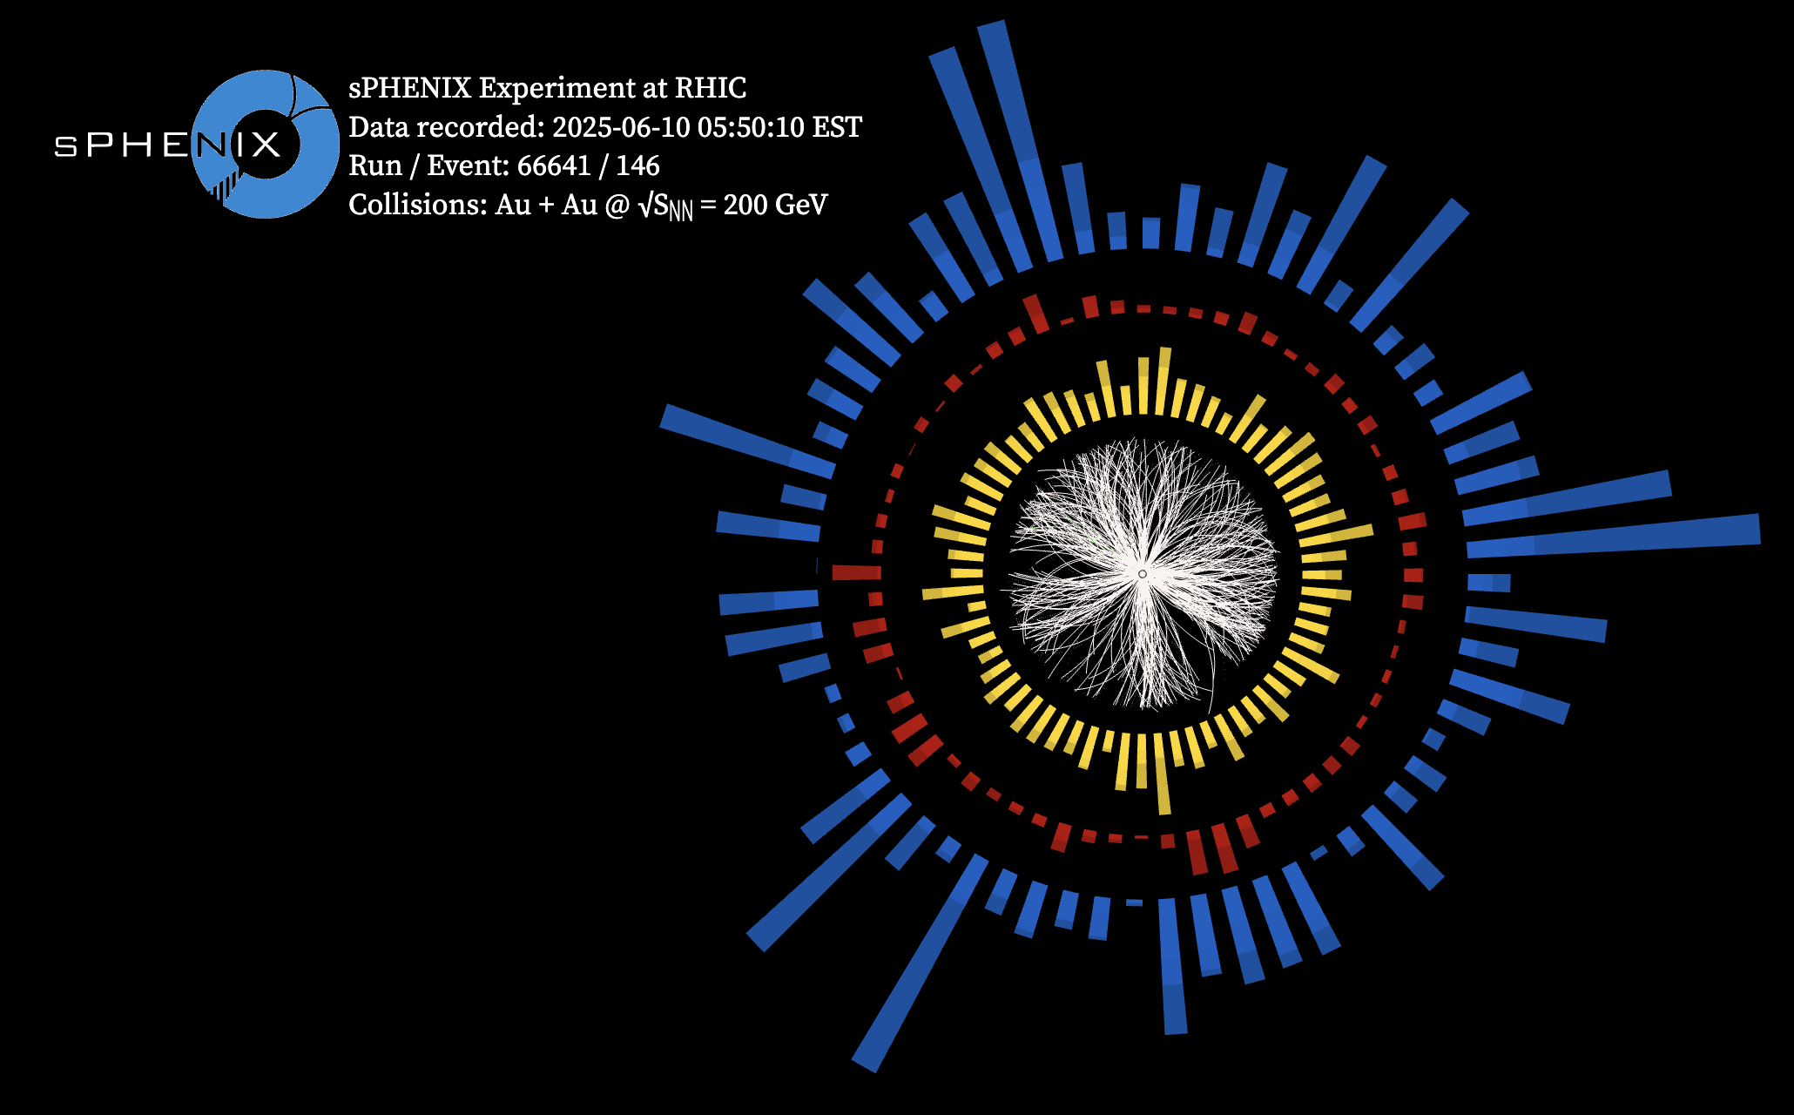
sPHENIX Status & Performance
All detectors have been used to take collision data in 111×111 stores and ~ready for physics.
With the MVTX operating in triggered mode, we can start taking physics quality Au-Au data.

Slide 3
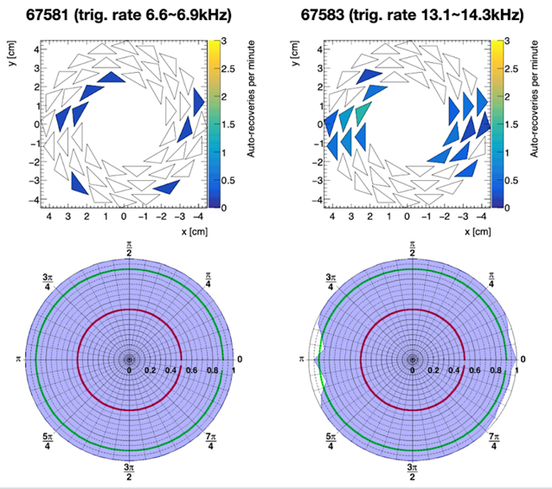
sPHENIX Status & Performance (cont.)
MVTX performance in triggered mode (small loss of acceptance at the highest rate):
Outer donuts
Inner donuts
ZDC’s

Slide 4
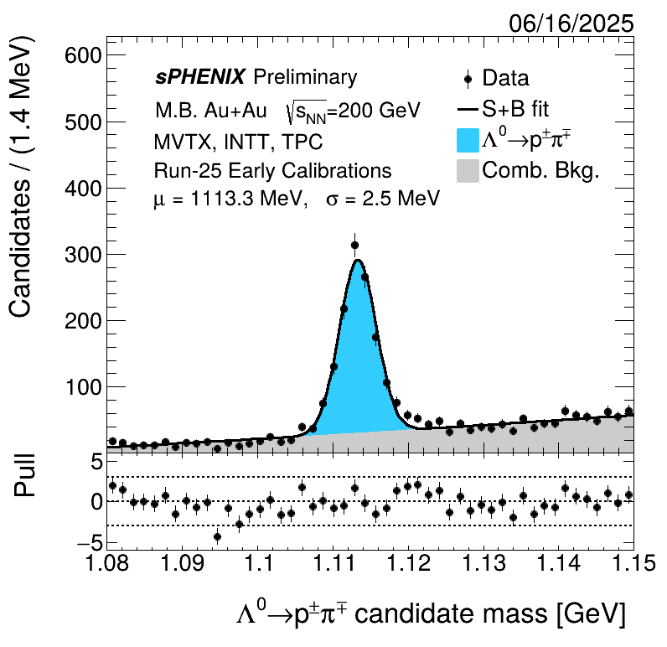
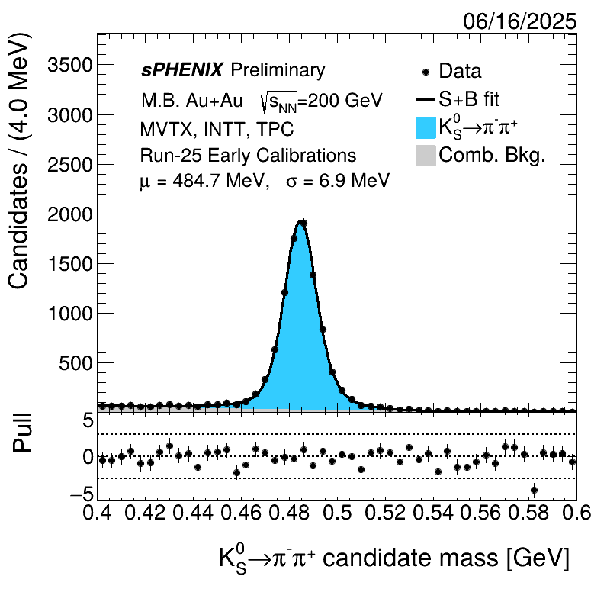
sPHENIX Status & Performance (cont.)
Invariant mass reconstructions requiring all tracking detectors

Slide 5
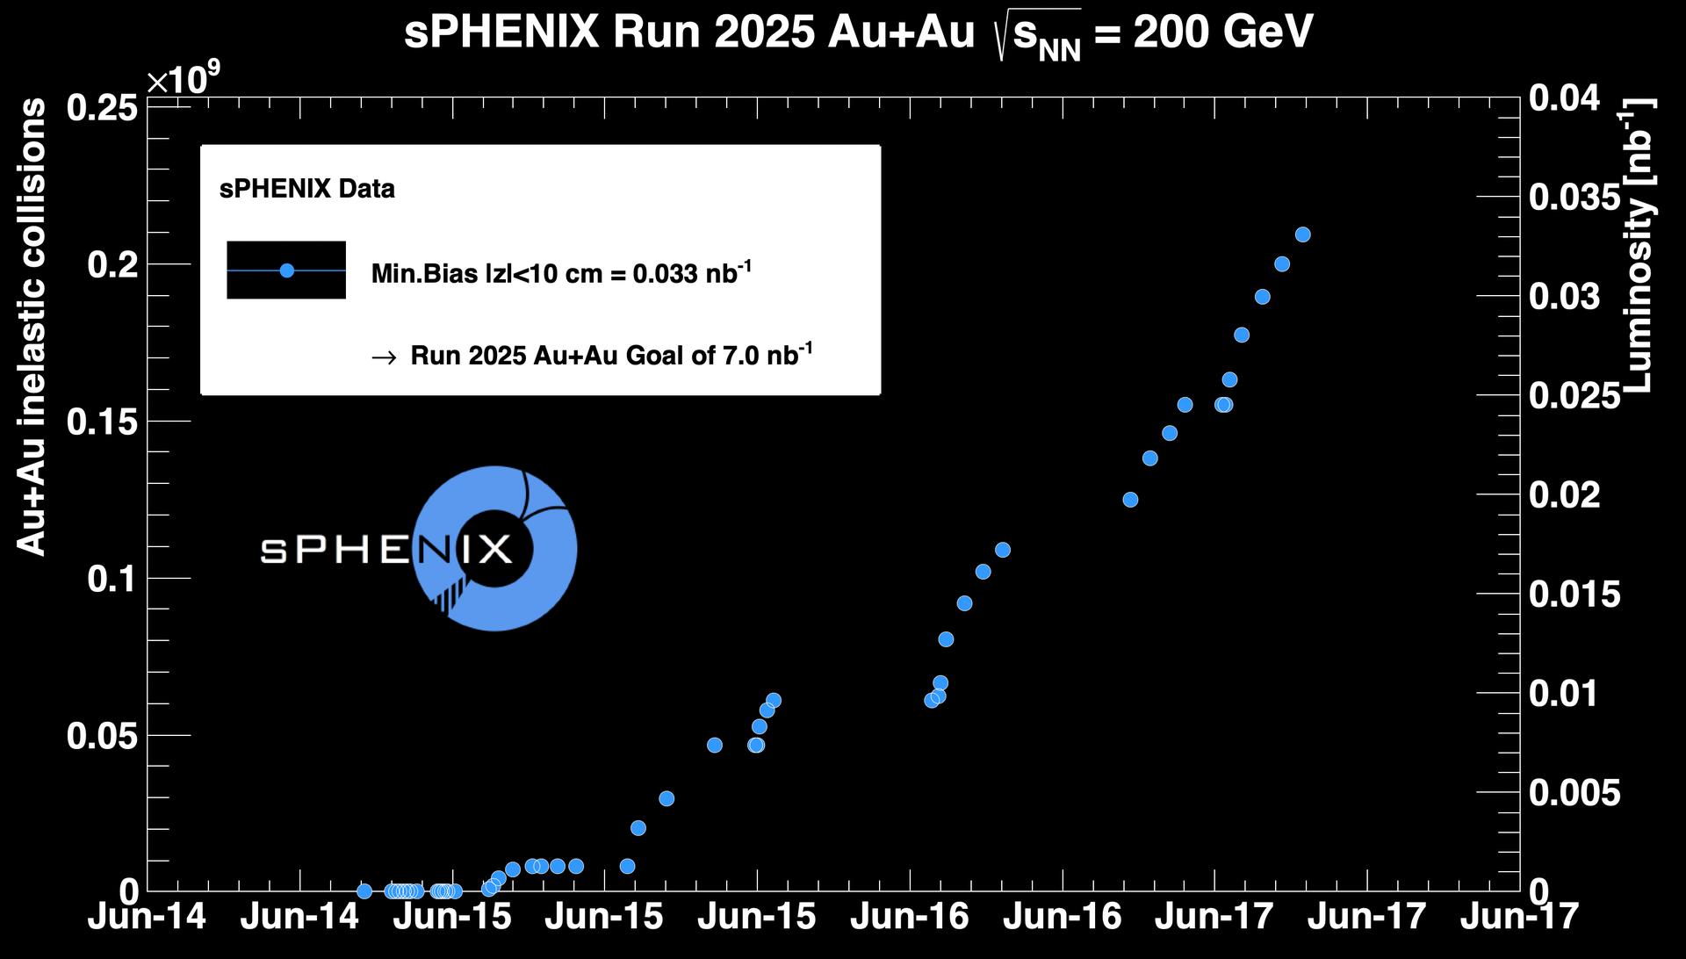
sPHENIX Status & Performance (cont.)

