Slide 1
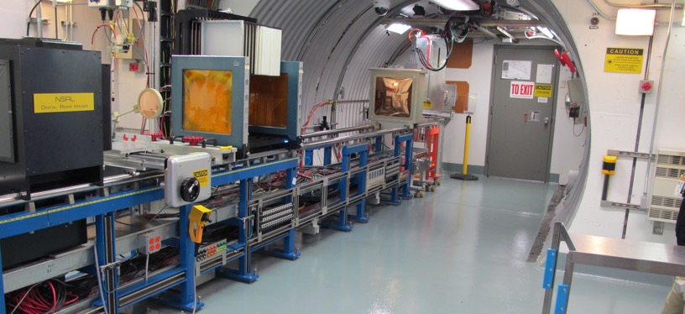
NSRL Time Meeting Report
17 June 2025
Michael Sivertz

Slide 2
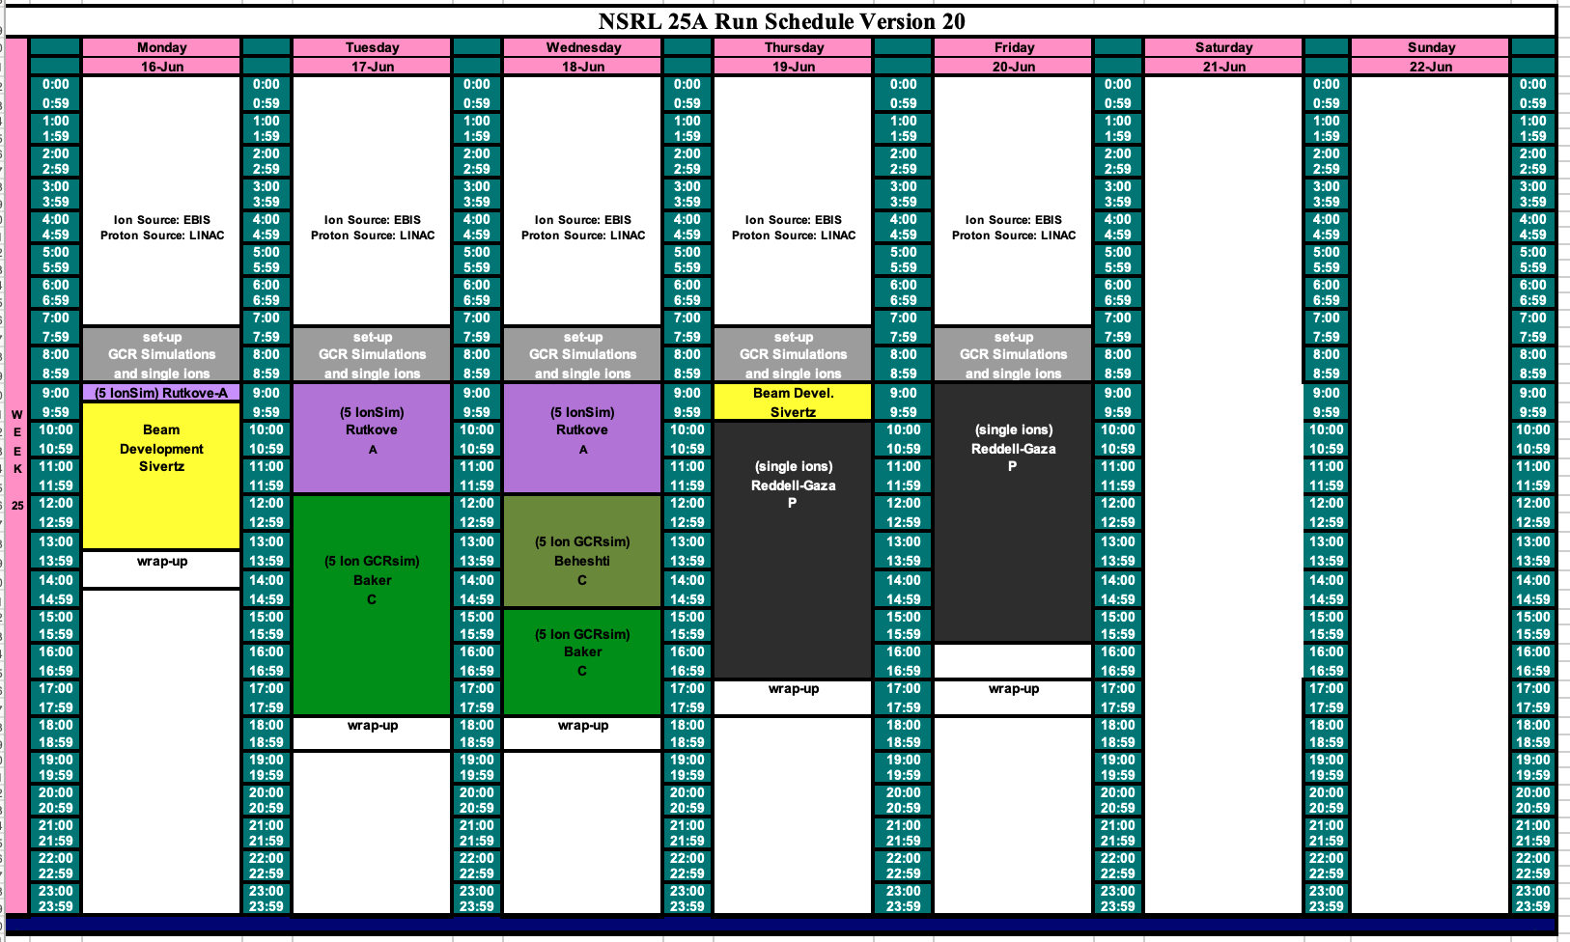
Schedule for this week

Slide 3
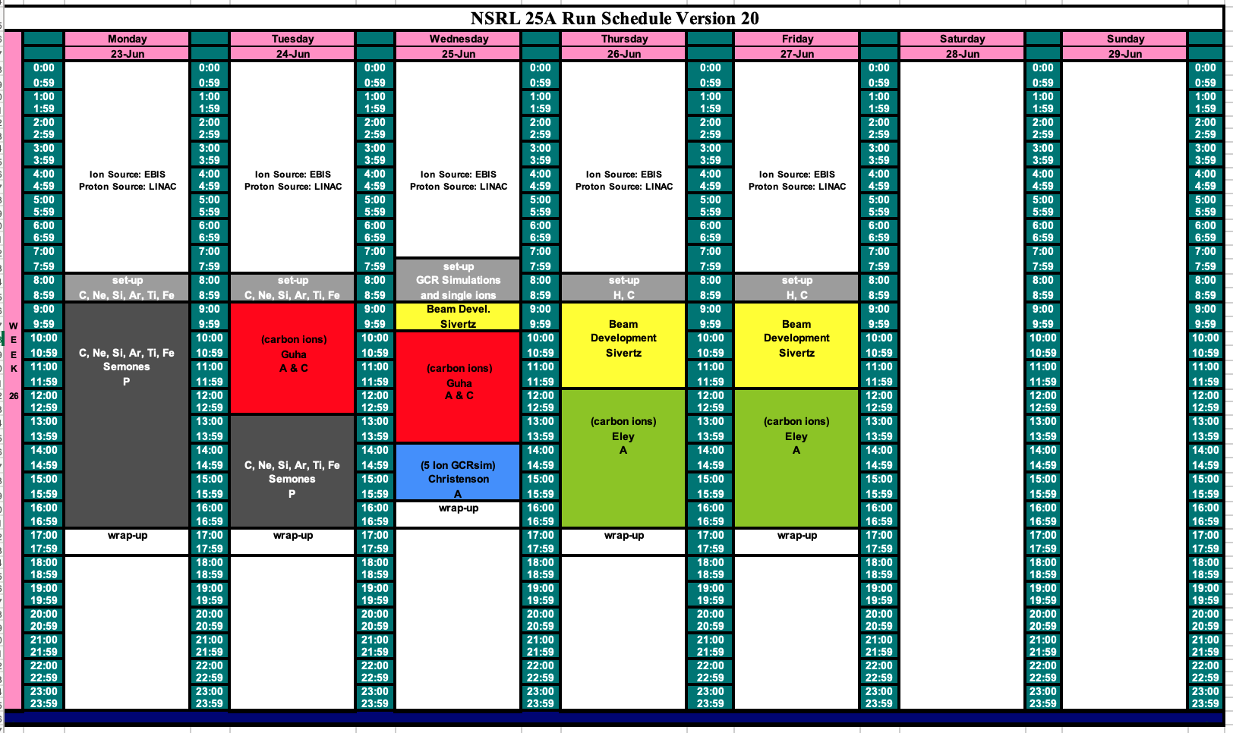
Schedule for next week

Slide 4
Future Schedule
Much improvement in the rate of EBIS Collector Power Supply trips this week.
Smoother running for the NASA biology.
Productive proton beamtime over the weekend for the FFAG study (Trbojevic and Brooks).
Next week is the last week of NASA biology.
Hope to get approval for Blue Origin experiment with HALEU target to be conducted on either 26 or 27 June.

