Slide 1
Data courtesy C. Naylor

Slide 3
Data courtesy C. Naylor

Slide 4
Data courtesy C. Naylor

Slide 5
Data courtesy C. Naylor

Slide 6
Data courtesy C. Naylor

Slide 7
Data courtesy C. Naylor

Slide 8
Data courtesy C. Naylor

Slide 9
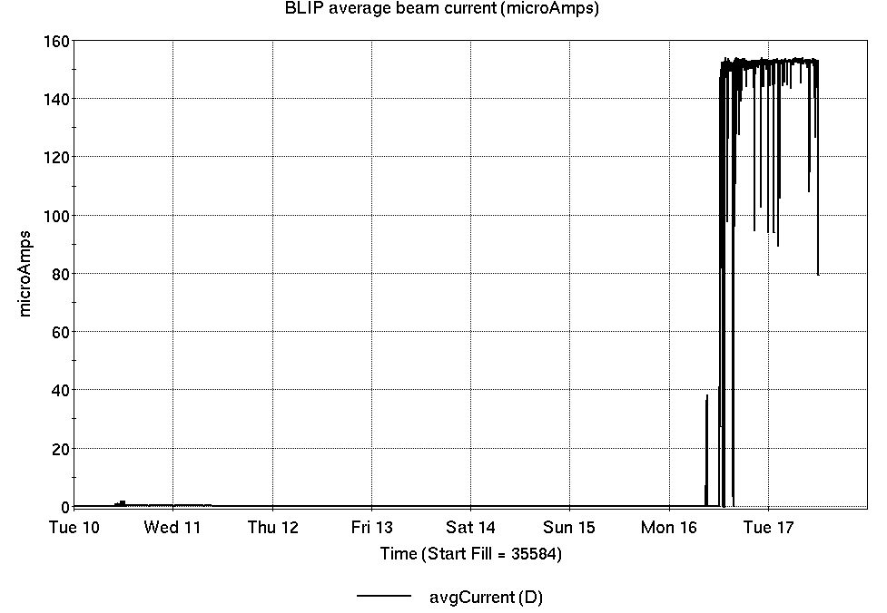
Operations for BLIP
No BLIP
this past week
6/10-17/2025:
200 MeV production resumed Monday.
39.60 hr production
4.32 hr setup
2.88 hr failures
Availability: 93.8%
Notes:
BLIP plot from LogView /MCR/PerformanceStats/timeMeetingBLIP.lvdisp
Avail calc on nsrl time Excel sheet

Slide 10
NSRL activity past week: 6/10-17/2025 (as of 0800)
NSRL running continues. NASA biology in GCR mode, with some other user time and beam development for upcoming schedule.
No Tandem ions; Linac protons, 7 EBIS ions (He, C, O, Si, Fe, Ta, Bi) delivered to NSRL.
Running 25-A schedule; Run concludes 27 June.
Run 25-C follows on 30 June; 25-C schedule posted through 1 October.
Availability: 92.9%
Notes:
Graph and avail calc from nsrl time.xlsx

Slide 11
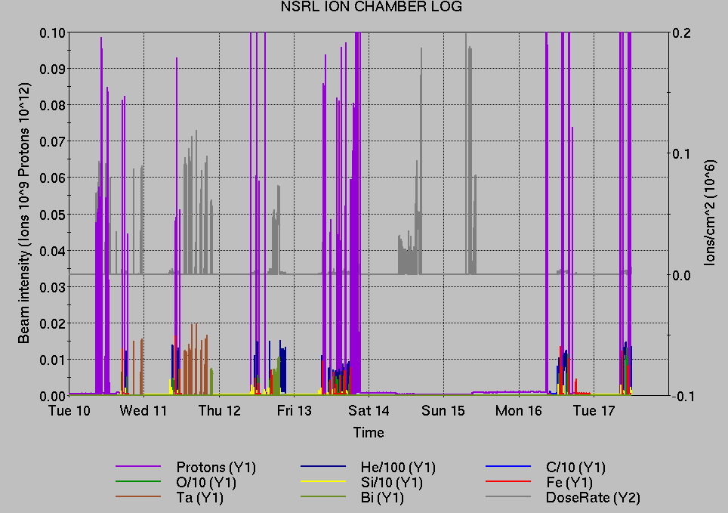
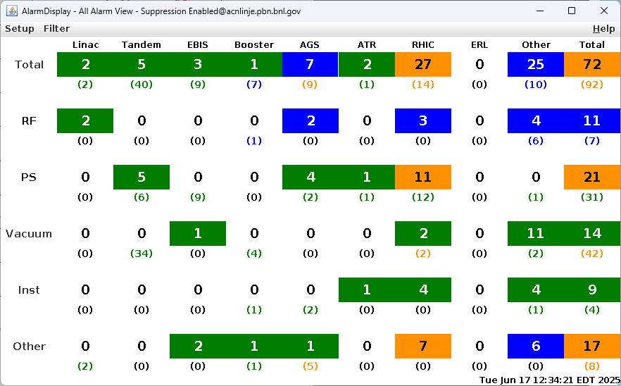
Notes from Operations
Notable failures (>1 hr)
56 MHz SRF water cooling, blowdown system
failure; cryo warmup required.
y08-tq4-ps failures (4x), 1008B thermal issues
Experimental access for detector work
EBIS Collector PS failures (17x), ongoing
EBIS drift tube failure, Trek PS replaced
Linac Mod 3 failure, 7835 tube replaced
Other notes
AGS G09C BLW PS remote control total loss, ongoing
Beam abort, bi5-tq4-ps trip
YS5 cavity trip during ramp; reseated connector for tuner
yo8-th8-ps replaced
Yellow abort kicker trip, trigger fault undiagnosed
AGS access, RF station D PA replaced
1002 cooling tower failure; fan VFD overcurrent reset.
Blue QP switch air flow fault, bypassed/ongoing
BS4 RF trip, reset locally
HVAC issues 1008B, 1012A, 1004B, 1006B, …various repairs or mitigations
AGS RF station B not following reference; low-level PPCs reset
ACS failure, 1012 remote keytree inoperable, ongoing
Beam abort, g5-lm9.2 loss early ramp; injection gap cleaning installed
Various injector PS trips, resets, tuning
Various Tandem tuning, access, foil changes
7 failures behind maintenance. 97.78→17.60 hr
Over 33 hours injector pp setup, Operator training, other studies
(when injector systems are available)
Notes:
NSRL plot from LogView /MCR/PerformanceStats/timeMeetingNSRL.lvdisp, select Dose Rate and ion species in use
Screenshot of AlarmSummary

Slide 12
Reminder from Operations
MCR beam operations continue
  RHIC physics running continues with more system startups, beam tuning, luminosity ramp-up
    Tandem remains sole provider of Au31 for RHIC
  Operator/OC shifts continue for NSRL biology, 1 shift/5 days this week and next.
    No ions from Tandem; Linac protons as required through 27 June; Ion beams from EBIS pending development.
  BLIP production continues until 27 June.
  AGS Polarized proton setup, other studies to continue behind stores as time allows.
  MCR on duty 24/7.
Changes? Time to update is now. Expect calls at all hours.
  Alarm response instructions: Groups prompted for updates
  http://directory.pbn.bnl.gov/
    CHECK AND EDIT YOUR OWN CONTACT INFO
  https://www.cadops.bnl.gov/Operations/personnel/call_in_lists/
    CHECK YOUR CALLIN LIST: expect contact off-hours

Slide 13
Keytree notes
Remote keytree systems require a database lookup to validate and authorize distribution of keytokens. The Keytrak system’s database is available for lookup functionality, but can no longer be modified in any way to add or edit qualified personnel.
Personnel affected:
New employees, experimenters arriving after 12/1/2024 could not be enrolled in database
Existing employees & experimenters, not already enrolled, cannot be added or modified in database
Remote keytrees affected:
Iris scan @NSRL
BNLID scan @AGS South gate, North Conjunction Gate
Iris scan @RHIC STAR, sPHENIX, IP12, IP4
Keytrees NOT affected:
BNLID scan @Linac, Booster
BNLID scan @RHIC IP2
MCR keytrees

Slide 14
Keytree notes, continued
Mitigation:
Choose entrants that are currently enrolled to perform the work in the enclosure under Controlled Access (CA).
Obtain CA keys from MCR for remote gate watch
Arrange for local gate watch using other tokens for entrants.
Arrange for Restricted Access, and allow for delays incurred to sweep areas.
CAUTION
Follow procedures. Gate Watch staff will remain vigilant.
  No “piggy-backing” – one key/token per entrant.
  Access keys are not candy! Authenticated entrant retains possession.
Radiological Controls and the Access Controls System are not to be circumvented. This is (has been) enforced with disciplinary action (dismissal).

Slide 15
Preliminary delivered Luminosity data for RHIC
Courtesy R. Terheide

Slide 17
Notes:
Reliability comparisons to previous runs

Slide 18
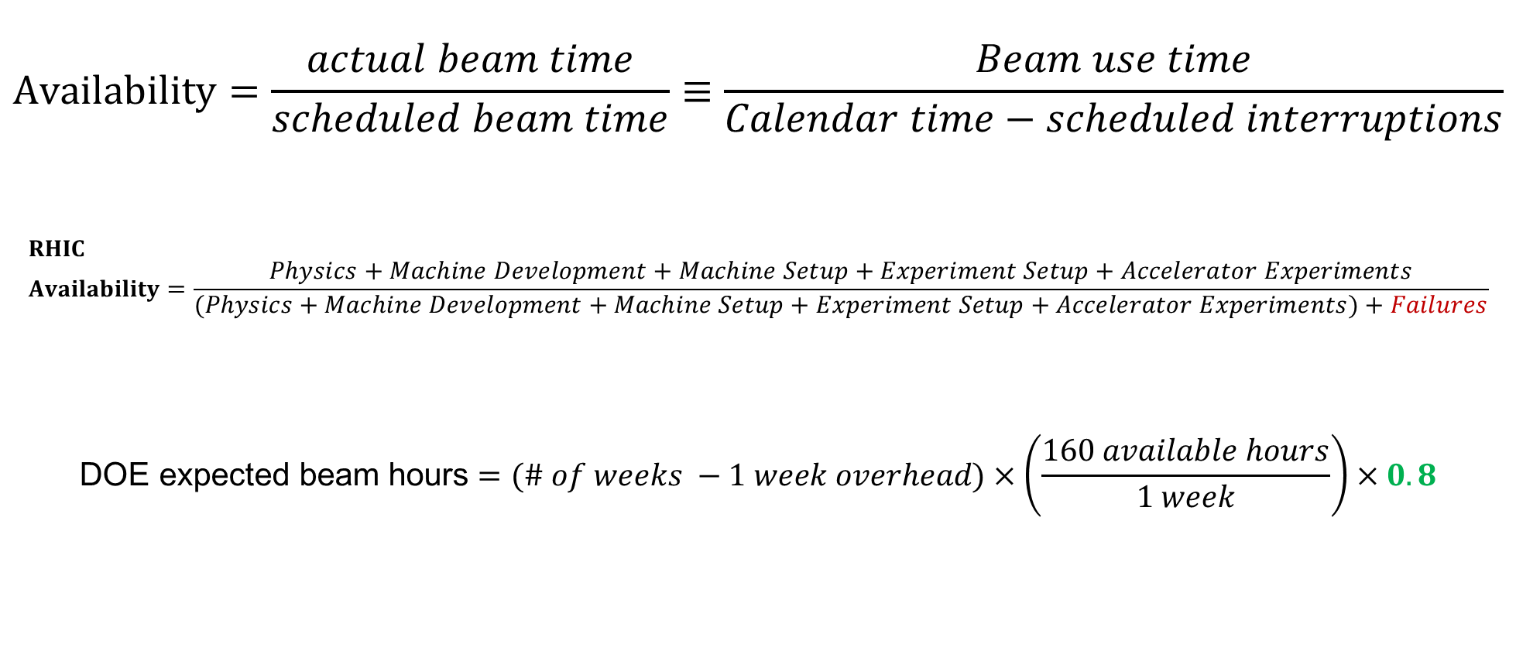
Availability, expected beam hours
$$Availability=\frac{actual beam time}{scheduled beam time}≡\frac{Beam use time}{Calendar time−scheduled interruptions}$$
$$RHIC \\ Availability=\frac{Physics+Machine Development+Machine Setup+Experiment Setup+Accelerator Experiments}{(Physics+Machine Development+Machine Setup+Experiment Setup+Accelerator Experiments)+Failures}$$
$$\text{DOE} \text{expected} \text{beam} \text{hours}=(\# of weeks −1 week overhead)×\left(\frac{160 available hours}{1 week}\right)×0.8$$
Notes:
Normally hidden. Explains how the 85% from DOE comes in to play, & general availability metrics

