Slide 1
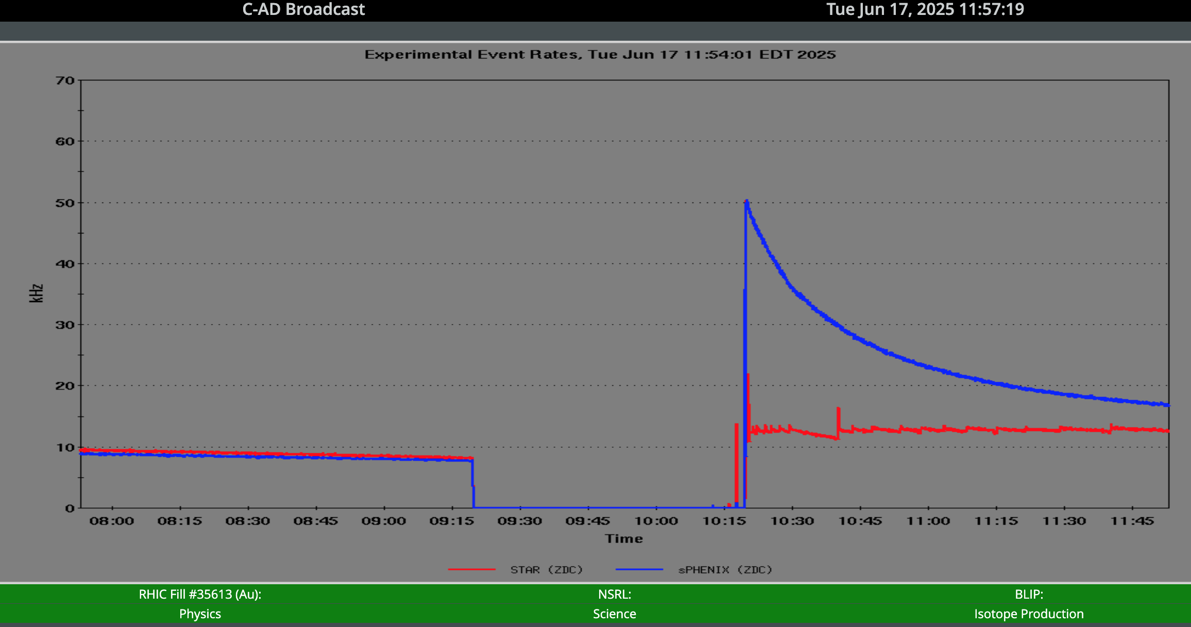
Time Meeting
Accelerator Operations Support

Slide 2
No Maintenance this week
Opportunistic Access until the Next Maintenance (July 2)
Ring Access request for consideration behind downtime…

Slide 3
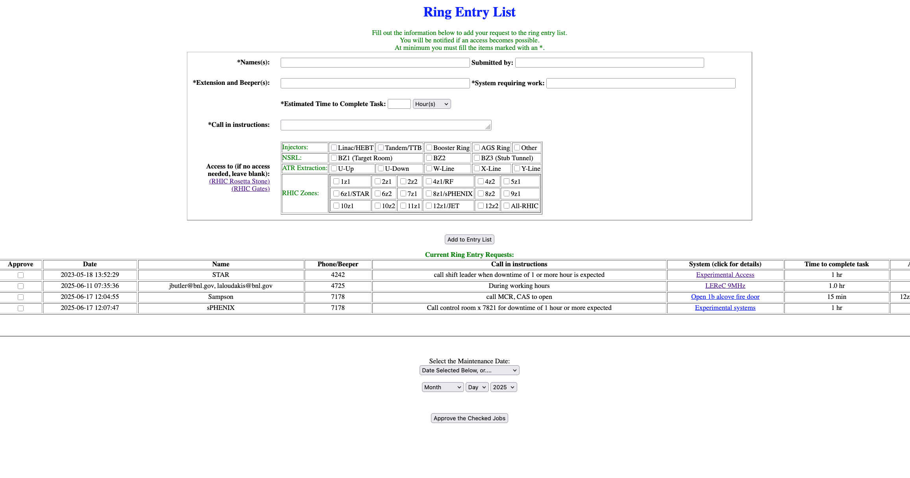
Ring Access Request List

