Slide 1
APEX Report
Time Meeting, June 17, 2025

Slide 2
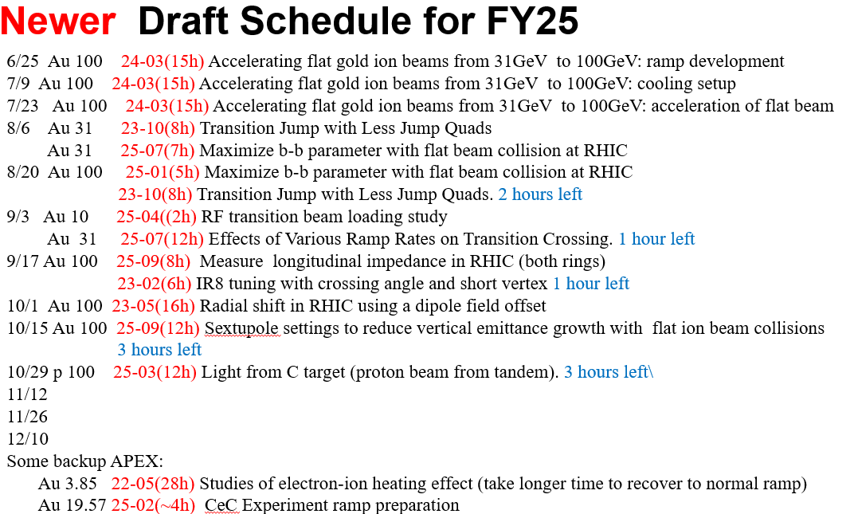
Updated APEX Schedules

