Slide 1
Preinjector Status
D. Raparia
Time Meeting
June 17, 2025

Slide 2
Tandem
MP7 is currently providing ions for RHIC setup
MP6 providing ions for external users
External users 6/18, 6/20-6/22
Renew class will start on 1st and run through the month
External user shechule on 7/1 and 7/2

Slide 3
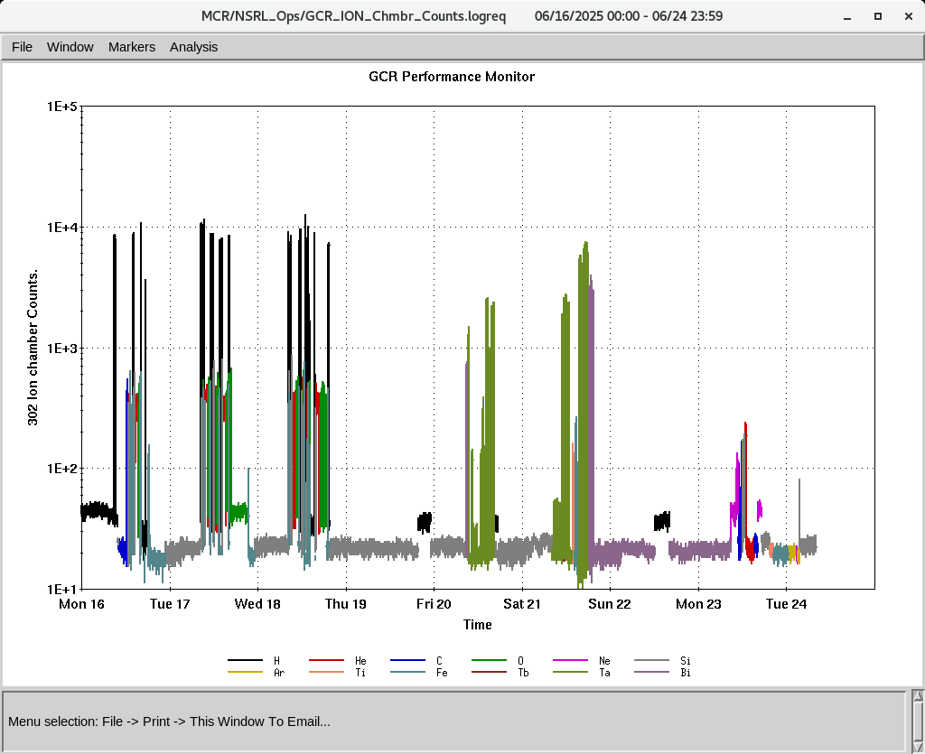
EBIS
Providing all required beams for NSRL
C , Ne and Ar ions were developed last week
DT 18 trek PS fail twice , diagnosis continue
IONS to NSRL
H, He⁺², C⁺⁵, O⁺⁷,Si⁺¹¹,Ne⁺⁸, Ar⁺¹⁵, Ti⁺¹⁷, Fe⁺²⁰, Tb⁺³⁵, Ta⁺³⁸, Bi⁺⁴⁷

Slide 4
Linac, providing beam to NSRL, AGS, 200 MeV Polarimeter
BLIP 200 MeV , 150 uA, Th irradiation started 6/16
6/17: Mod 7, Modulator diode(1.5 HRS)
6/19: Mod 7 tunning (2 HRS)
6/19: Mod 9: tripped (2 HRS)
6/22: Mod 7 : Modulator diode (2.5 HRS)
6/22: mod 2 and BLIP current transformer (2 HRS)
6/23: BLIP transformer (1 HRS)
OPPIS is successfully delivering beam to the 200 MeV line, Polarimeter Booster, and NSRL.
BLIP requesting two more irradiation on 27th
Ni-Au , 117 MeV, 50 uA, 60 sec
Thallium (Tl) , 66 MeV, 1 uA, 4 hours

