Slide 1
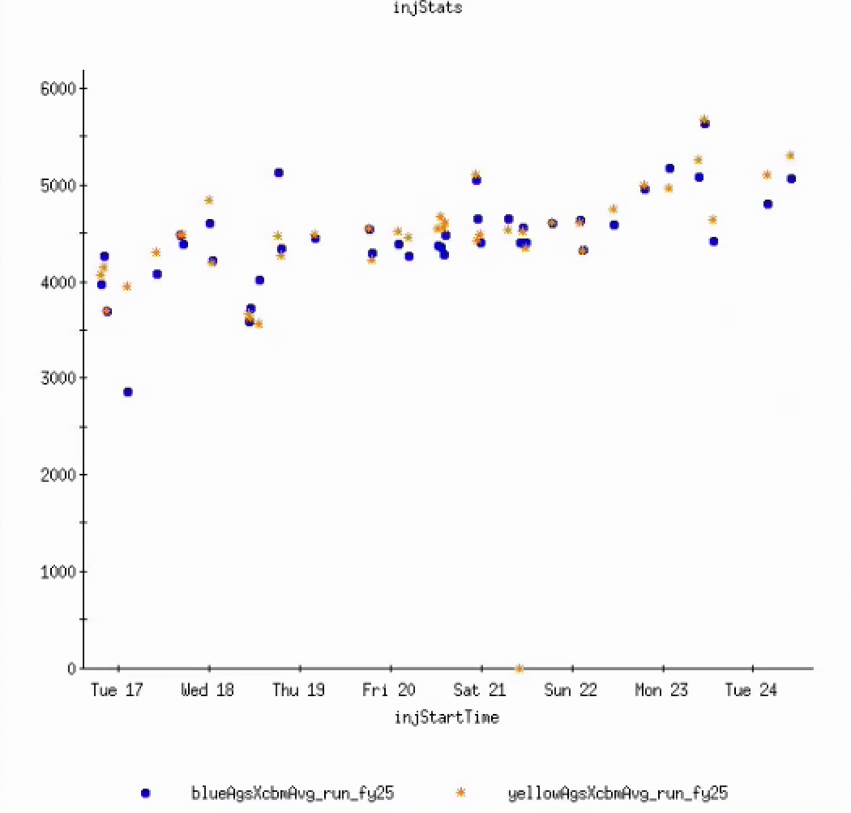
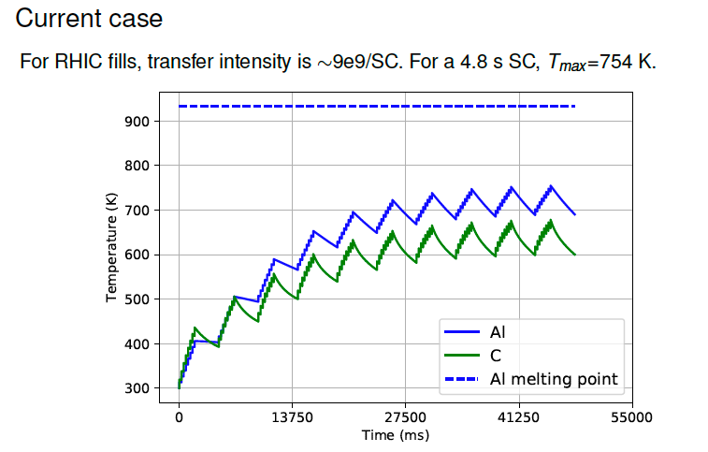
Injector Status: Time meeting 6/24/25
AGS Extraction Intensity
(total in 2 bunches)
AGS delivering ~2.5x109 per bunch for RHIC fills
Has had as high as 3x10⁹
Reducing extractions from 4->2 allows shorter supercycle (6 -> 5.4 seconds). Benefits RHIC efficiency, IBS and debunching at injection
Possible to reduce further to 4.8 seconds.
  Principle limit is heating of the BtA Al-C stripping foils
  A 4.8 sec supercycle, would allow up to 12-14x10⁹ Au transferred per Booster cycle (30-50% higher than what we have now).
AGS main magnet supply cannot run full current pulses continuously mid-day until ambient temperature decreases
  Will affect store scheduling through ~Thursday
Intensity, (10⁶)
Simulated BtA foil temp

