Slide 1
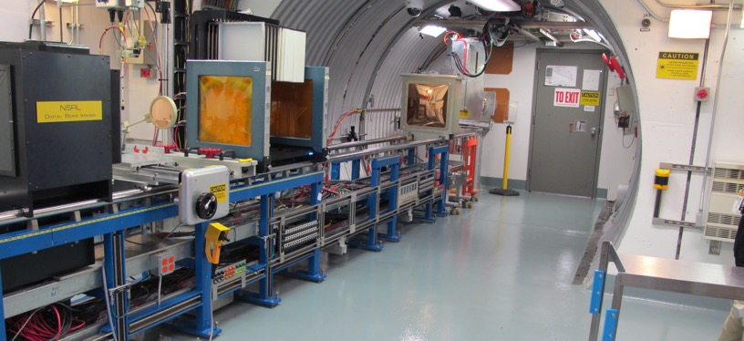
NSRL Time Meeting Report
24 June 2025
Michael Sivertz

Slide 2
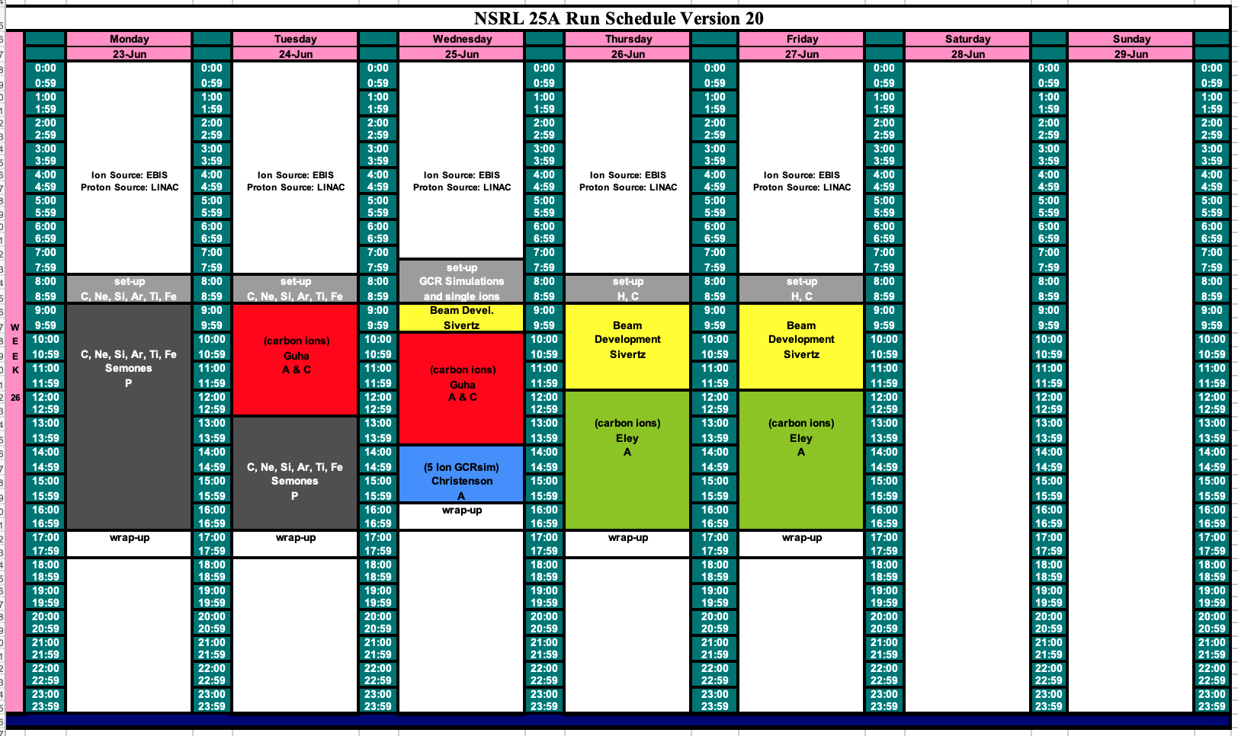
Schedule for this week

Slide 3
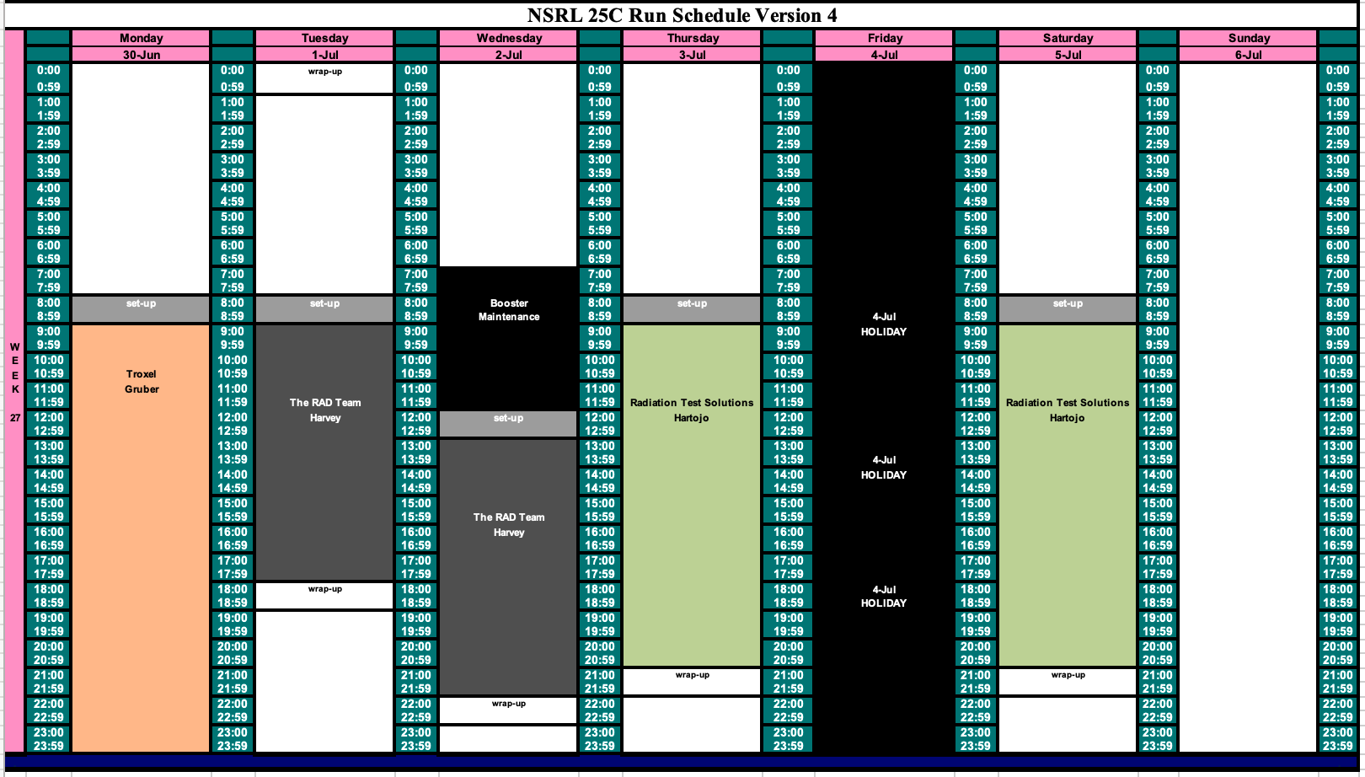
Schedule for next week

Slide 4
Future Schedule
This is the last week of NASA biology. Problems with EBIS DT18 causing multiple failures of Power Supplies in EBIS. May require extended downtime to address the problem.
Hope to get approval for Blue Origin experiment with HALEU target to be conducted on either 26 or 27 June. Blue Origin did not get approval in time to run with protons from LINAC. Hoping to get approval for the fall of 2025.
Beginning to run electronics testers again through the summer.

