Slide 1
Data courtesy C. Naylor

Slide 3
Data courtesy C. Naylor

Slide 4
Data courtesy C. Naylor

Slide 5
Data courtesy C. Naylor

Slide 6
Data courtesy C. Naylor

Slide 7
Data courtesy C. Naylor

Slide 8
Data courtesy C. Naylor

Slide 9
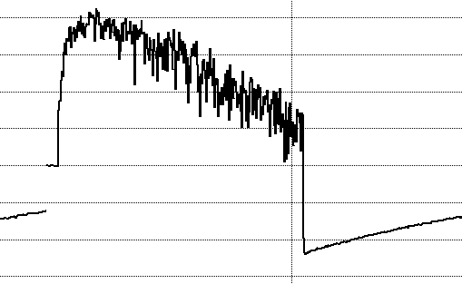
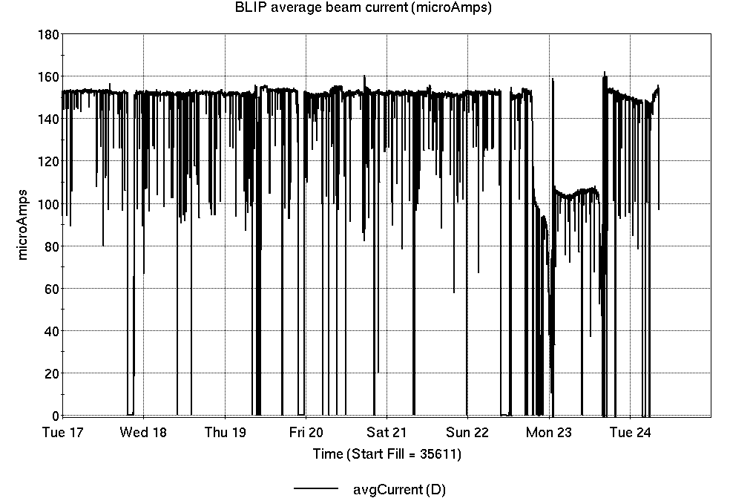
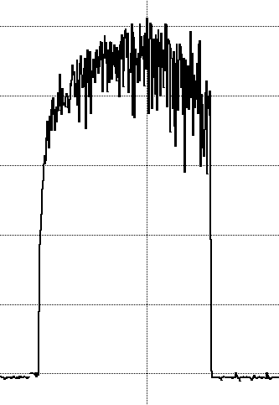
Operations for BLIP
No BLIP
this past week
6/17-24/2025:
200 MeV production continued all week.
156.2 hr production
11.8 hr failures
Availability: 93.0%
note current transformer issues affecting logged data
Notes:
BLIP plot from LogView /MCR/PerformanceStats/timeMeetingBLIP.lvdisp
Avail calc on nsrl time Excel sheet

Slide 10
NSRL activity past week: 6/17-24/2025 (as of 0800)
NSRL running continues. NASA biology in GCR mode, with other user time and beam development.
No Tandem ions; Linac protons, 11 EBIS ions (He, C, Ne, O, Si, Ar, Ti, Fe, Tb, Ta, Bi) delivered to NSRL.
Running 25-A schedule; Run concludes 27 June.
Run 25-C follows on 30 June; 25-C schedule posted through 1 October.
Availability: 92.6%
Notes:
Graph and avail calc from nsrl time.xlsx

Slide 11
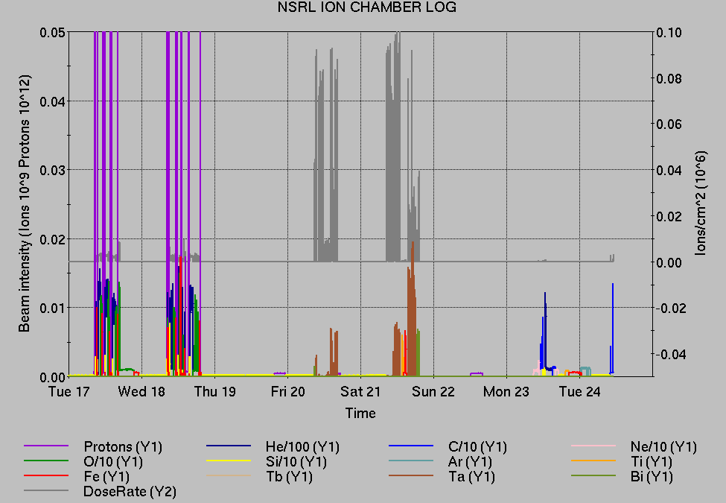
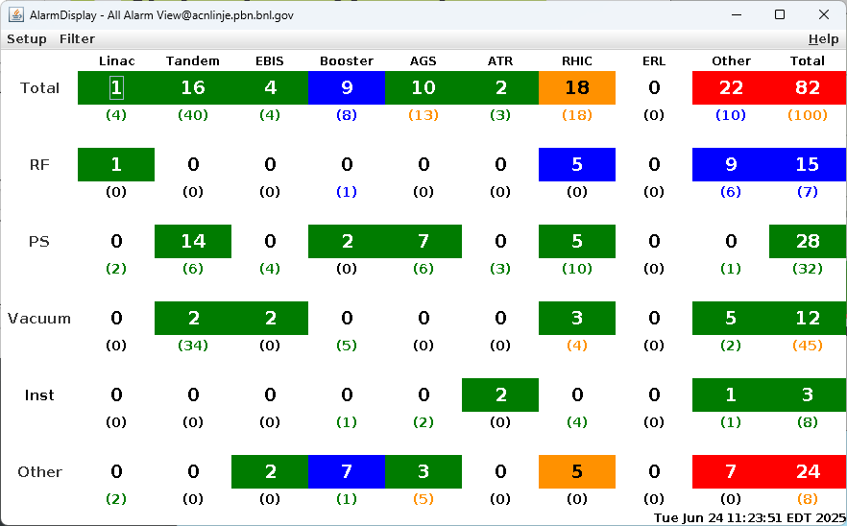
Notes from Operations
Notable failures (>1 hr)
Beam abort, yi7-sxd2-ps trip
Booster MMPS failure, trench opened for magnet bus insulator repair
RHIC RF Cooling Tower failure, fan repaired
Beam abort, 56MHz MPS trip; water flow faults reset
Yellow injection kicker PS failure (4x); output remains below normal
Blue orbit feedback system failure, Controls bucket selector misconfigured
Blue collimator drive failure, v0 motors exercised
STAR magnet PS trip, required half-field due to cooling limits
RHIC Controls failure, 6b-ps1 fanout failure, replaced hardware
Linac RF Mod 7 failure, diode stack/resistor replaced
Linac Mod 9 failure, retuned for arcing in 7835 tube
Linac RF Mod 7 failure, crowbar circuit required power cycles to FECs
BLIP interlock, NMON+permit+BM1&2 trip; reset
Linac Mod2 trips (6x)
EBIS collector PS trips (14x)
RHIC beam aborts (13x); various injection/ramp issues, intensity, tuning…
Other notes
1 lightning stand down; rain and heat affecting in plenty of other ways…
AGS G09C BLW PS remote control total loss, ongoing
ACS 1012 remote keytree remains inoperable, awaiting maintenance day
AGS E17 gamma-t PS failure (2x); bus contacts, GTO repaired
Various Linac trips, resets
BLIP current transformer failure, rewired/recalibrated to share working transformer
Various injector PS trips, resets, tuning
Various Tandem tuning, access, foil changes
Over 11 hours injector pp setup, Operator training, other Au setup (when injector systems are available)
Notes:
NSRL plot from LogView /MCR/PerformanceStats/timeMeetingNSRL.lvdisp, select Dose Rate and ion species in use
Screenshot of AlarmSummary

Slide 12
Reminder from Operations
MCR beam operations continue
RHIC physics running continues with more system startups, beam tuning, luminosity ramp-up
Tandem remains sole provider of Au31 for RHIC
Operator/OC shifts continue for NSRL biology, 1-2 shifts/5 days this week and next.
No ions from Tandem; Linac protons as required through 27 June; Ion beams from EBIS.
BLIP production ends 27 June. Additional short runs follow end of 200MeV production on Friday
AGS Polarized proton setup, other studies to continue behind stores as time allows.
MCR on duty 24/7.
Changes? Time to update is now. Expect calls at all hours.
Alarm response instructions: Groups prompted for updates
http://directory.pbn.bnl.gov/
CHECK AND EDIT YOUR OWN CONTACT INFO
https://www.cadops.bnl.gov/Operations/personnel/call_in_lists/
CHECK YOUR CALLIN LIST: expect contact off-hours

Slide 13
Keytree notes
Remote keytree systems require a database lookup to validate and authorize distribution of keytokens. The Keytrak system’s database is available for lookup functionality, but can no longer be modified in any way to add or edit qualified personnel.
Personnel affected:
New employees, experimenters arriving after 12/1/2024 could not be enrolled in database
Existing employees & experimenters, not already enrolled, cannot be added or modified in database
Remote keytrees affected:
Iris scan @NSRL
BNLID scan @AGS South gate, North Conjunction Gate
Iris scan @RHIC STAR, sPHENIX, IP12, IP4
Keytrees NOT affected:
BNLID scan @Linac, Booster
BNLID scan @RHIC IP2
MCR keytrees

Slide 14
Keytree notes, continued
Mitigation:
Choose entrants that are currently enrolled to perform the work in the enclosure under Controlled Access (CA).
Obtain CA keys from MCR for remote gate watch
Arrange for local gate watch using other tokens for entrants.
Arrange for Restricted Access, and allow for delays incurred to sweep areas.
CAUTION
Follow procedures. Gate Watch staff will remain vigilant.
No “piggy-backing” – one key/token per entrant.
Access keys are not candy! Authenticated entrant retains possession.
Radiological Controls and the Access Controls System are not to be circumvented. This is (has been) enforced with disciplinary action (dismissal).

Slide 16
Notes:
Reliability comparisons to previous runs

Slide 17
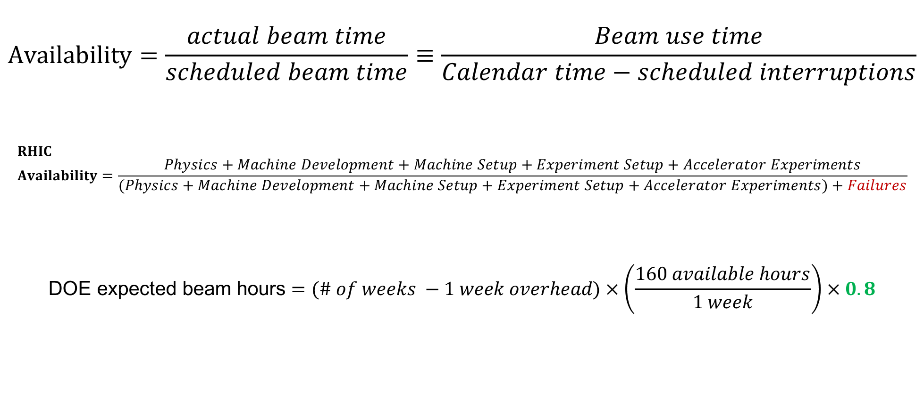
Availability, expected beam hours
$$Availability=\frac{actual beam time}{scheduled beam time}≡\frac{Beam use time}{Calendar time−scheduled interruptions}$$
$$RHIC \\ Availability=\frac{Physics+Machine Development+Machine Setup+Experiment Setup+Accelerator Experiments}{(Physics+Machine Development+Machine Setup+Experiment Setup+Accelerator Experiments)+Failures}$$
$$\text{DOE} \text{expected} \text{beam} \text{hours}=(\# of weeks −1 week overhead)×\left(\frac{160 available hours}{1 week}\right)×0.8$$
Notes:
Normally hidden. Explains how the 85% from DOE comes in to play, & general availability metrics

