Slide 1
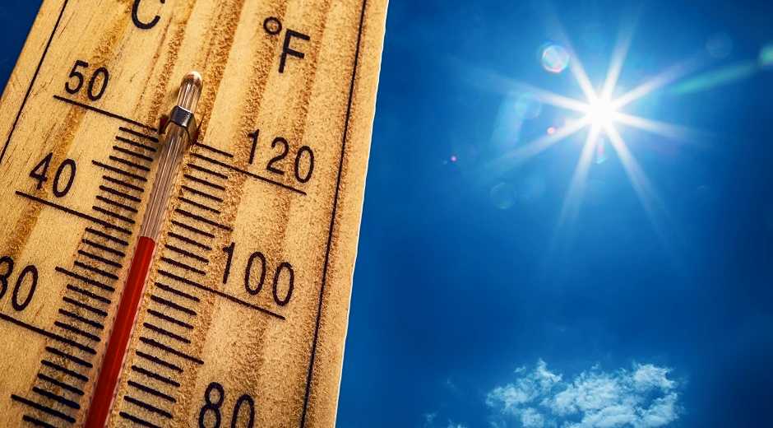
Time Meeting
Accelerator Operations Support

Slide 2

Fire Alarm System Outage Tomorrow
Does not affect local alarms or pull boxes.
Communications with the Fore Rescue Watch will be affected.
Emergencies must be called in directly on x2222
LECs, Shift workers, Police and Fire rescue will be patrolling and Observing areas and will report any issues.

Slide 3
Maintenance Next Week
Opportunistic Access until then (July 2)
Ring Access request for consideration behind downtime…

Slide 4
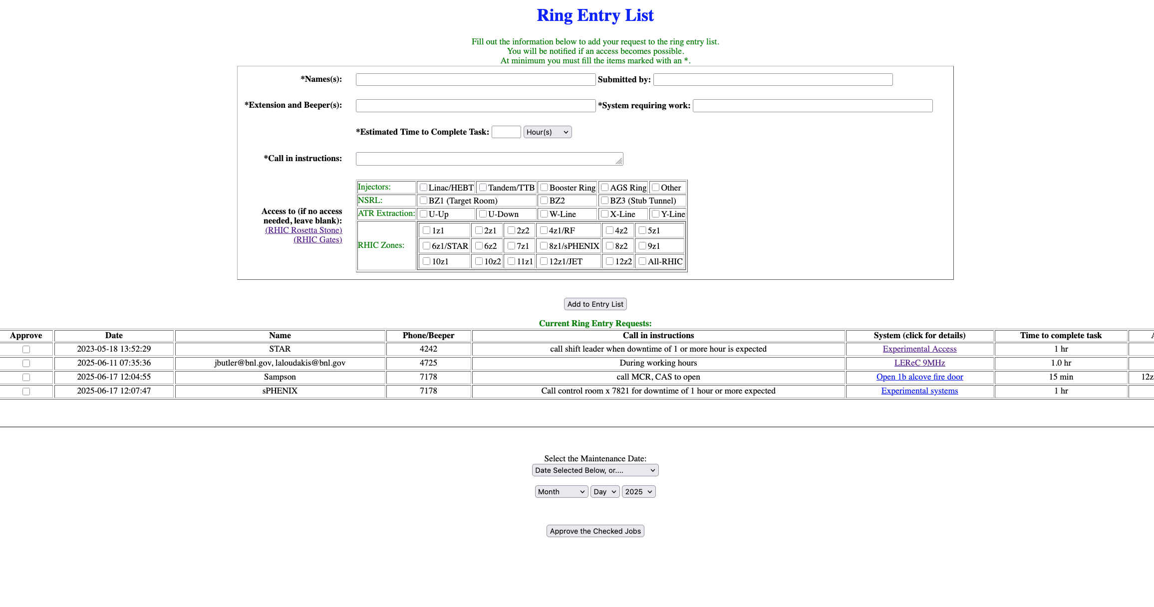
Ring Access Request List

