Slide 1
Preinjector Status
D. Raparia
Time Meeting
July 01 2025

Slide 2
Tandem
MP7 is currently providing ions for RHIC setup
MP6 providing ions for external users
External users 07/01-07/02
Power dips, systems recovered
Renew class will start on 1st and run through the month
Need to refurbish foils in MP7 some time in mid August

Slide 3
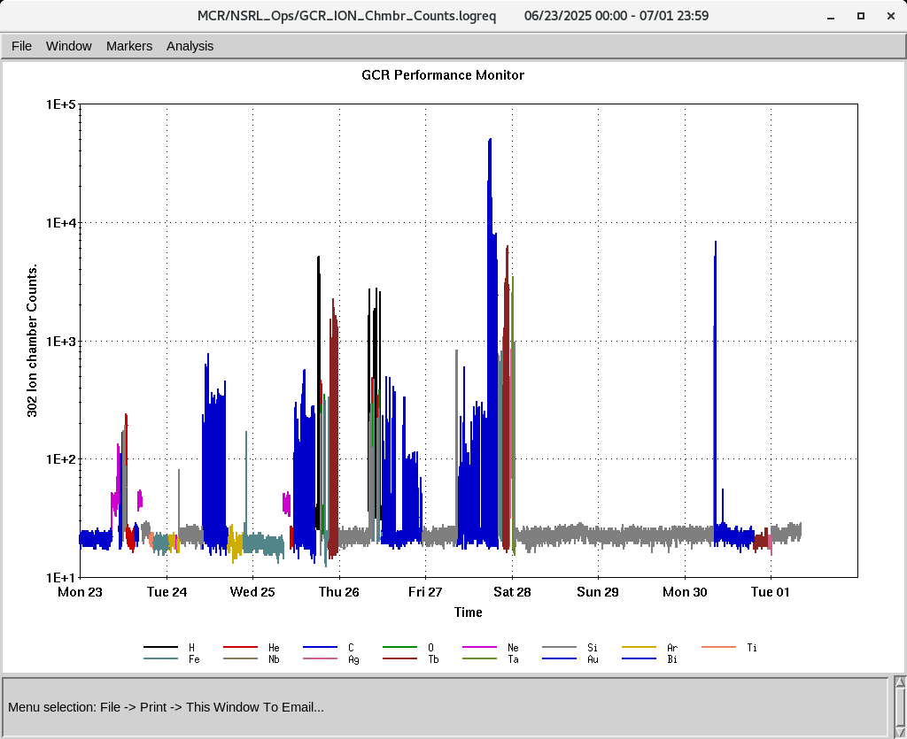
EBIS
NSRL Biology program successfully concluded last Friday
Electronics testing continues
Collector PS trips continues but less frequent
Power dips, most of the systems were down , all recovered
IONS to NSRL
H, He⁺², C⁺⁵, O⁺⁷, Si⁺¹¹,Ne⁺⁸, Ar⁺¹⁵, Ti⁺¹⁷, Fe⁺²⁰, Nb⁺²³, Ag⁺²⁹, Tb⁺³⁵, Ta⁺³⁸, Bi⁺⁴⁷

Slide 4
Linac, providing beam to NSRL, AGS, 200 MeV Polarimeter
Linac run is extended till July 8th
BLIP run concluded for this year on June 27th
200 MeV-Th 11d, 117 MeV- NiAu 120 s, 66 MeV-Tl 4 HRS
6/24: RF mod 4 ( 2 HRS)
6/26, Buncher. (0.5 HRS)
6/27, RF mod 7 ( 0.5 HRS)
7/01: power dip, systems recovered except OPPIS,
OPPIS is successfully delivering beam to the 200 MeV line, Polarimeter Booster, and NSRL.

