Slide 1
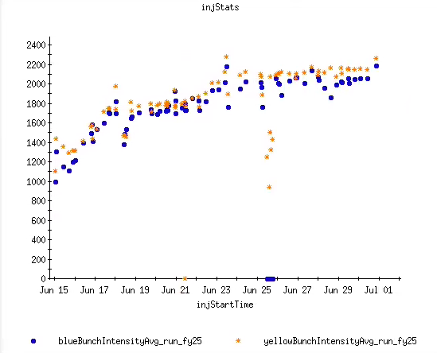
Injector Status: Time meeting 7/01/25
AGS Extraction Intensity
(total in 2 bunches)
AGS delivering well for RHIC stores, incremental intensity increases
Developing 3->1 merge cycle (instead of 4->1): lower possible peak intensity (2.6x10⁹/bunch instead of ~3x10⁹)
Still higher than RHIC needs.
Likely to be more efficient in RHIC lower longitudinal emittance and shorter fill time.
Power dip last night, widespread impact on injectors
  Dip at 0100, beam accelerating in AGS around 0800 (system recovery + weather standown)
Wrapping up proton development behind stores (hard stop for Linac on 7/8)
Intensity, (10⁶)

