Slide 1
sPHENIX status
Kin Yip
sPHENIX Director of Operations
Time Meeting
July 1, 2025

Slide 2
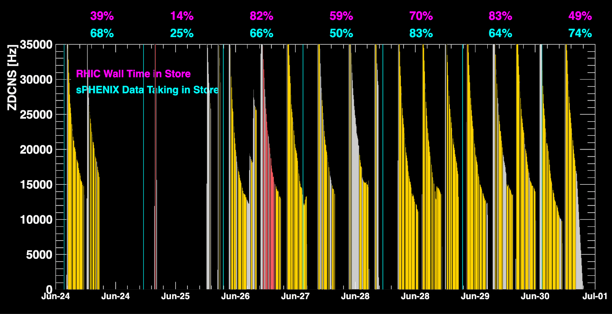
sPHENIX Status & Performance
We have been making effort to take physics data as efficiently as possible. There still have been some minor improvements in the DAQ system.
E.g. we’ve been optimizing data transfer during data taking.
No major difference for MVTX streaming (auto-recoveries) for various crossing angles.

Slide 3
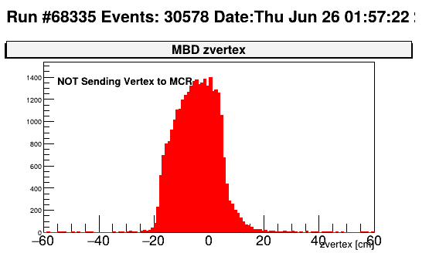
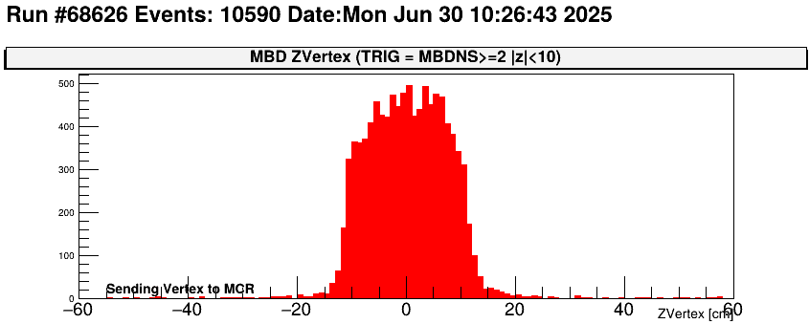
sPHENIX Status & Performance (cont.)
MBD z-vertexing (after chiller/power interruption) in online monitoring
recalibrated
Old calibration
New calibration

Slide 4
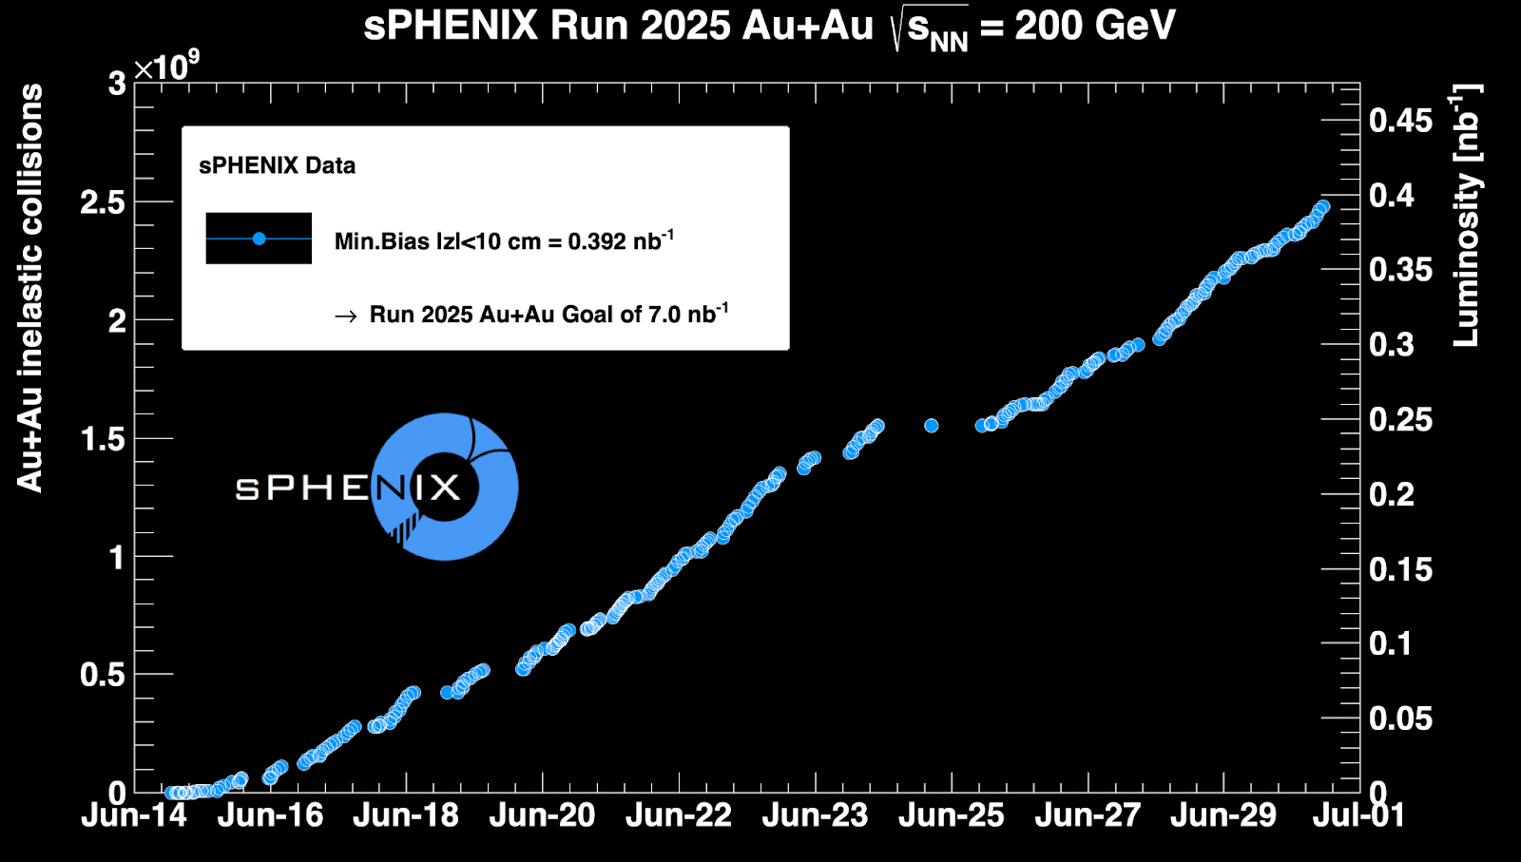
sPHENIX Status & Performance (cont.)

