Slide 1
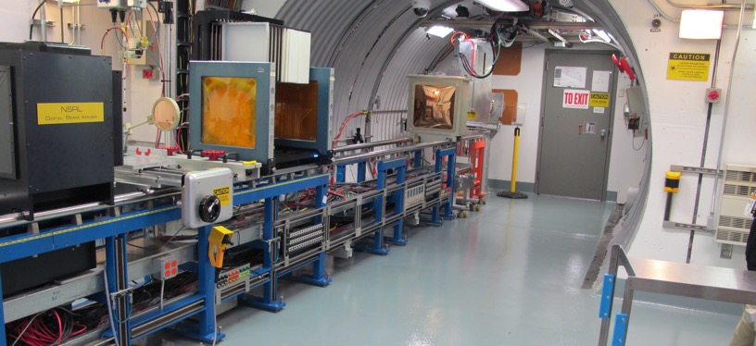
NSRL Time Meeting Report
1 July 2025
Michael Sivertz

Slide 2
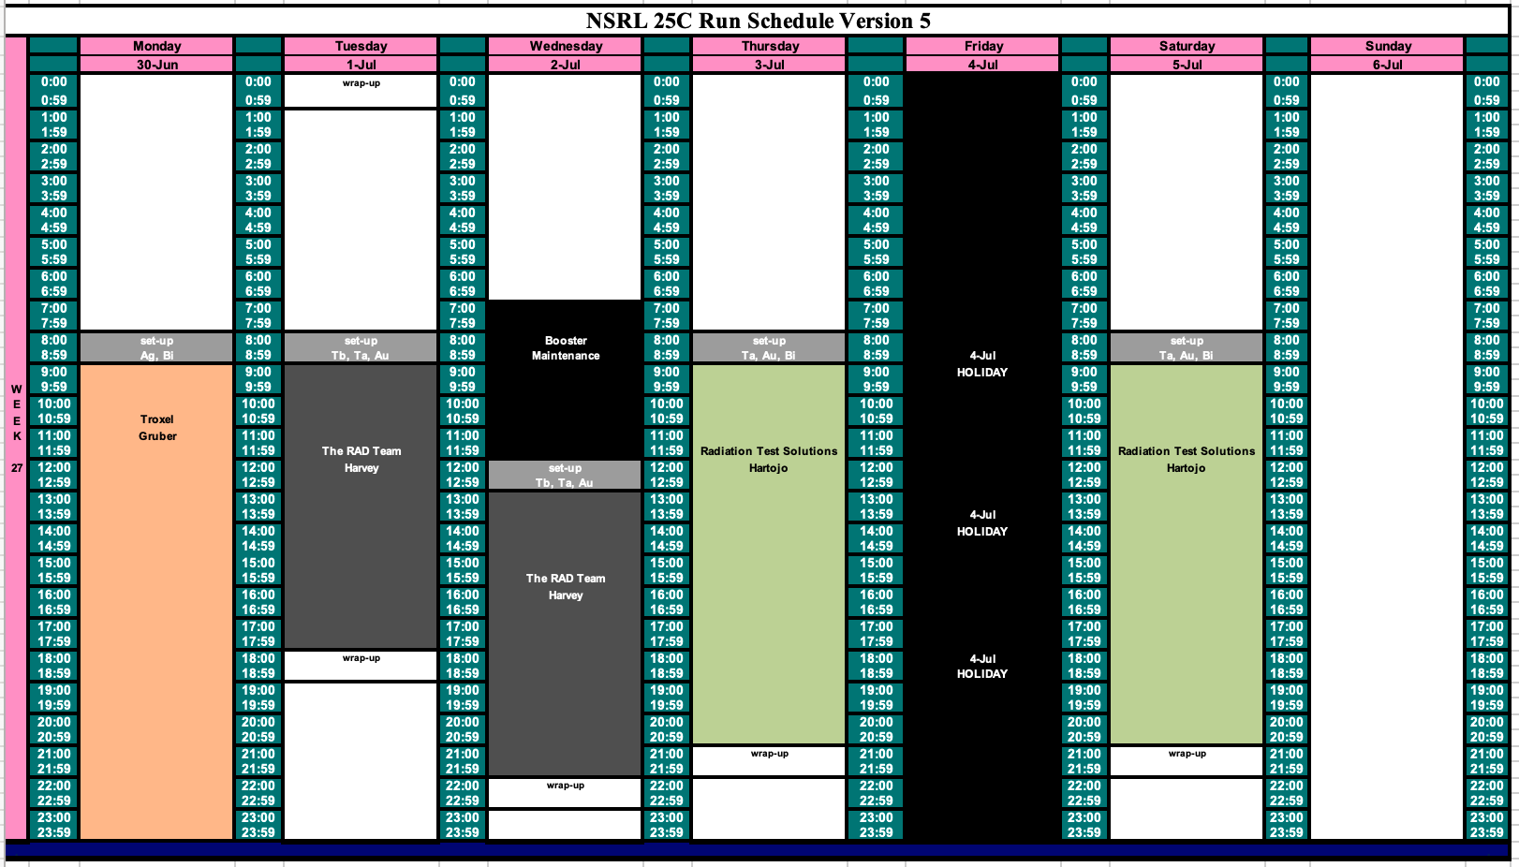
Schedule for this week

Slide 3
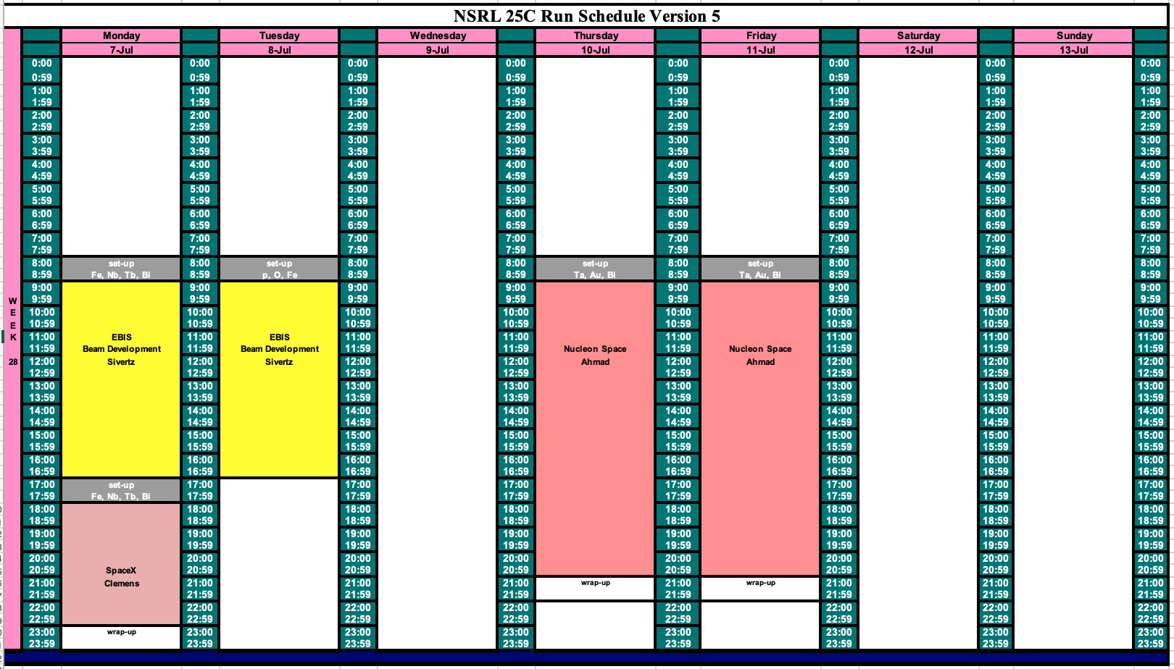
Schedule for next week

Slide 4
Future Schedule
The NASA radiobiology program ended last Friday. The NSRL program is electronics testing through the end of September.
Mostly all beams will be heavy ions from EBIS, with the exception of protons from LINAC next Tuesday 8 July.
Still hoping to get approval to run an experiment for Blue Origin with a Uranium target and proton beam before LINAC shuts down.

