Slide 1
Data courtesy C. Naylor

Slide 3
Data courtesy C. Naylor

Slide 4
Data courtesy C. Naylor

Slide 5
Data courtesy C. Naylor

Slide 6
Data courtesy C. Naylor

Slide 7
Data courtesy C. Naylor

Slide 8
Data courtesy C. Naylor

Slide 9
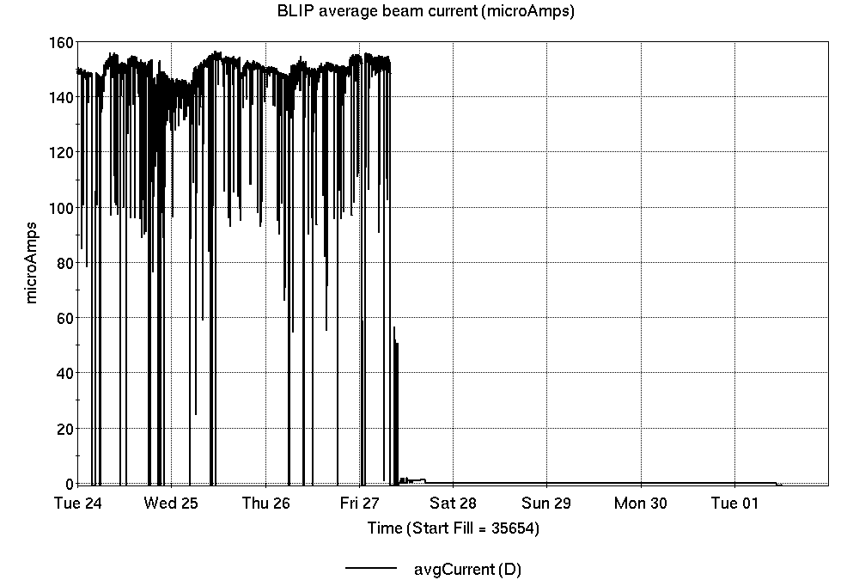
Operations for BLIP
No BLIP
this past week
6/24-7/1/2025:
200 MeV production conluded Friday, with additional 117 and 66 MeV exposures.
75.27 hr production
4.08 hr setup
1.65 hr failures
Availability: 98.0%
Notes:
BLIP plot from LogView /MCR/PerformanceStats/timeMeetingBLIP.lvdisp
Avail calc on nsrl time Excel sheet

Slide 10
NSRL activity past week: 6/24-7/1/2025 (as of 0800)
NSRL running continues.
NASA biology in GCR mode ends, with other user time and beam development continuing.
No Tandem ions; Linac protons, 13 EBIS ions (He, C, Ne, O, Si, Ar, Fe, Nb, Ag, Tb, Ta, Au, Bi) delivered to NSRL.
Run 25-A concluded.
Run 25-C began 30 June; 25-C schedule posted, updates forthcoming through 1 October.
Availability: 90.8%
Notes:
Graph and avail calc from nsrl time.xlsx

Slide 11
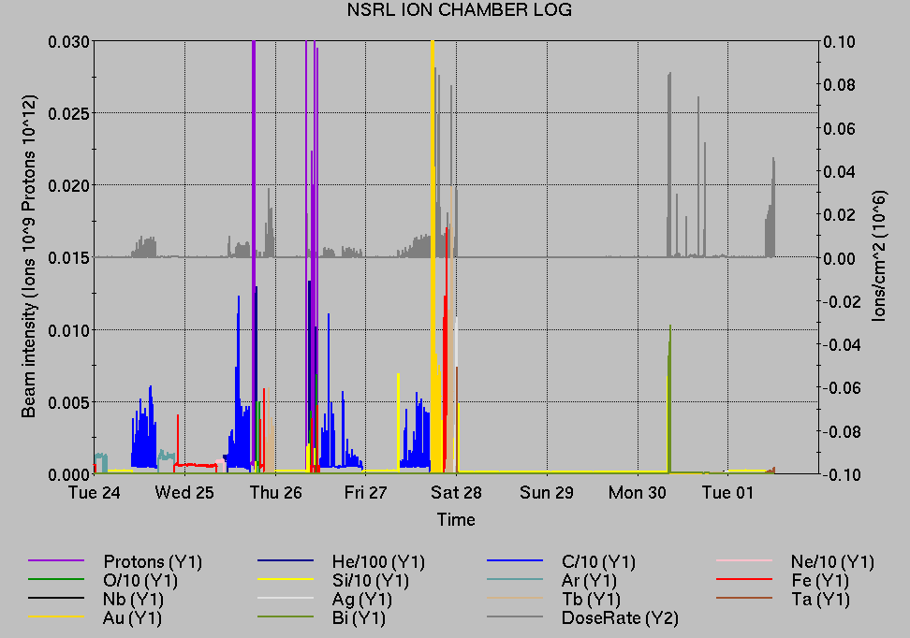
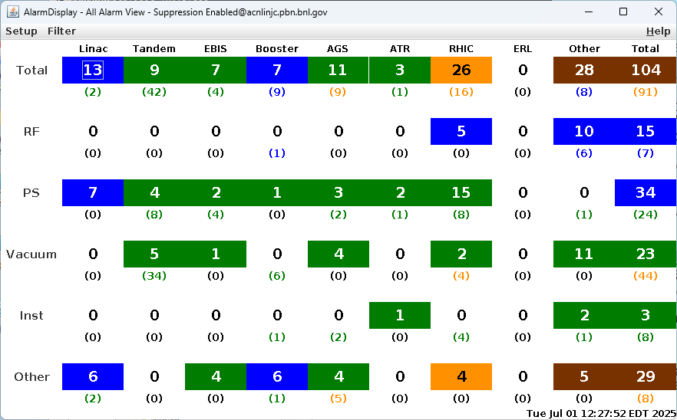
Notes from Operations
Notable failures (>1 hr)
Yellow QLI/beam abort, Yellow Main PS temp issues in 1004B
  Weather stand-down ensued, due to the heat
bi5-tq4-ps failure, replaced
Fire/Rescue response and tunnel access, sector 4
  ODH sensor failure ensued due to active fans
RHIC BS1 cavity trip, breaker reset
9a alcove HVAC failure
56MHz lead flow issue, access
EBIS drift tube PS failure, Trek supply restored
Booster vacuum failure, valve closed from bad gauge
controller; replaced
EBIS LION2 source failure, cage access to repair digi unit
EBIS collector PS trips (16x, more logged than previous week)
Additional RHIC beam aborts (8x);
  BPM 3x (disabled bi12-bh3)
  human error (PS control)
  BLM 3x (YA1 trip, rebucketing loss, transition loss)
multiple NQBPS trip, beam induced QLI ensued
Blue QLI/beam abort, sector 10 QPA replaced
y05-qs3-ps failure, replaced
Stand down for weather, power dips, and extended recovery.
RHIC vacuum failure, sector 9 valve interlocked on failed pump. reconfigured
Other notes
AGS G09C BLW PS remote control unavailable, ongoing
ACS 1012 remote keytree remains inoperable, awaiting maintenance day
Blue, Yellow injection kicker PS trips, trigger issues
Experiment, CeC accesses
Various Linac mispulsing, trips, resets
Various RF trips, reets (BS4, YA1, YS2, BS1
Various injector PS trips, resets, tuning
Various Tandem tuning, access, foil changes
Over 25 hours injector pp setup, Operator training, other Au setup
(when injector systems are available)
Notes:
NSRL plot from LogView /MCR/PerformanceStats/timeMeetingNSRL.lvdisp, select Dose Rate and ion species in use
Screenshot of AlarmSummary

Slide 12
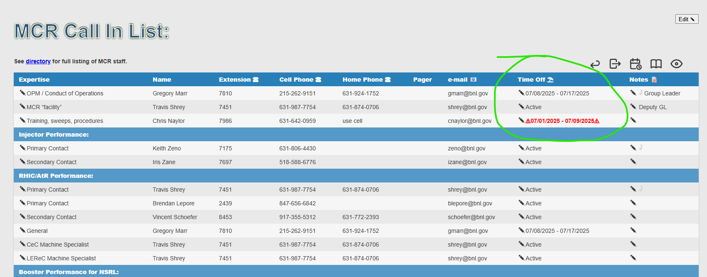
Reminder from Operations
MCR beam operations continue
  RHIC physics running continues
    Tandem remains sole provider of Au31 for RHIC
  Operator/OC shifts continue for NSRL biology, 1-2 shifts/5 days this week and next.
    No ions from Tandem; Linac protons as required through 27 June; Ion beams from EBIS.
  No additional BLIP production, Linac remains available.
  AGS Polarized proton setup, other studies to continue behind stores as time allows.
  MCR on duty 24/7.
Changes? Time to update is now.
Expect calls at all hours.
  Alarm response instructions: need updates
  http://directory.pbn.bnl.gov/ CHECK AND EDIT
  YOUR OWN CONTACT INFO
  https://www.cadops.bnl.gov/Operations/personnel/call_in_lists/
    CHECK YOUR CALLIN LIST: expect contact off-hours
    Summer is vacation time! Make sure your list is accurate

Slide 13
Keytree notes
Remote keytree systems require a database lookup to validate and authorize distribution of keytokens. The Keytrak system’s database is available for lookup functionality, but can no longer be modified in any way to add or edit qualified personnel.
Personnel affected:
New employees, experimenters arriving after 12/1/2024 could not be enrolled in database
Existing employees & experimenters, not already enrolled, cannot be added or modified in database
Remote keytrees affected:
Iris scan @NSRL
BNLID scan @AGS South gate, North Conjunction Gate
Iris scan @RHIC STAR, sPHENIX, IP12, IP4
Keytrees NOT affected:
BNLID scan @Linac, Booster
BNLID scan @RHIC IP2
MCR keytrees

Slide 14
Keytree notes, continued
Mitigation:
Choose entrants that are currently enrolled to perform the work in the enclosure under Controlled Access (CA).
Obtain CA keys from MCR for remote gate watch
Arrange for local gate watch using other tokens for entrants.
Arrange for Restricted Access, and allow for delays incurred to sweep areas.
CAUTION
Follow procedures. Gate Watch staff will remain vigilant.
  No “piggy-backing” – one key/token per entrant.
  Access keys are not candy! Authenticated entrant retains possession.
Radiological Controls and the Access Controls System are not to be circumvented. This is (has been) enforced with disciplinary action (dismissal).

Slide 16
Notes:
Reliability comparisons to previous runs

Slide 17
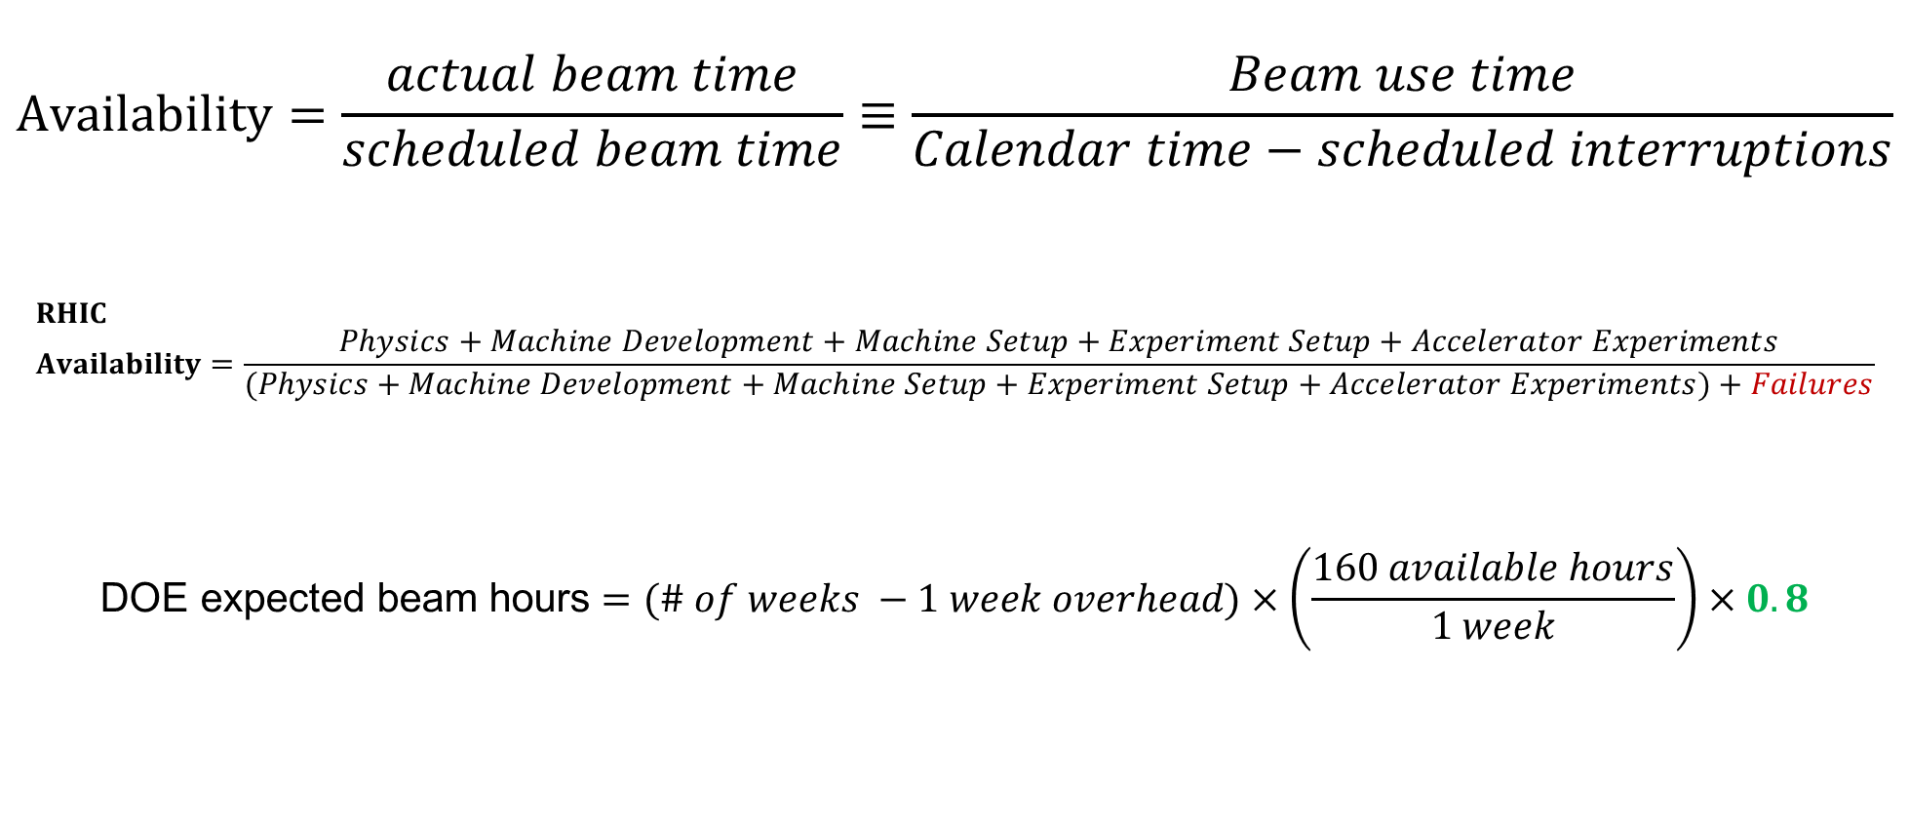
Availability, expected beam hours
$$Availability=\frac{actual beam time}{scheduled beam time}≡\frac{Beam use time}{Calendar time−scheduled interruptions}$$
$$RHIC \\ Availability=\frac{Physics+Machine Development+Machine Setup+Experiment Setup+Accelerator Experiments}{(Physics+Machine Development+Machine Setup+Experiment Setup+Accelerator Experiments)+Failures}$$
$$\text{DOE} \text{expected} \text{beam} \text{hours}=(\# of weeks −1 week overhead)×\left(\frac{160 available hours}{1 week}\right)×0.8$$
Notes:
Normally hidden. Explains how the 85% from DOE comes in to play, & general availability metrics

