Slide 1

Time Meeting
Accelerator Operations Support

Slide 2
Maintenance Tomorrow
NO LINAC- LINAC off starting the 9th
NSRL Tower Cleaning – EBIS is aware

Slide 3
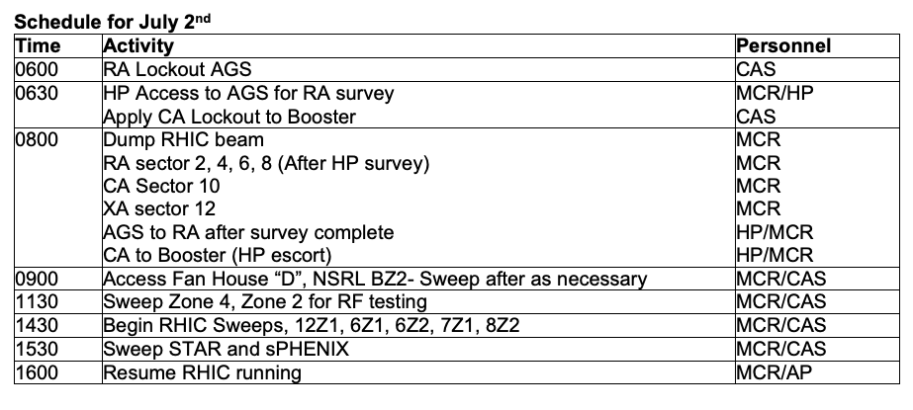

Slide 4
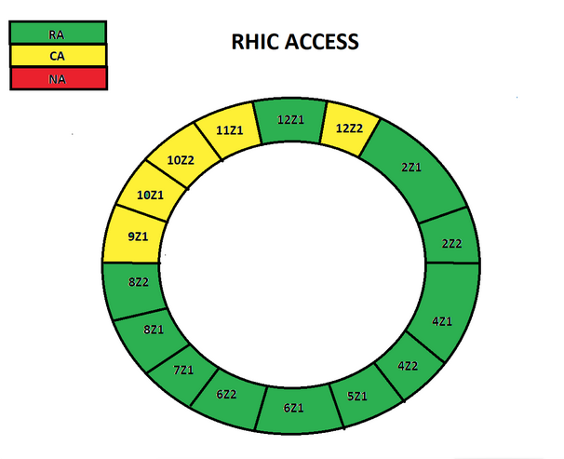

Slide 5
Planning and Scheduling
Here and Streaming at 3PM
Those doing work send representation…

