Slide 1
APEX Report
Time Meeting, July 1, 2025

Slide 2
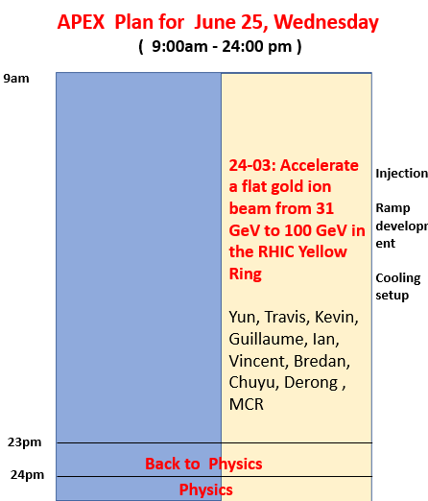
Notes:
Only one experiment.
Started at 9am, and ended at 9:00pm, physics on at 10pm.
Totally APEX hours: 12+1 hours

Slide 3
24-03: Accelerate flat beam from 31GeV to 100GeV in RHIC Yellow Ring
Main goals for this session achieved, and did more
1) developed Au25-31GeV ramp
2) developed Au25-100GeV ramp ( added )
3) stitched both ramps ( added )
4) vertical cooling setup at 31GeV
5) 6:1 transverse emittance ratio obtained
( unfortunately blew up vertical emittance by turning on BBQ )

Slide 4
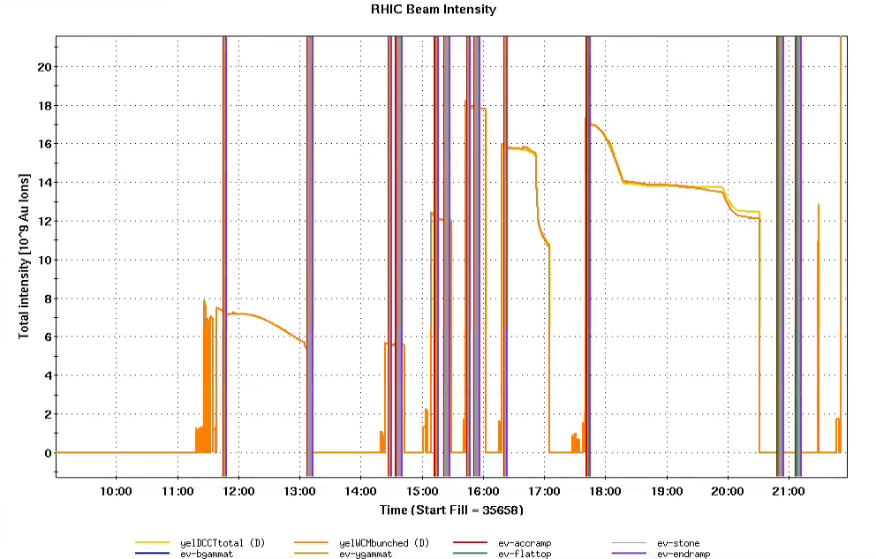
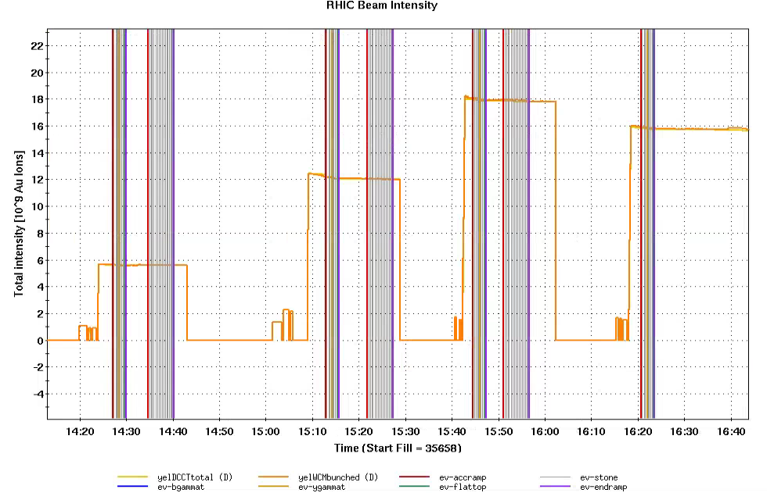
Beam Intensity ( 12 bunches in Yellow ring )
Two ramps together
Zoom in

Slide 5
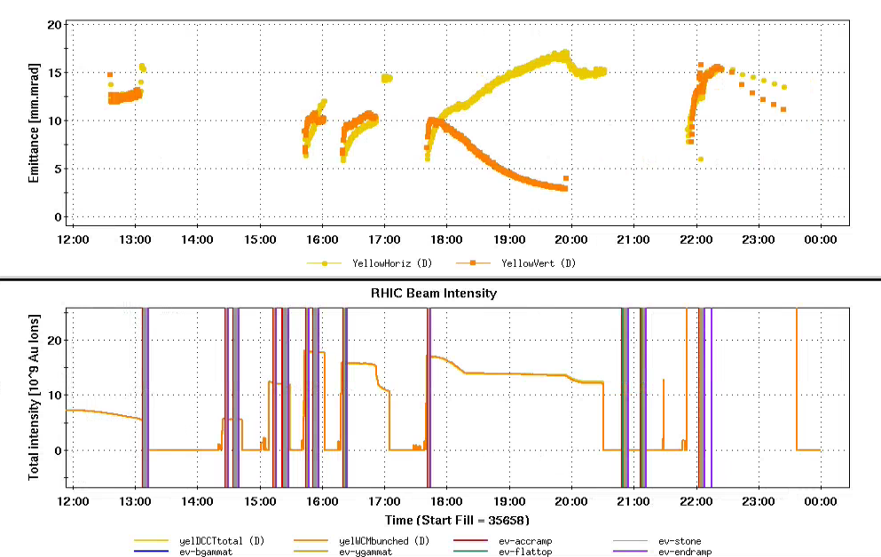
Beam Emittances
APEX Session
Current Physics
Vertical cooling

Slide 6
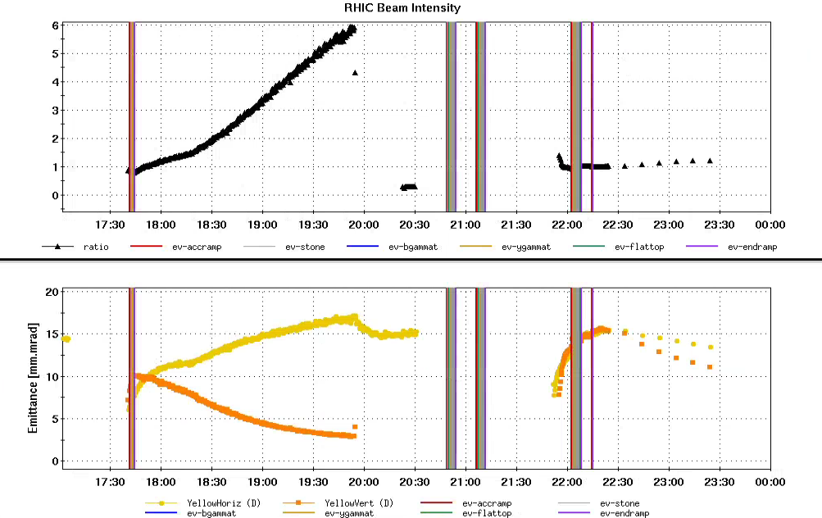
Fill 35672: 12 bunches to cool vertical emittance, maximum 6:1 obtained
Notes:
In 2 hours, we got 6:1 emittance ratio.
2) Vertical emittance was blown-up by accidentally turning on BBQ for tune/coupling measurement. ( Chromaticitiesclose to zero and BBQ needs fine tuning. )
Emittance Ratio
6:1
Experiment store
physics store
Beam decay improvement
Emittances

Slide 7
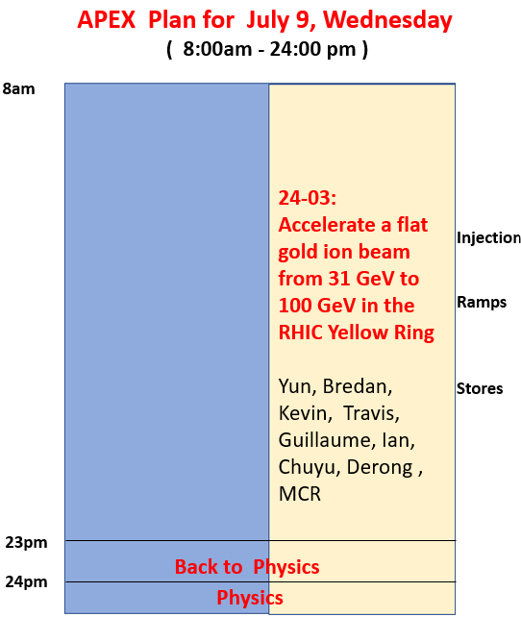
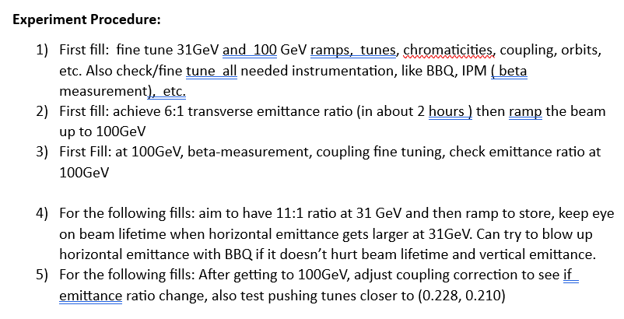
APEX Schedule for July 9
Goals:
1) Fine tune ramps and instrumentation.
2) Ramp up large transverse emittance ratio beam to 100GeV.

