Slide 1
Take 5 for Safety
Presenter(s): Michael Dany
Date: 7/8/2025

Slide 2
Summer Students
University interns are currently on site,
High School interns starting this week
2025 Incidents:
Two Students Injured during horseplay outside NSLS-II
Student cuts finger at NSLS-II
Student fell from bike, taken to hospital
Student received burn while cooking in apartment

Slide 3
Student Mentors
How you can help:
Be a Safety Mentor -
Be the “Leader who values the safety legacy they create in their discipline”.
Daily / Weekly safety reminders & group discussions
“Everyone is personally responsible for safe operations”
Leverage safety resources: BNL ES&H Dept., Review Safety Topics, Contact our ESH Reps, Discuss Examples

Slide 4
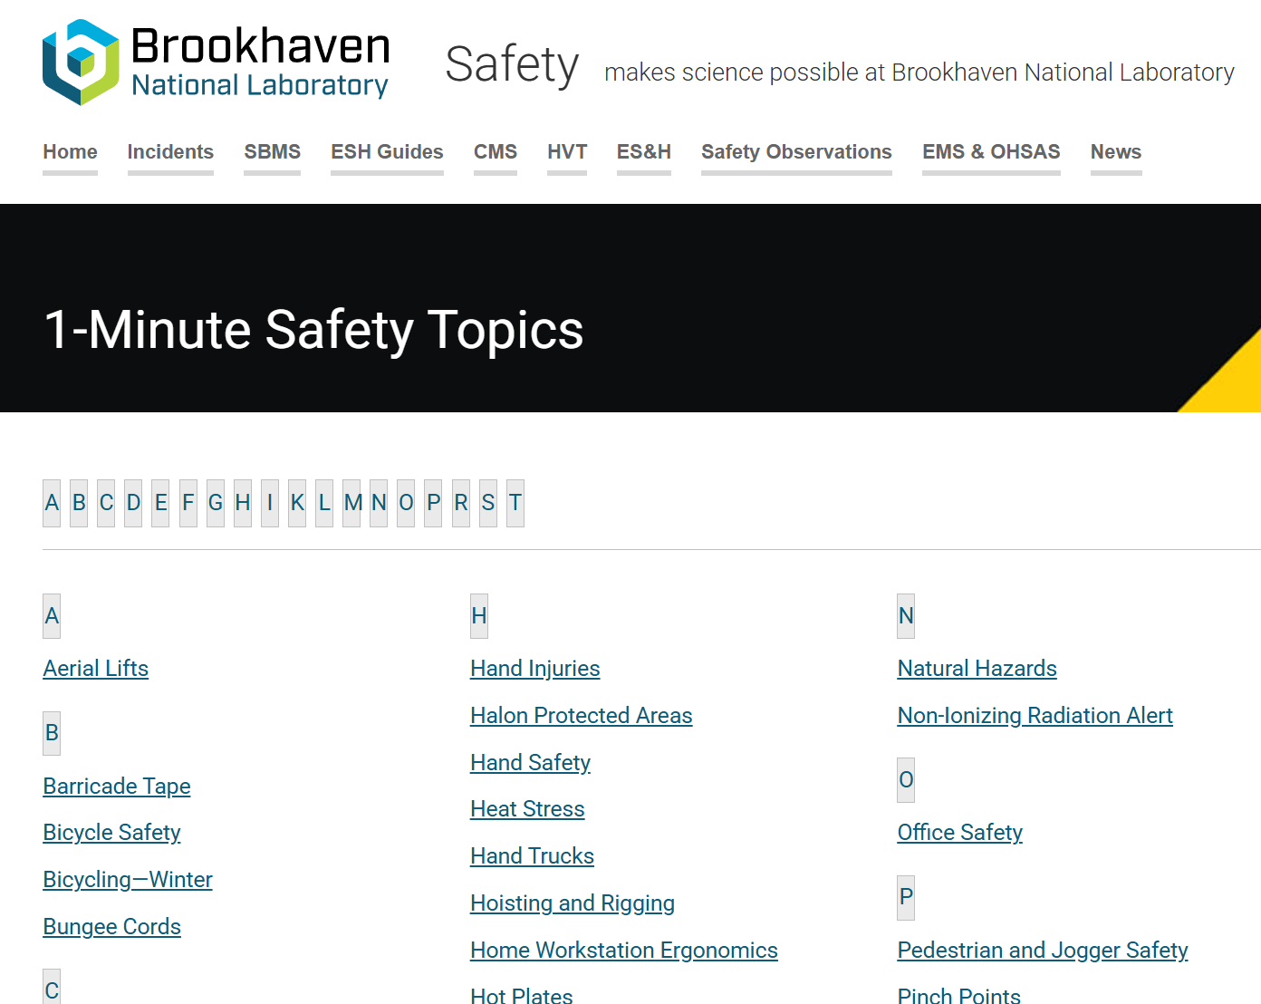
Resources
Bicycles
Barricades
Driving
Eye Protection
Heat Stress
Traffic
Ticks
Student Safety
& more….

Slide 5
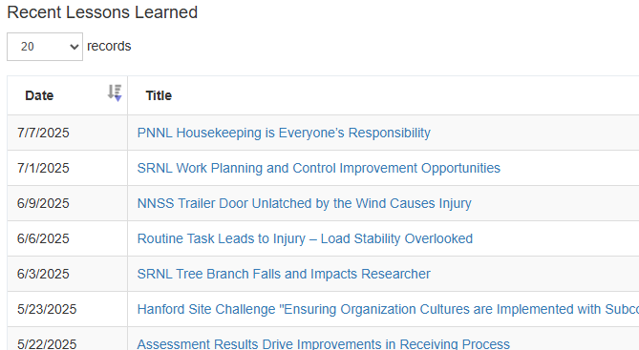
Lessons Learned
BNL is a Professional Workplace Campus
Safety is priority!
Graduate Student Incurs Laser Injury to Eyes
From DOE - Insufficient Training and Supervision Lead to Cavity Window Failure
UC Berkeley Student Suffers Severe Skin Burn
Let’s make is a SAFE Summer for ALL!

Slide 6
End

