Slide 1
Preinjector Status
D. Raparia
Time Meeting
July 08 2025

Slide 2
Tandem
MP7 is currently well and providing ions for RHIC
Track to replace terminal foils in mid August
MP6 providing ions for external users
MP6 will deliver bean for Renew class in target room 4
External user is scheduled for next weekend.

Slide 3
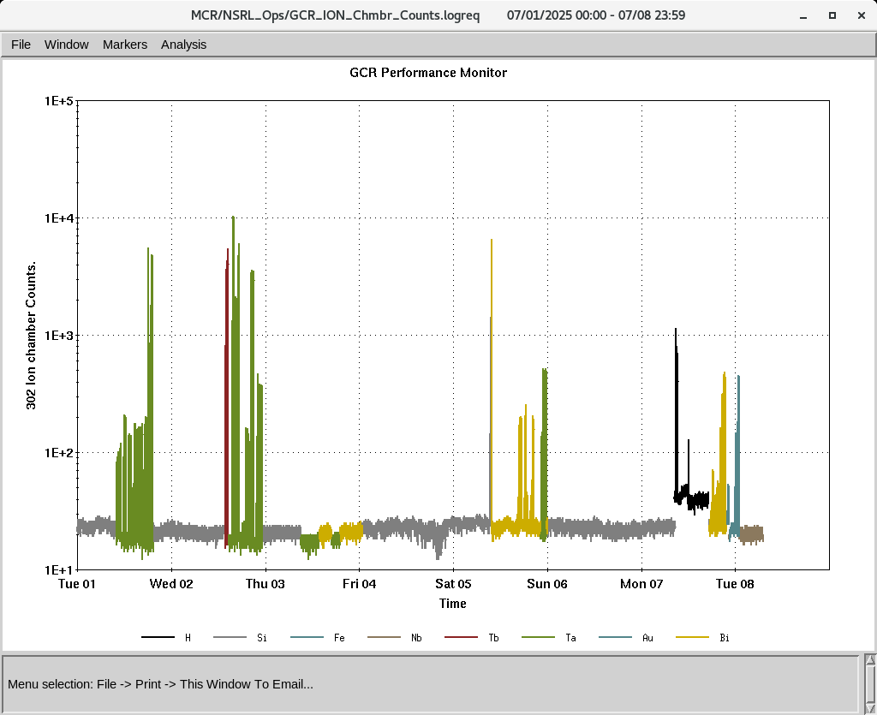
EBIS
Electronics testing continues
Collector PS trips investigation continues
Power dips, most of the systems were down , EBIS linac was recover on Saturday
LION XY controller need to replace and tested
IONS to NSRL
H, Si⁺¹¹, Fe⁺²⁰, Nb⁺²³, Tb⁺³⁵, Ta⁺³⁸, Au⁺³¹, Bi⁺⁴⁷

Slide 4
Linac, providing beam to NSRL, AGS, and 200 MeV Polarimeter
Linac run is extended till July 8th
7/2: power dip, RF and quad systems were recovered on Saturday for Sunday PP session
XF100 reset on Sunday
OPPIS is successfully delivering beam to the 200 MeV line, Polarimeter Booster, and NSRL.

