Slide 1
sPHENIX status
Kin Yip
sPHENIX Director of Operations
Time Meeting
July 8, 2025

Slide 2
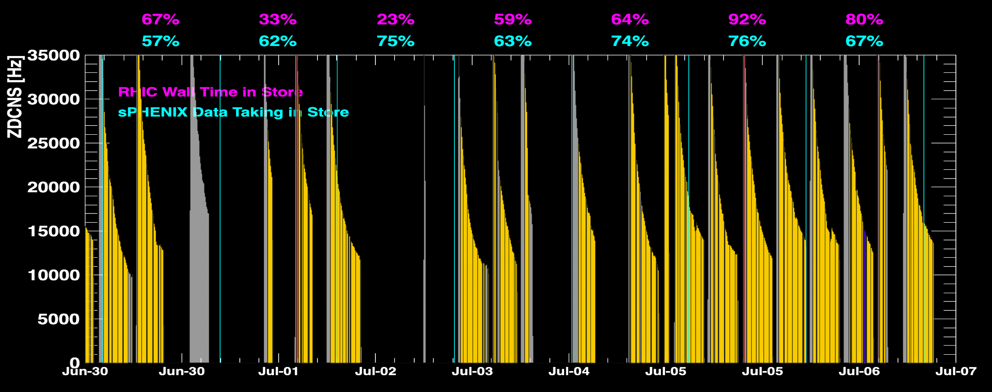
sPHENIX Status & Performance
July 5/6 have seen sPHENIX collecting the most data this run.
MBD vertex issue has been finally clarified and resolved.
While the DAQ system continues to be improved and our Run Coordinators have continued to streamline and optimize the data taking operation.
Down-time includes power dips (mainly on machine) and ODH sensor problem in IR8 Sunday evening.

Slide 3
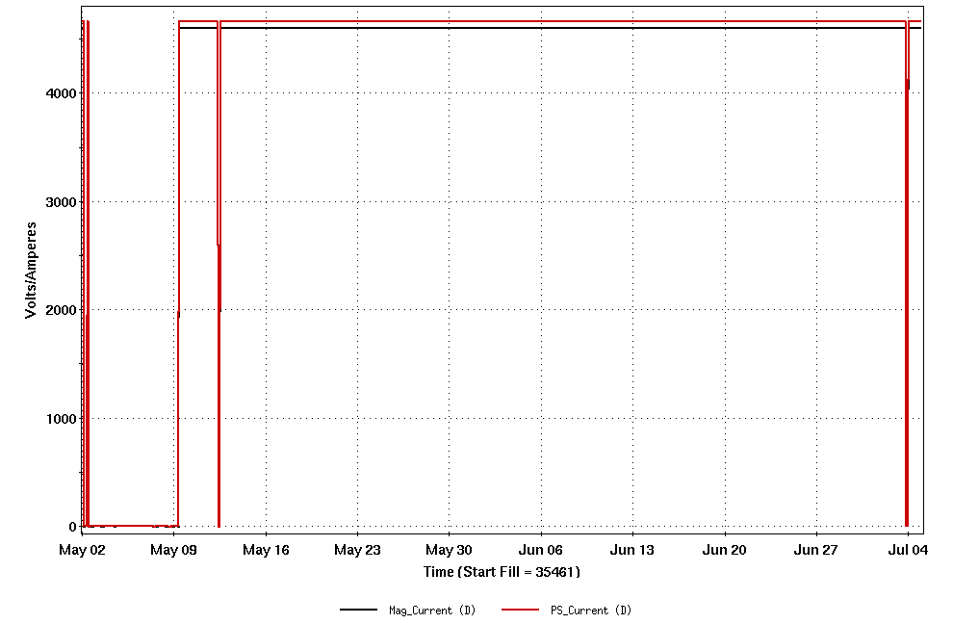
sPHENIX Status & Performance (cont.)
Magnet has been at top current for the longest time until the power dip last Thur.
Trip (power dip)
Ramped down/up normally for chiller test
Trip (power dip) last Thur.

Slide 4
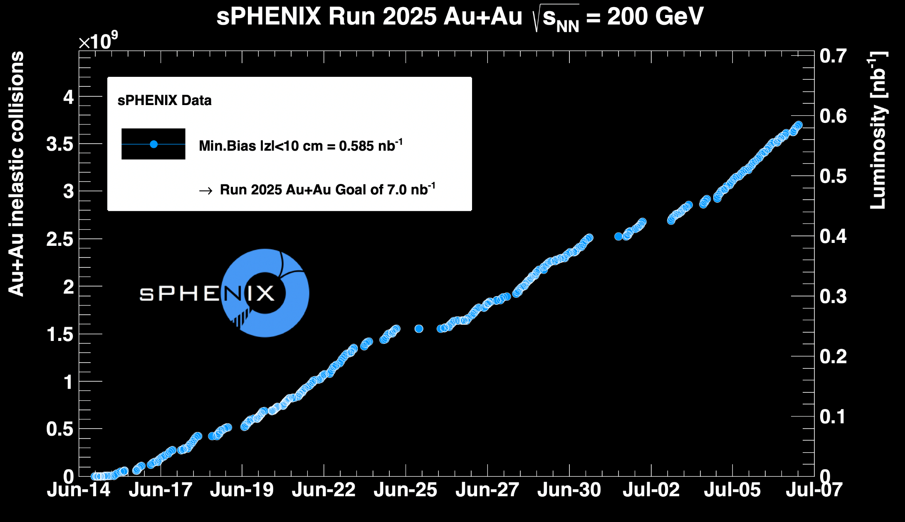
sPHENIX Status & Performance (cont.)

