Slide 1
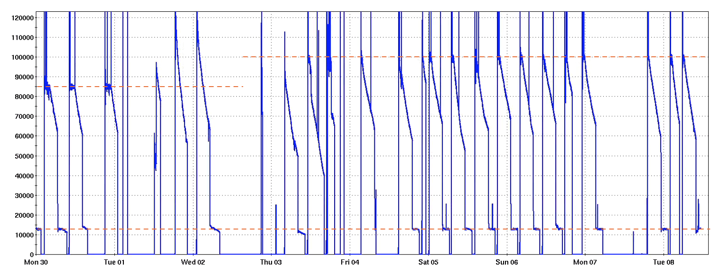
STAR Status (July 1 - 7, 2025)
Xiaoxuan Chu, xchu@bnl.gov
STAR status now:
Hi-lumi: No crossing angle, leveling ZDC at 100kHz
Low-Lumi: 1 mrad crossing angle, leveling ZDC at 13kHz
Efficient data-taking from STAR when we have beam
Problems addressed expediently to minimize downtime
Power dip
Maintenance
Power dip
56 mHz commissioning

Slide 2
Xiaoxuan Chu, xchu@bnl.gov
MinBias
BTH3
Current: 1.47B
Our goal for MinBias:
28 weeks: 9B
Current: 2.15/nb
Our goal for BHT3:
28 weeks: 28.6/nb
Running hours

