Slide 1
Preinjector Status
D. Raparia
Time Meeting
July 15, 2025

Slide 2
Tandem
MP7
currently well and providing ions for RHIC
Track to replace terminal foils in mid August
Spark on Wednesday was recovered
MP6
providing ions for external users
Ion source was replaced last week
MP6 will deliver bean for Renew class in target room 4
External user is scheduled for this weekend.

Slide 3
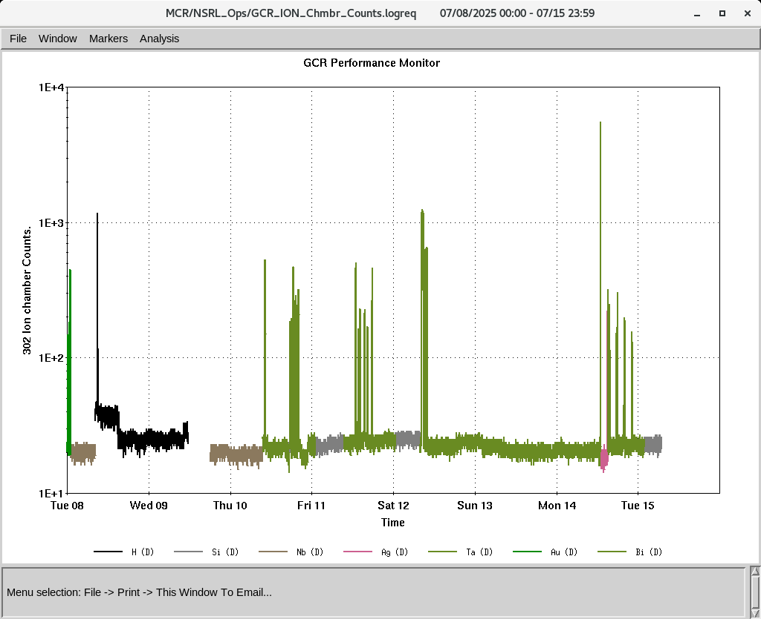
EBIS
Electronics testing continues
Collector PS tripping: added extra cap between EBIS platform and Collector PS
EBIS MPS was fixed yester by repairing module SN3
LION XY controller need to replace and tested
Planning to develop gold beams on 23rd and 29th July
We need to get safety approval running Deuterium for NSRL
IONS to NSRL
H, Si^{+11 ,} Nb⁺²³, Ag⁺²⁹, Ta⁺³⁸, Au⁺³¹, Bi⁺⁴⁷

Slide 4
Linac, Maintenance
Linac planning to restart mid November
OPPIS is running to for optimization of beam current studies

