Slide 1
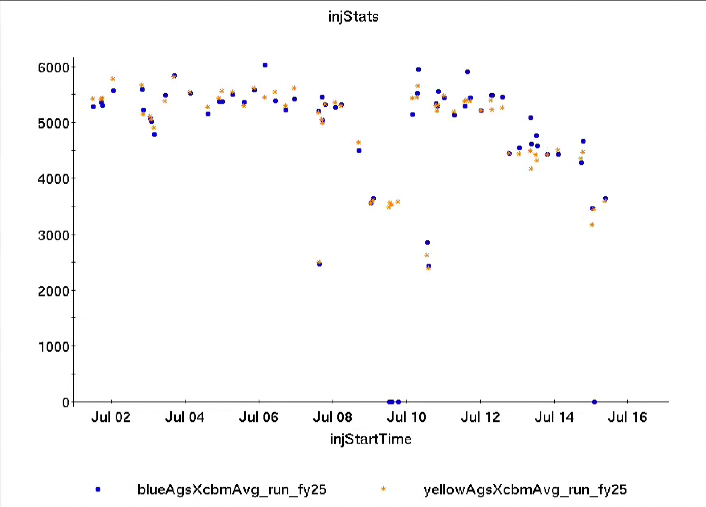
Injector Status: Time meeting 7/15/25
AGS delivering well for RHIC stores
Had been using detuned merge to control intensity/longitudinal emittance
Full merge requires less intensity out of Tandem for same RHIC intensity
Linac in maintenance, proton development is over
Developments aimed at model development and AI/ML efforts continue
AGS Extraction Intensity by Fill
Intensity (10⁶)

