Slide 1
sPHENIX status
Kin Yip
sPHENIX Director of Operations
Time Meeting
July 15, 2025

Slide 2
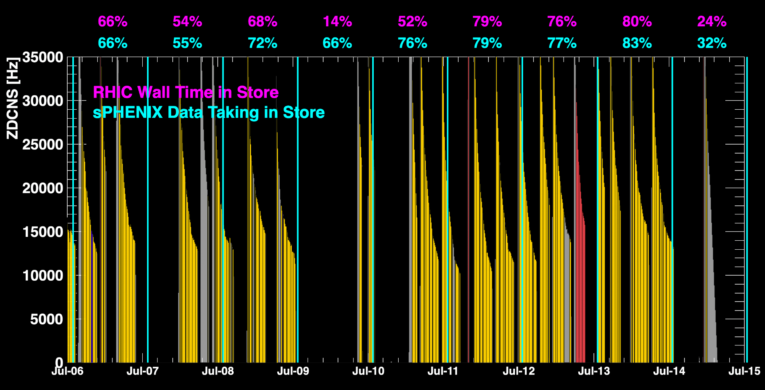
sPHENIX Status & Performance
Mon. (July 14): Cooling water pump(s) in 1008C tripping led to Magnet trips (fast-discharge) twice. We didn’t ramp the Magnet up again Monday night but wait to see whether the pumps would trip again …
Continue to deal with issues of data transfer (to SDCC) and improve
Otherwise, generally taking physics data.

Slide 3
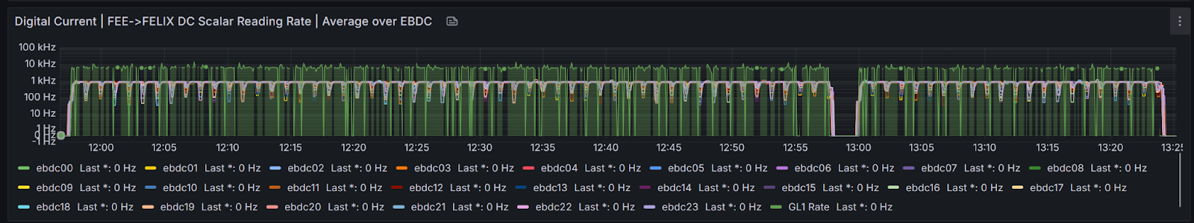
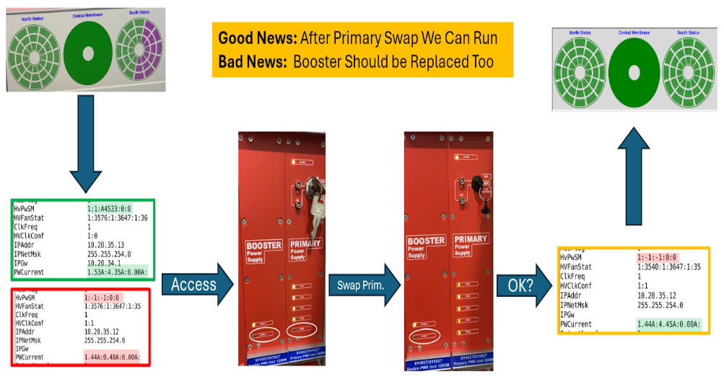
sPHENIX Status & Performance
Latest firmware for the Digital Current (TPC) has been installed and the tests are ongoing to make sure that there is no unintended consequence.
Thur. (July 10): New firmware needs more current => needed to go into the IR to increase LV voltages for TPC.
Sun. (July 13): replaced primary &
booster (CAEN) power supplies of TPC
inside the IR (as ½ of South side was not functioning)

Slide 4
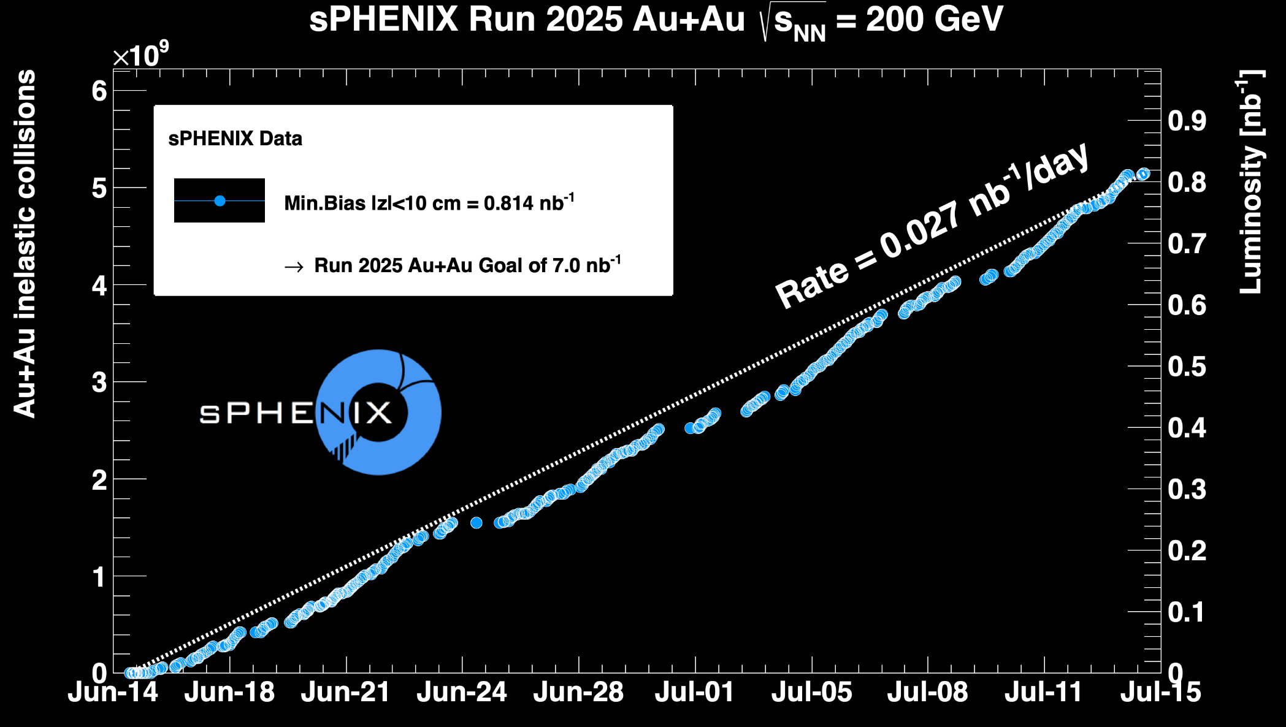
sPHENIX Status & Performance (cont.)

