Slide 1
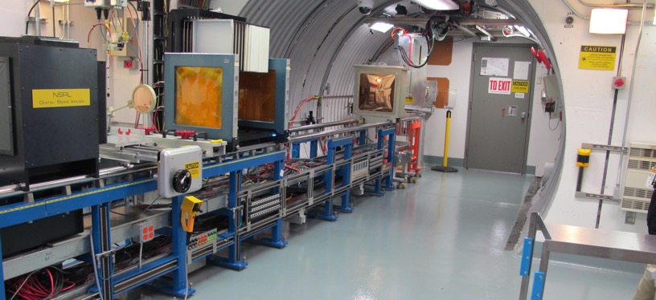
NSRL Time Meeting Report
15 July 2025
Michael Sivertz

Slide 2
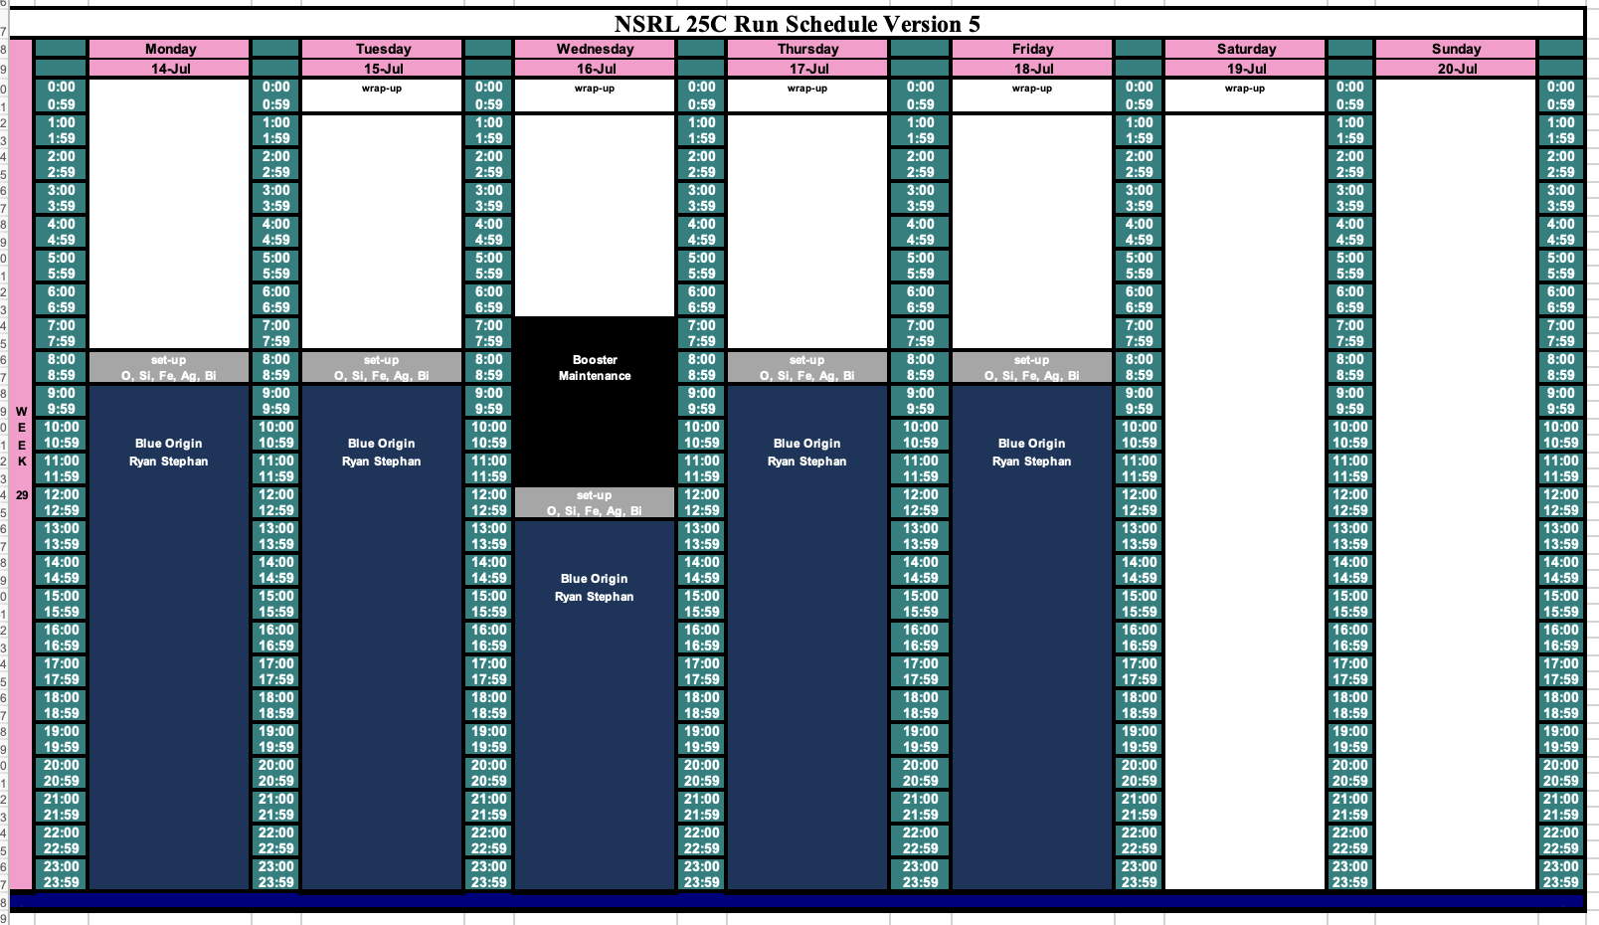
Schedule for this week

Slide 3
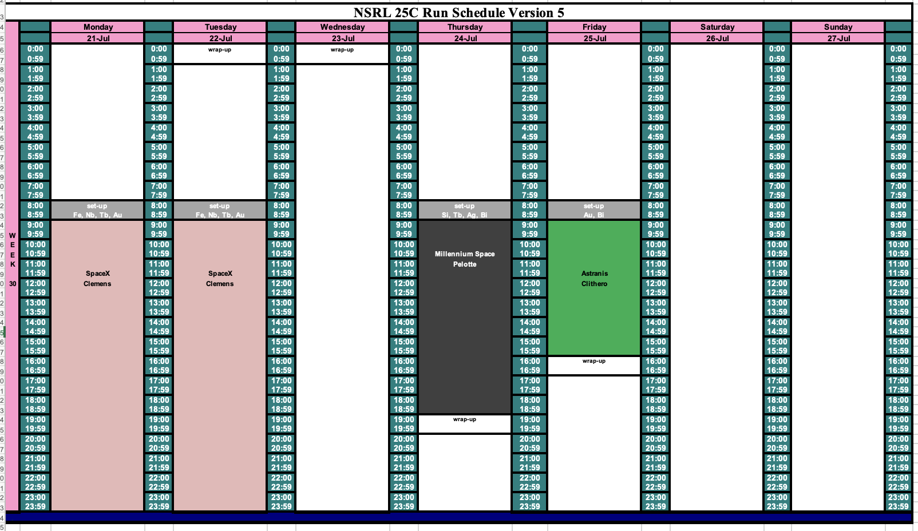
Schedule for next week

Slide 4
Future Schedule
Last week EBIS problems lost a day of electronics testing. We tried to make it up on Saturday, but problems persisted. The Nucleon Space team is evaluating whether or not they can come back on 23 July to complete their testing.
Blue Origin is running 16-hours/day all week this week. They lost their first shift on Monday during EBIS interlock repairs. They do not plan to run Saturday to make it up, but will come back in August to complete their testing.
SpaceX, Millennium Space Systems, and Astranis will come to test the following week.

