Slide 1
APEX Report
Time Meeting, July 15, 2025

Slide 2
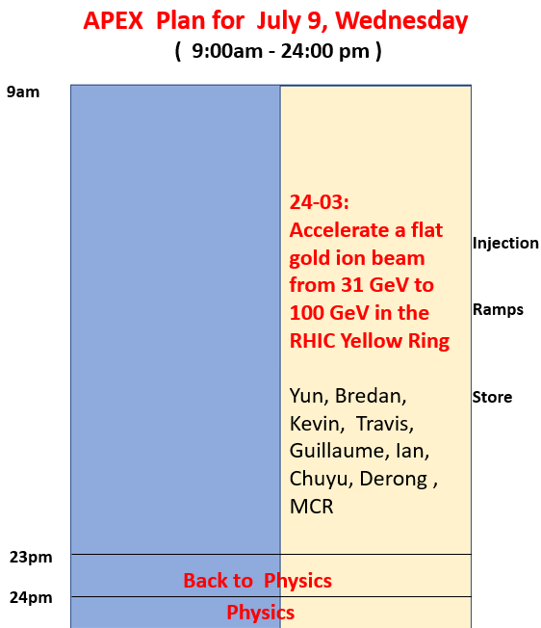
Planned APEX time:
9am-11pm, totally 14 + 1 hours, 1 hour for back-to-physics.
Actual time:
1) lost 2.5 hours to get QLI recovered at the beginning of APEX;
2) Paused APEX to get Blue abort kicker repaired and lost 2.5 hours;
3) We stopped APEX at 10:30pm ( followed by a tough night shift )
Main activities this session
1) fine tuned both ramps: chromaticity, BBQ, optics measurement, etc.
2) Two ramps from 31GeV to 100GeV: with emittance ratios 2:1 and 6:1
3) The emittance ratio was maintained during acceleration

Slide 3
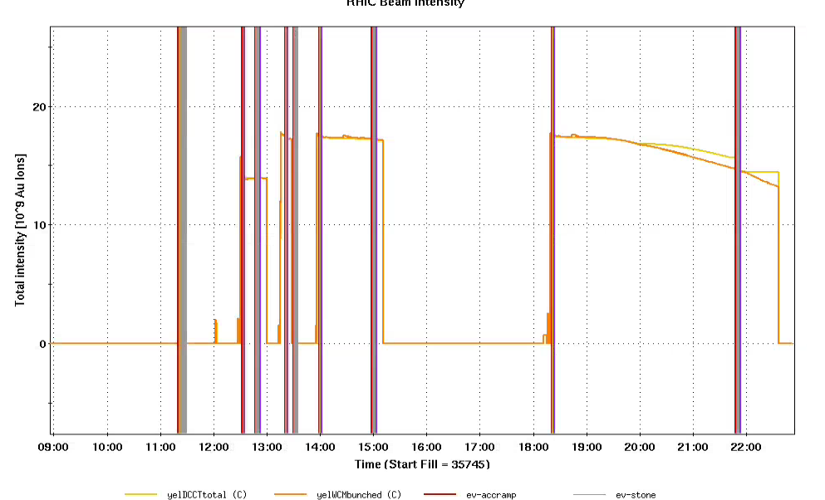
Ramps & Beam Intensities
Fill 35747
Fill 35750
QLI recovering
Blue abort kick repairing
Ramp tuning
Beta meas.

Slide 4
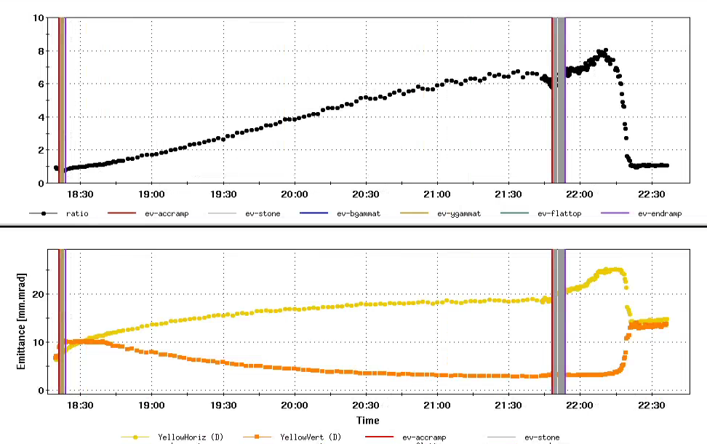
Emittances and Ratio for Fill 35750
Cooling at 31GeV
Measurements
at 100GeV
31 to 100GeV ramp

Slide 5
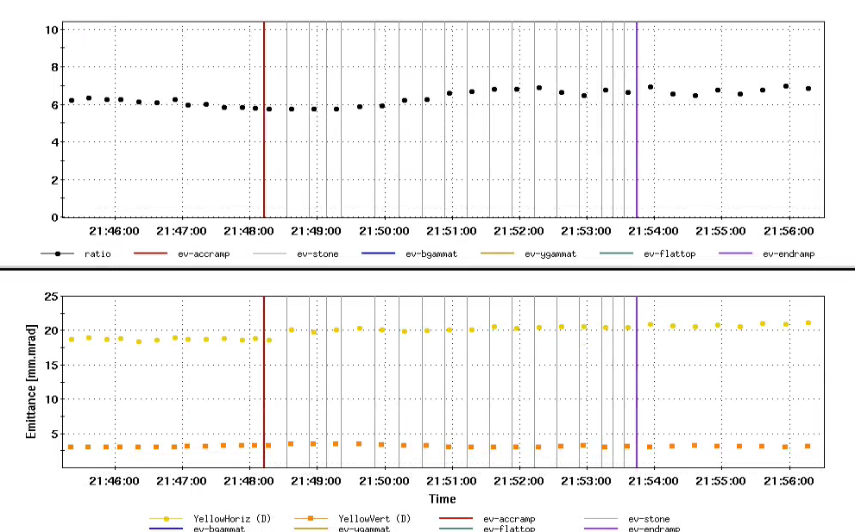
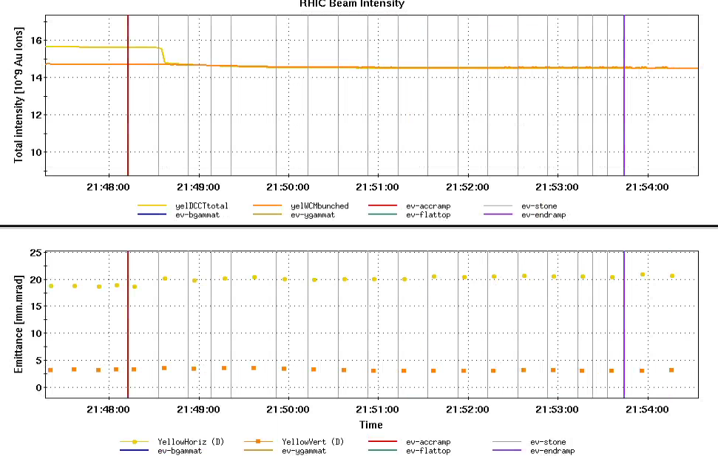
Accelerate 6:1 Emittance Ratio Beam
Emittance Ratio
Total Intensity
Emittances
Emittances
Emittance ratio 6:1 was maintained on 31->100GeV ramp.

Slide 6
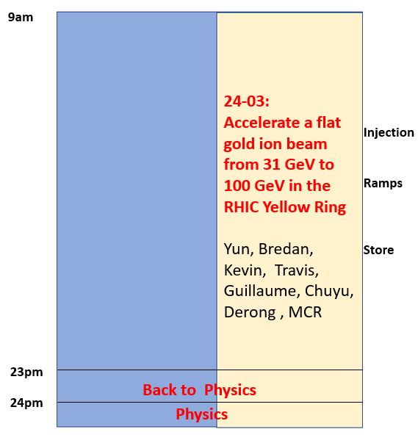
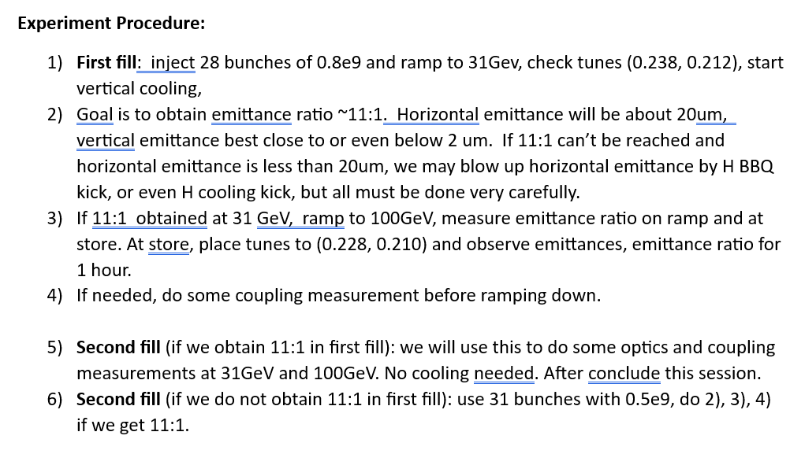
APEX Schedule for July 23
Goal: generate and accelerate 11:1 beam

