Slide 1
Preinjector Status
D. Raparia
Time Meeting
July 22, 2025

Slide 2
Tandem
MP7
currently providing ions for RHIC
Track to replace terminal foils in mid August
Low energy beam stop bellow replaced; beam stop still having issues
MP6
providing ions for external users
Next week Mon-Fri , external user
Tuning Au in the bypass line

Slide 3
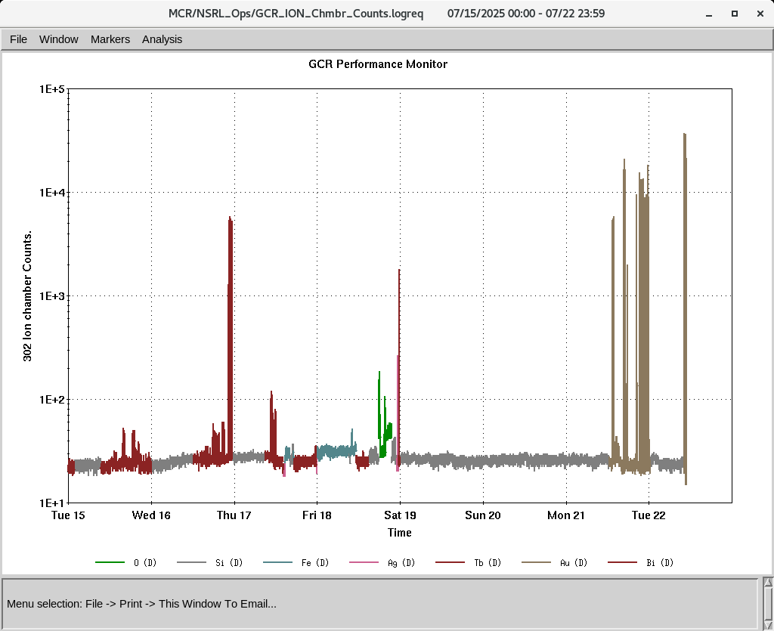
EBIS
Electronics testing continues
Scroll pump for the LEBT vacuum turbo was replaced
MPS issue for vacuum
Planning to develop gold beams on 22nd , 23rd and 29th July
IONS to NSRL
O⁺⁷ Si^{+11 ,}Fe⁺²⁰ Ag⁺²⁹, Tb⁺³⁵ Au^{+31,43}, Bi⁺⁴⁷

Slide 4
Linac, Maintenance
Linac planning to restart mid November
OPPIS is running to for optimization of beam current studies

