Slide 1
sPHENIX status
Kin Yip
sPHENIX Director of Operations
Time Meeting
July 22, 2025

Slide 2
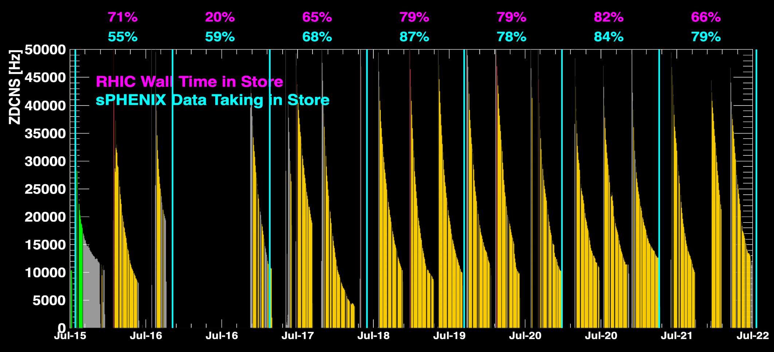
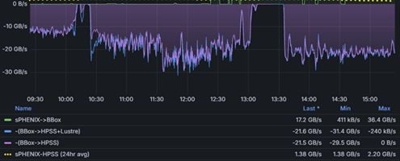
sPHENIX Status & Performance
While taking data as efficiently as
possible, we are also finding ways to
improve data transfer to SDCC/HPSS. Now we’re transferring data to HPSS at ~23 GB/s while taking data.

Slide 3
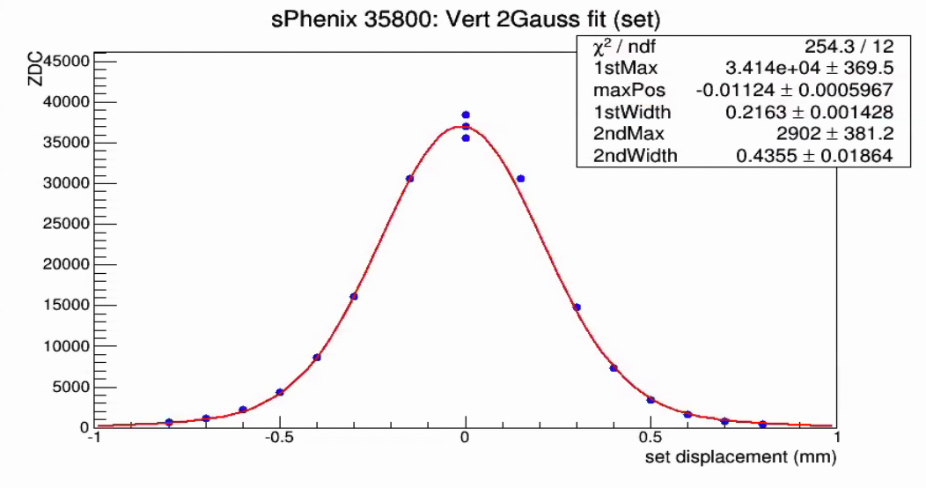
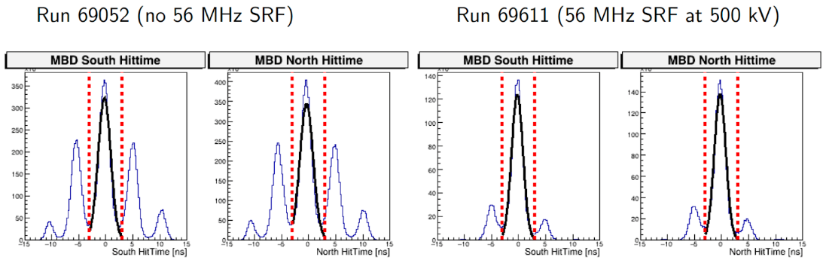
sPHENIX Status & Performance (cont.)
From the preliminary analysis
of last week’s vernier scan, it’s
found that the cross-section is ~10 b, just like previous year.
We did notice the difference between having 56 MHz cavity or not.

Slide 4
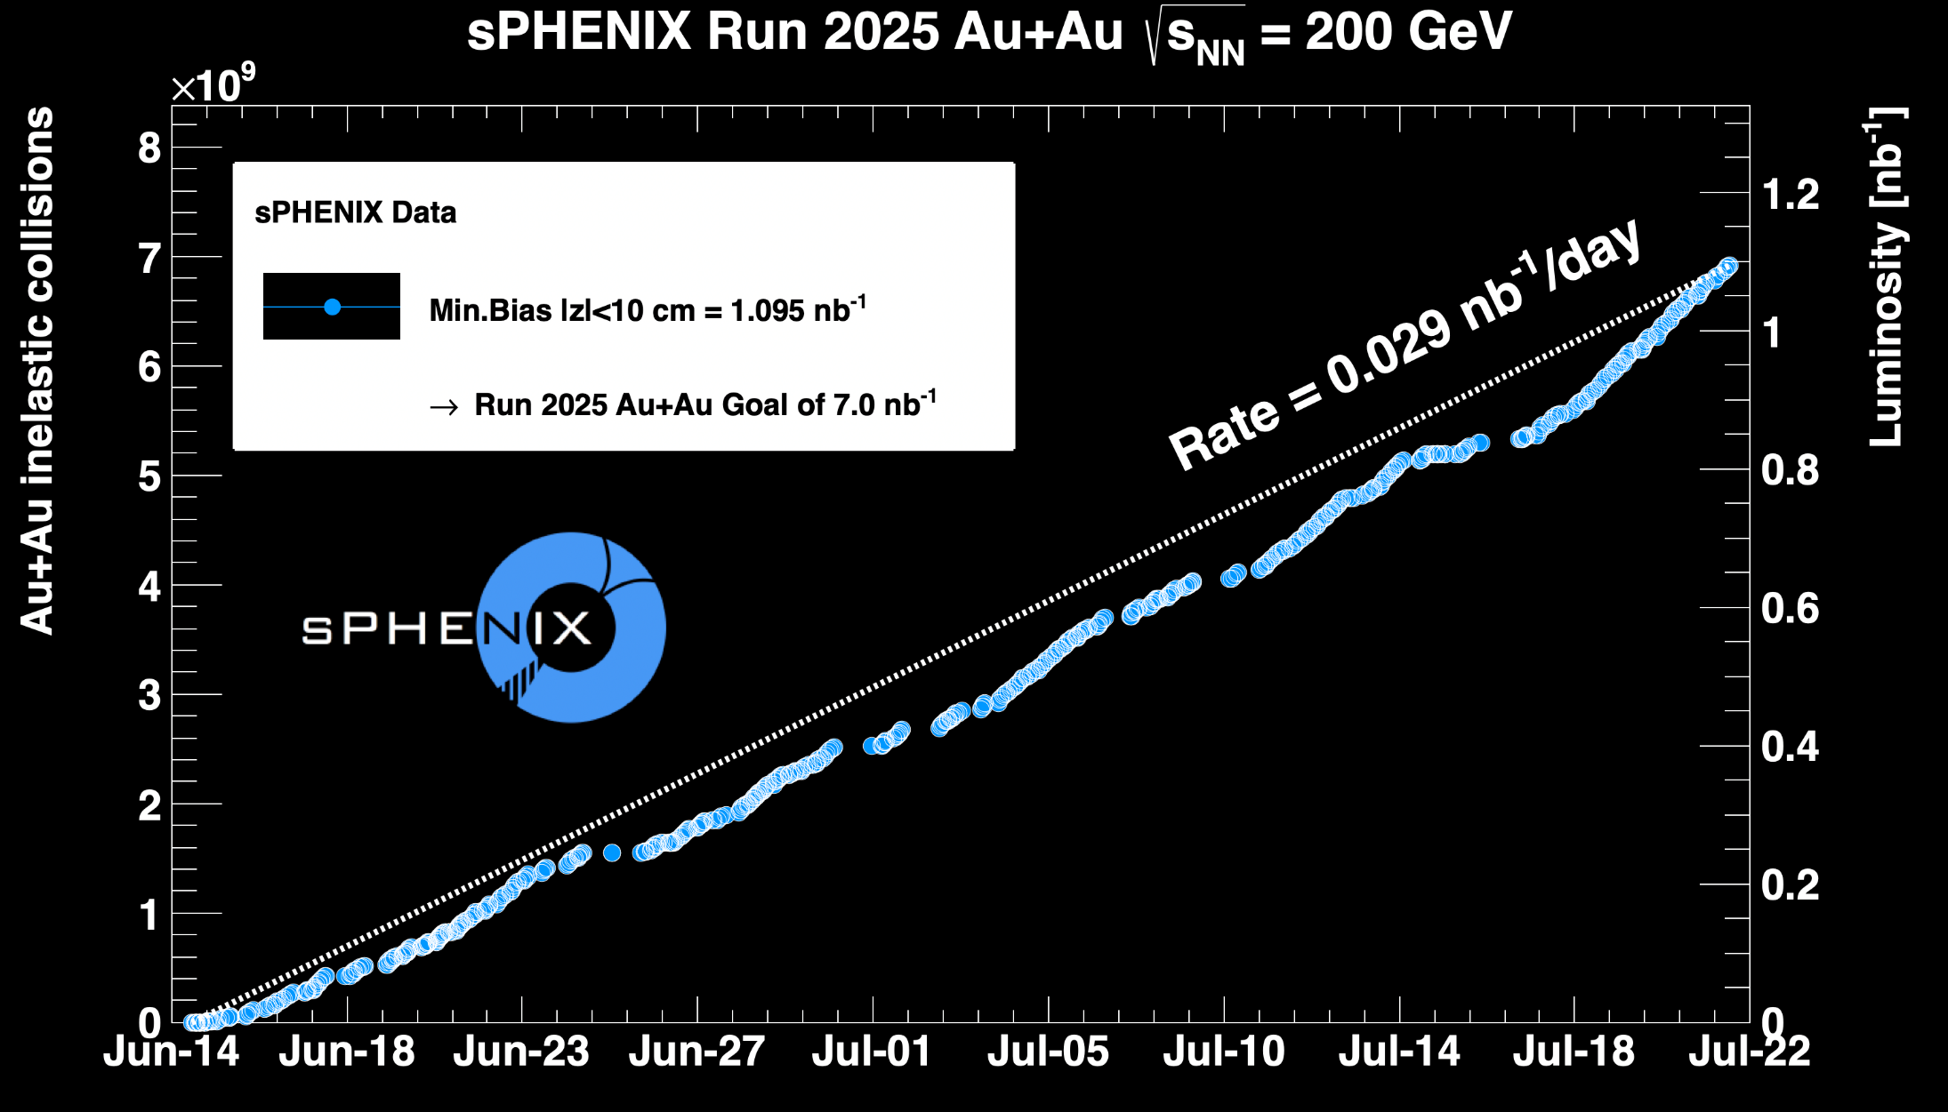
sPHENIX Status & Performance (cont.)

