Slide 1
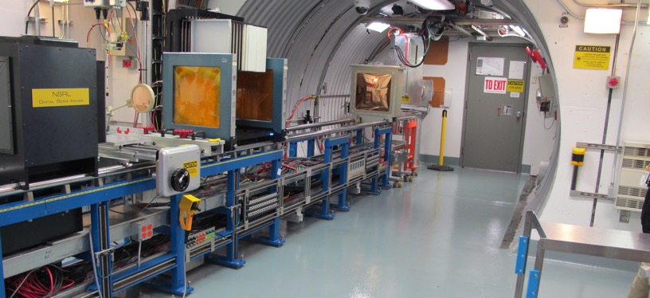
NSRL Time Meeting Report
15 July 2025
Michael Sivertz

Slide 2
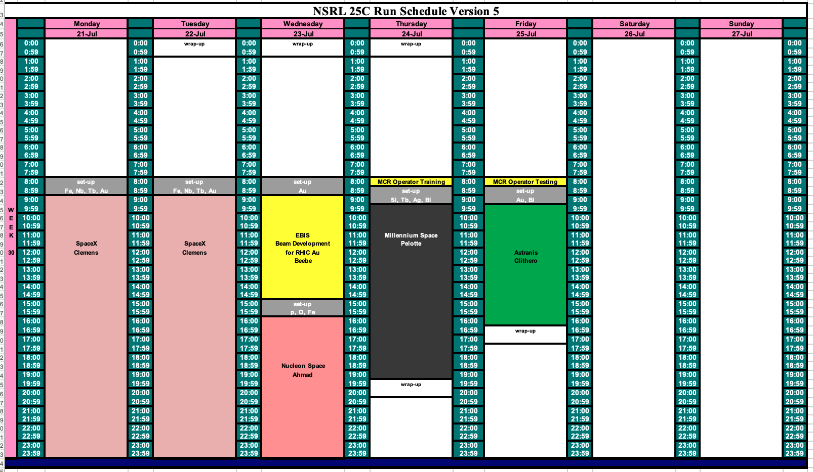
Schedule for this week

Slide 3
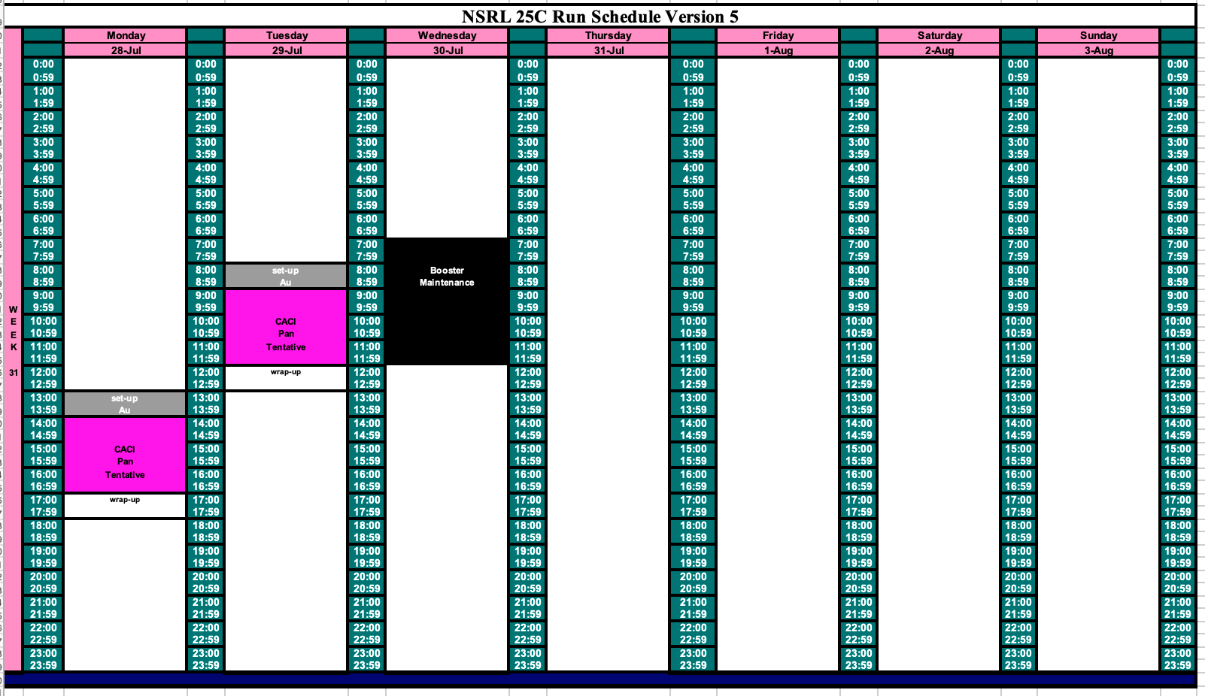
Schedule for next week

Slide 4
Future Schedule
Last week EBIS problems lost a day of electronics testing for Blue Origin. They were unable to stay and make it up on Saturday, so they will get a make-up day when they come back in August.
SpaceX is running 16-hours/day on Monday and Tuesday of this week. Wednesday first shift is given over to EBIS for Gold beam development. We will finish Wednesday second shift with the make-up day for Nucleon Space.
Millenium Space runs Thursday and Astranis on Friday.
We will begin both Thursday and Friday with a 30-minute delay to allow for MCR Operator training and testing.
CACI will come to test the following week, starting late at 2:00 PM on Monday, but normal time on Tuesday. The remainder of the week can be given over to EBIS Gold work and beam development.

