Slide 1
Data courtesy C. Naylor

Slide 2
Data courtesy C. Naylor

Slide 4
Data courtesy C. Naylor

Slide 5
Data courtesy C. Naylor

Slide 6
Data courtesy C. Naylor

Slide 7
Data courtesy C. Naylor

Slide 8
Data courtesy C. Naylor

Slide 9
Data courtesy C. Naylor

Slide 10
Data courtesy C. Naylor

Slide 11
Operations for BLIP
No BLIP
this past week
BLIP remains in shutdown.
Linac off since 8 July.
Notes:
BLIP plot from LogView /MCR/PerformanceStats/timeMeetingBLIP.lvdisp
Avail calc on nsrl time Excel sheet

Slide 12
NSRL activity past week: 7/15-22/2025 (as of 0800)
NSRL running continues. Various user time and beam development continuing.
EBIS ions only (7: O, Si, Fe, Ag, Tb, Au, Bi) delivered to NSRL.
Run 25-C began 30 June; 25-C schedule posted, updates forthcoming through 1 October.
Availability: 88.4%
Notes:
Graph and avail calc from nsrl time.xlsx

Slide 13
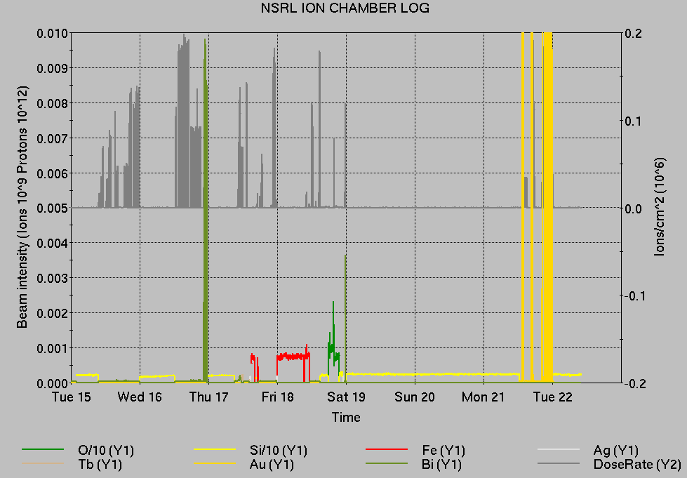
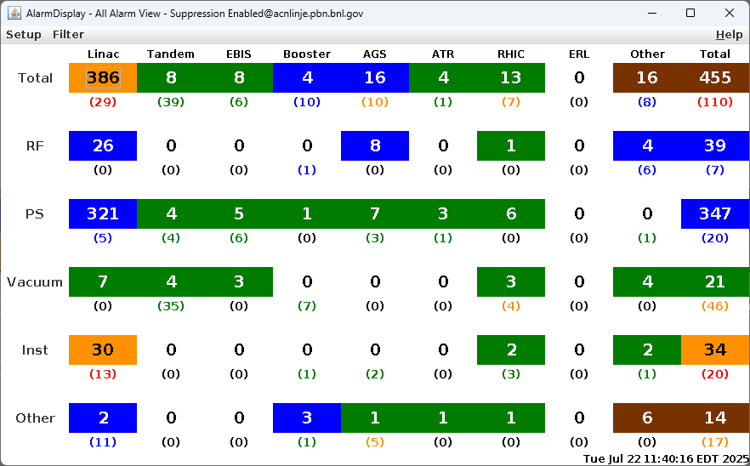
Notes from Operations
Notable failures (>1 hr)
Tandem MP7 beamstop, vacuum issues
yo5-tq5-ps failure, replaced
AGS extraction/beam intensity issue during fill, retuned
yi11-tq6-ps failure, replaced
Controls cfe-9a-ps3 failure, permit board replaced
AGS Main Magnet PS trip (4x) on flow rate faults
ODH sensor failure 8z2, access with Fire/Rescue and ACS to repair
AGS RF station KL trip, cycled power on cavity controller box; additional trips/resets
NSRL program logged as failure when RHIC fill configuration prevents NSRL cycle (4x).
EBIS vacuum failure, MPS reset required.
Other notes
sPHENIX and STAR magnet cooling issues, did not preclude beam
BLM aborts (5x), beam tuning (and errors), 56MHz RF issues.
BPM abort, bi8-bh11 failed (removed from interlock array)
Booster MMPS active filter fault, repair deferred
RHIC DCCT noise issues requiring multiple resets
Various injector PS trips, resets, tuning
Various Tandem tuning, access, foil changes
Over 62 hours CeC shifts with beam; additional injector beam for Au setup, Operator training (when injector systems are available)
Notes:
NSRL plot from LogView /MCR/PerformanceStats/timeMeetingNSRL.lvdisp, select Dose Rate and ion species in use
Screenshot of AlarmSummary

Slide 14
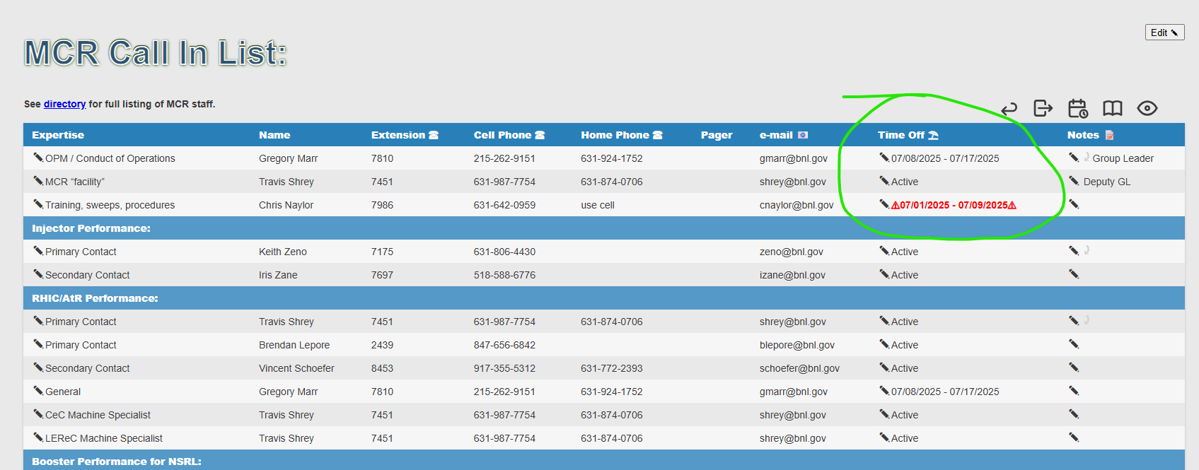
Reminder from Operations
MCR beam operations continue
RHIC physics running continues
Tandem remains sole provider of Au31 for RHIC
Operator/OC shifts continue for NSRL users, 1-2 shifts/5 days this week, 2 days next.
No beams from Tandem or Linac; Ion beams from EBIS.
AGS tuning, other studies to continue behind stores as time allows.
MCR on duty 24/7.
Changes? Time to update is now. Expect calls at all hours.
Alarm response instructions: need updates
http://directory.pbn.bnl.gov/ CHECK AND EDIT YOUR OWN CONTACT INFO
https://www.cadops.bnl.gov/Operations/personnel/call_in_lists/
CHECK YOUR CALLIN LIST: expect contact off-hours
Summer is vacation time! Make sure your list is accurate

Slide 15
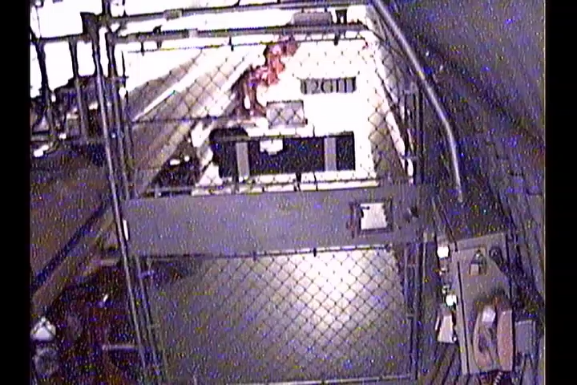
Reminder from Operations
Resweeping = increased failure time, delays when resuming physics program
Just because you can open a gate, does not mean you should do it without calling x7400…

Slide 16
Keytree notes
Remote keytree systems require a database lookup to validate and authorize distribution of keytokens. The Keytrak system’s database is available for lookup functionality, but can no longer be modified in any way to add or edit qualified personnel.
Personnel affected:
New employees, experimenters arriving after 12/1/2024 could not be enrolled in database
Existing employees & experimenters, not already enrolled, cannot be added or modified in database
Remote keytrees affected:
Iris scan @NSRL
BNLID scan @AGS South gate, North Conjunction Gate
Iris scan @RHIC STAR, sPHENIX, IP12, IP4
Keytrees NOT affected:
BNLID scan @Linac, Booster
BNLID scan @RHIC IP2
MCR keytrees

Slide 17
Keytree notes, continued
Mitigation:
Choose entrants that are currently enrolled to perform the work in the enclosure under Controlled Access (CA).
Obtain CA keys from MCR for remote gate watch
Arrange for local gate watch using other tokens for entrants.
Arrange for Restricted Access, and allow for delays incurred to sweep areas.
CAUTION
Follow procedures. Gate Watch staff will remain vigilant.
No “piggy-backing” – one key/token per entrant.
Access keys are not candy! Authenticated entrant retains possession.
Radiological Controls and the Access Controls System are not to be circumvented. This is (has been) enforced with disciplinary action (dismissal).

Slide 19
Notes:
Reliability comparisons to previous runs

Slide 20
Notes:
Reliability comparisons to previous runs

Slide 21
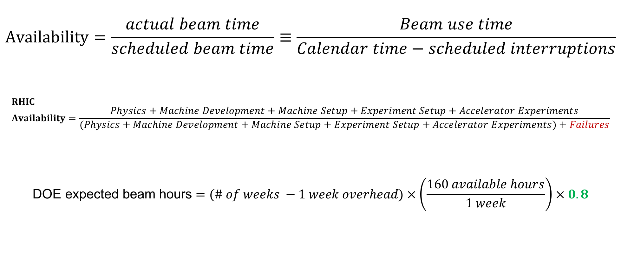
Availability, expected beam hours
$$Availability=\frac{actual beam time}{scheduled beam time}≡\frac{Beam use time}{Calendar time−scheduled interruptions}$$
$$RHIC \\ Availability=\frac{Physics+Machine Development+Machine Setup+Experiment Setup+Accelerator Experiments}{(Physics+Machine Development+Machine Setup+Experiment Setup+Accelerator Experiments)+Failures}$$
$$\text{DOE} \text{expected} \text{beam} \text{hours}=(\# of weeks −1 week overhead)×\left(\frac{160 available hours}{1 week}\right)×0.8$$
Notes:
Normally hidden. Explains how the 85% from DOE comes in to play, & general availability metrics

