Slide 1
Preinjector Status
J. Ritter/ D. Raparia
Time Meeting
July 29, 2025

Slide 2
Tandem
MP7- RHIC support
Currently providing ions for RHIC
Track to replace terminal foils in mid August
- 119 foil in 48 days , 2.48/day , 68 foil remaining=> 27 days
Low energy beam stop beam stop still having issues , Piston need to be replaced
MP6 –External User
providing ions for external users this week
Au similar intensity were extracted from AGS
TTB
Flooded , sump pump issues, float need rewiring

Slide 3
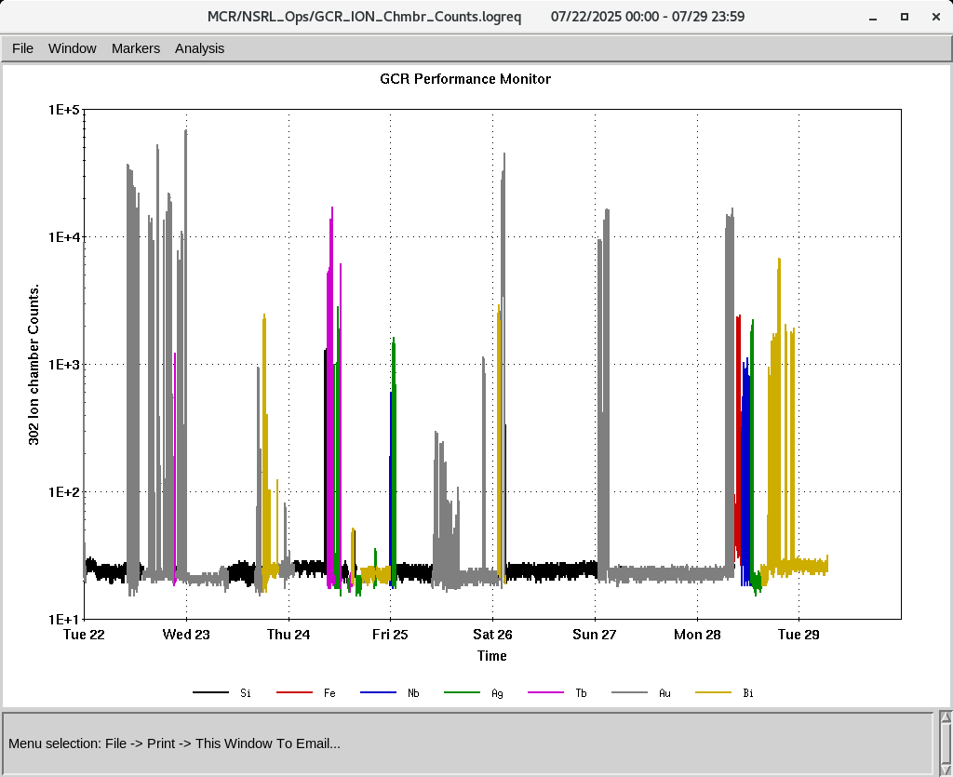
EBIS
Electronics testing continues
Vacuum MPS issues were resolved
Water pipe inside Compressor cage was bonded with frame
Worked on Au develop gold beams on 22nd , 23rd
6.5 A e current, 6 pulses at 2.5 Hz, stability only 5 min, need more work
Au+43 intensity issues
IONS to NSRL
Si^{+11 ,}Fe⁺²⁰ ,Nb⁺²³ Ag⁺²⁹, Tb⁺³⁵ Au^{+31,43}, Bi⁺⁴⁷

