Slide 1
sPHENIX status
Kin Yip
sPHENIX Director of Operations
Time Meeting
July 29, 2025

Slide 2
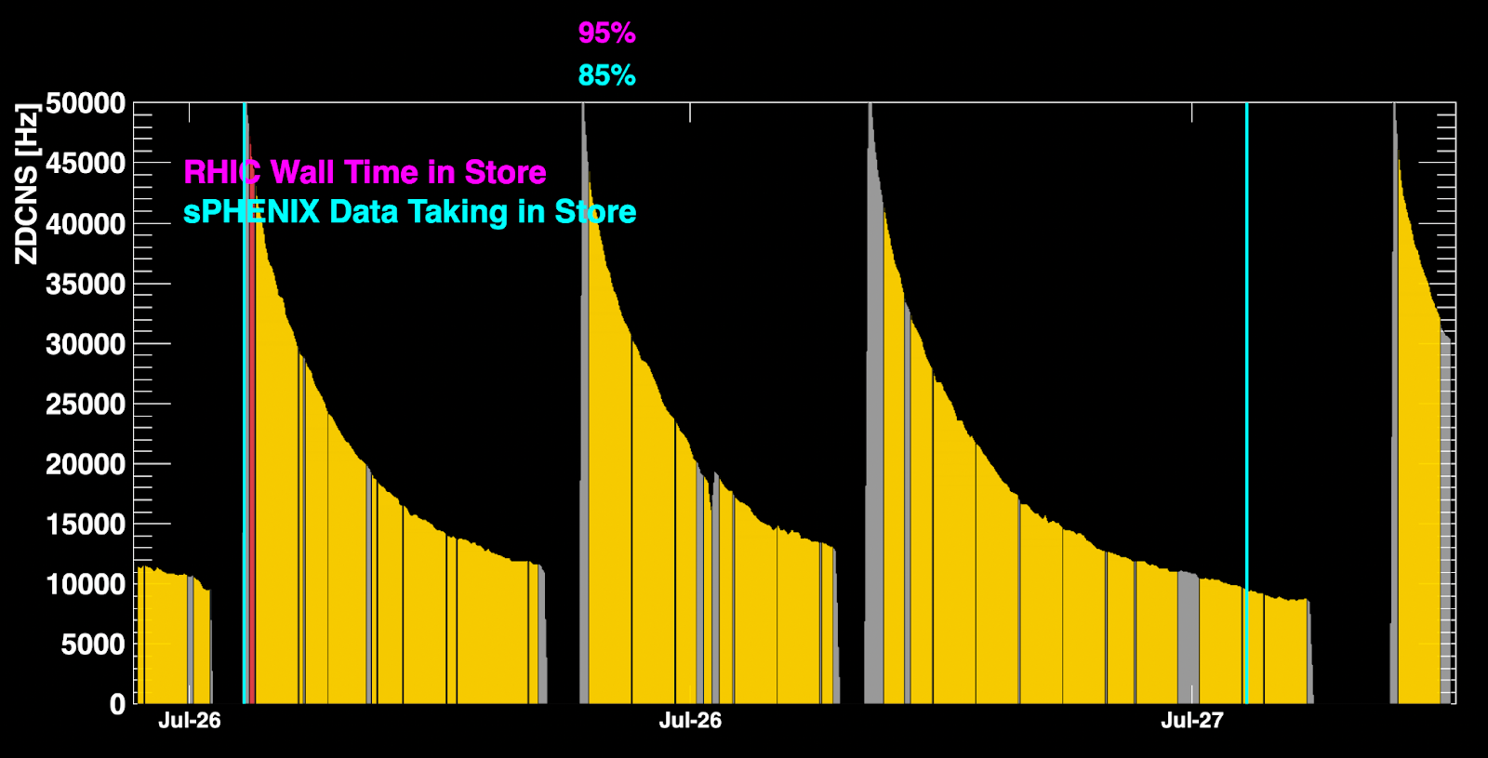
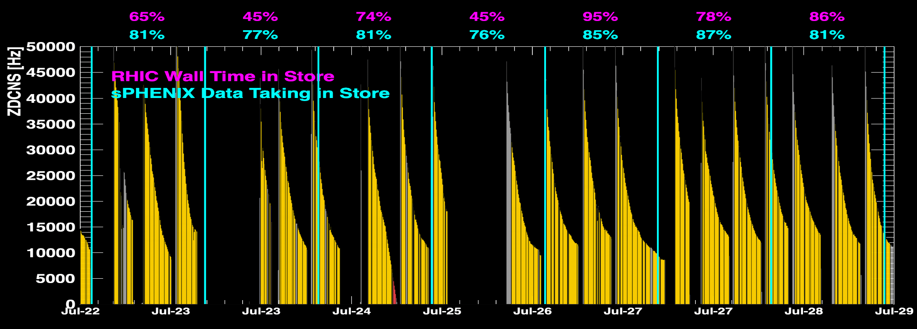
sPHENIX Status & Performance
July 26 was one of the best days yet !
sPHENIX has made efficient use of beam time

Slide 3
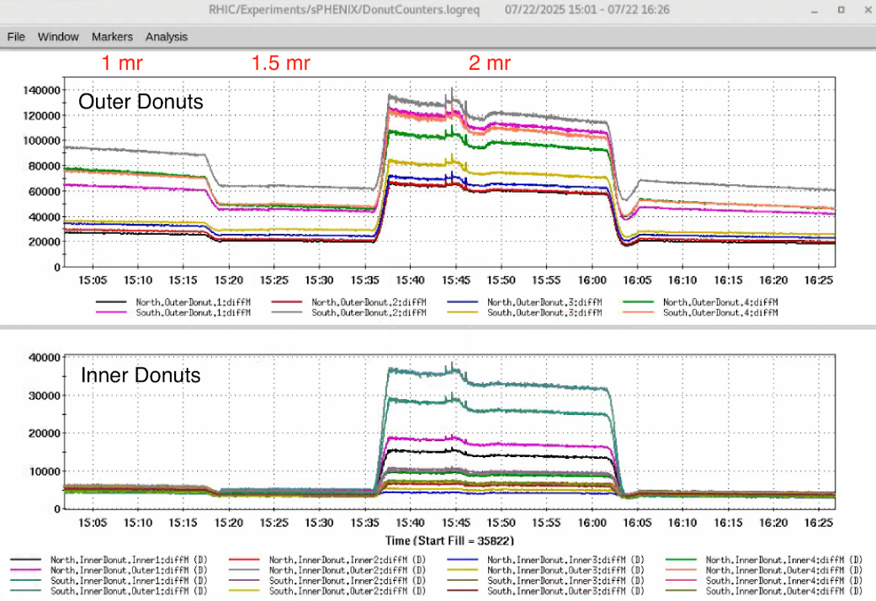
sPHENIX Status & Performance (cont.)
High crossing angle scan
was done ~ July 22. The
conclusion (from TPC et. al.) is
that we’ll stick with 1 mrad.
In the recent month/weeks,
we have increased the level of
offline QA to verify the quality
of the data we’ve taken.
Data transfer to SDCC/HPSS is still being optimized almost daily.
  We have also written and run additional monitoring/analysis software to better quantify the data transfer every day.

Slide 4
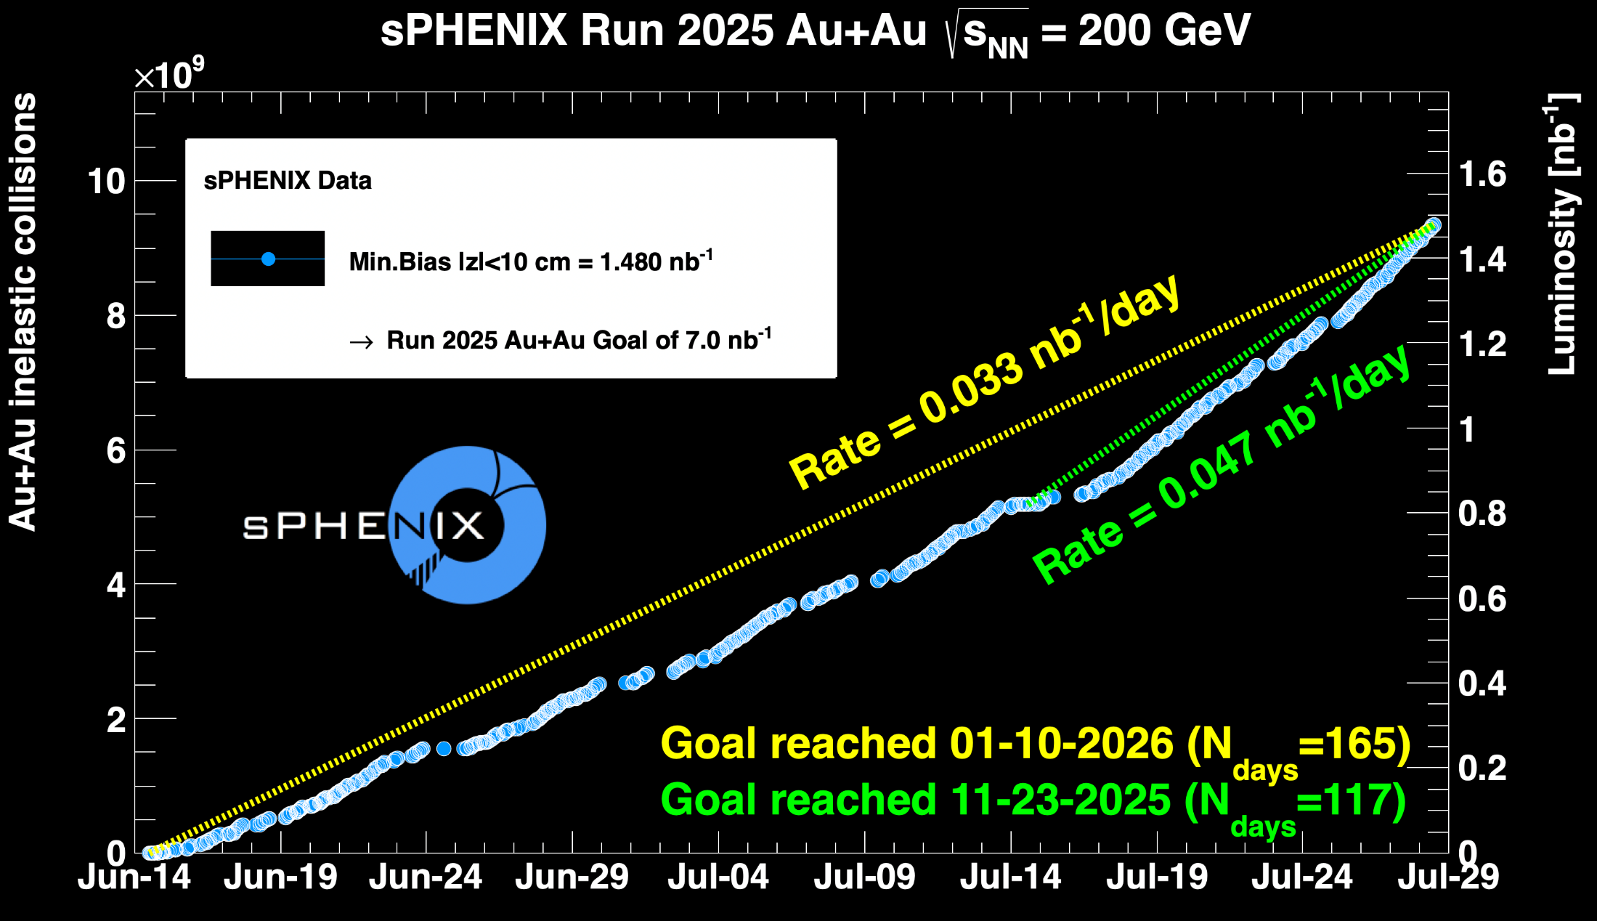
sPHENIX Status & Performance (cont.)

