Slide 1
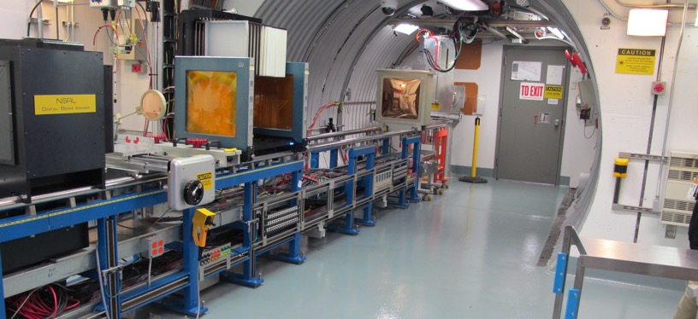
NSRL Time Meeting Report
29 July 2025
Michael Sivertz

Slide 2
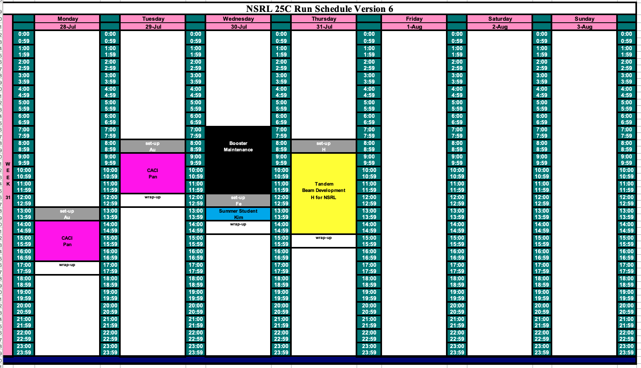
Schedule for this week

Slide 3
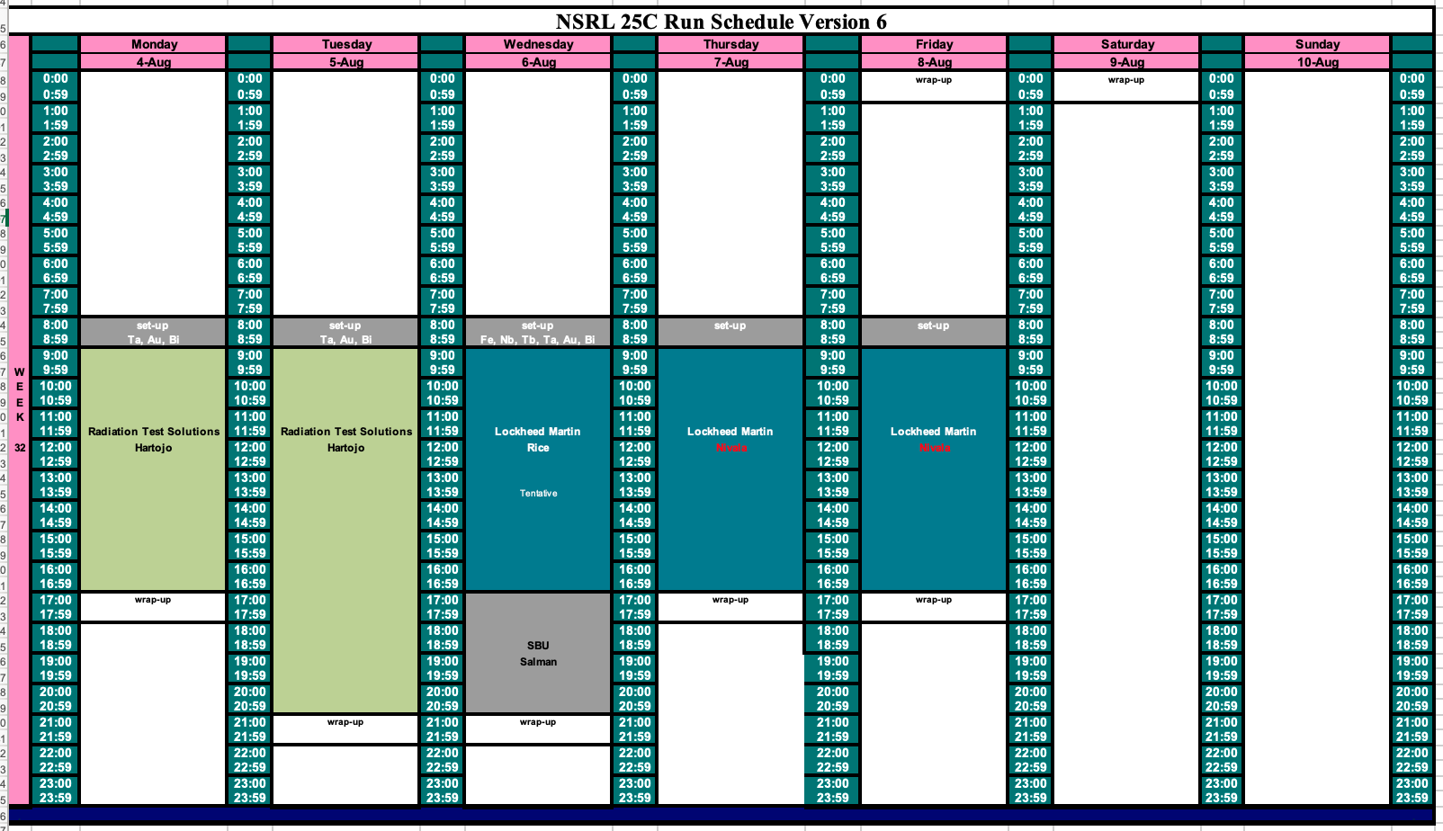
Schedule for next week

Slide 4
Future Schedule
We finished today with our only researchers for the week: CACI.
Need to run Fe @ 600 MeV/n for a summer student project on Wednesday.
Need to work with Tandem to develop protons from Tandem for a group scheduled for 6 August. May need to postpone their beamtime until H from Tandem is possible.
The rest of this week is open for EBIS development of Au for RHIC.
Heavy ion beams required all next week.

