Slide 1
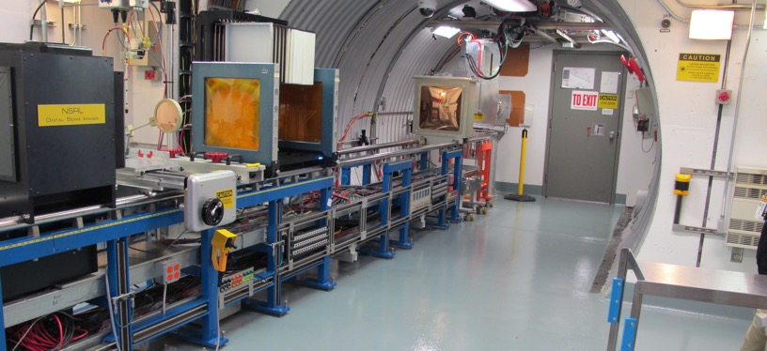
NSRL Time Meeting Report
29 July 2025
Michael Sivertz

Slide 2
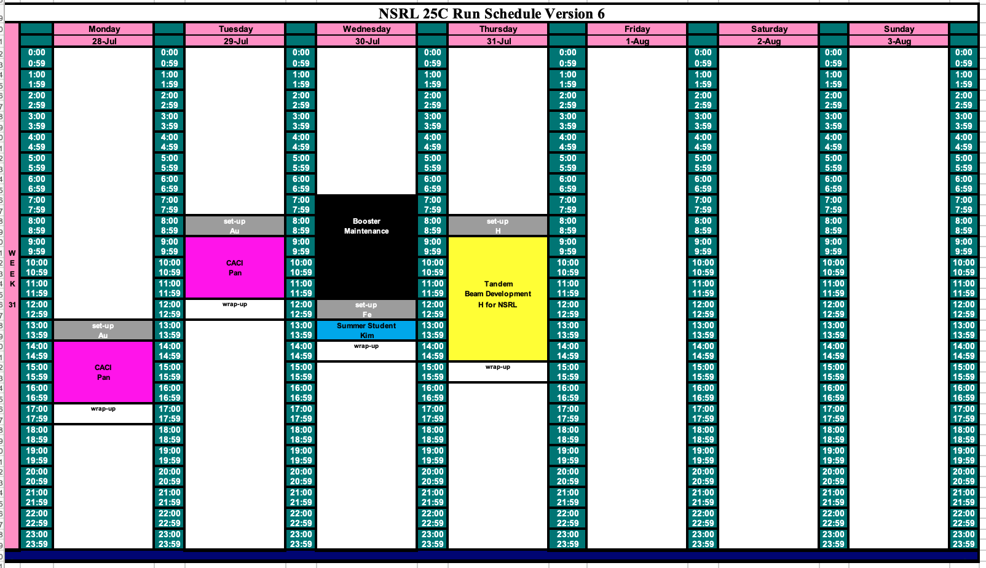
Schedule for this week

Slide 3
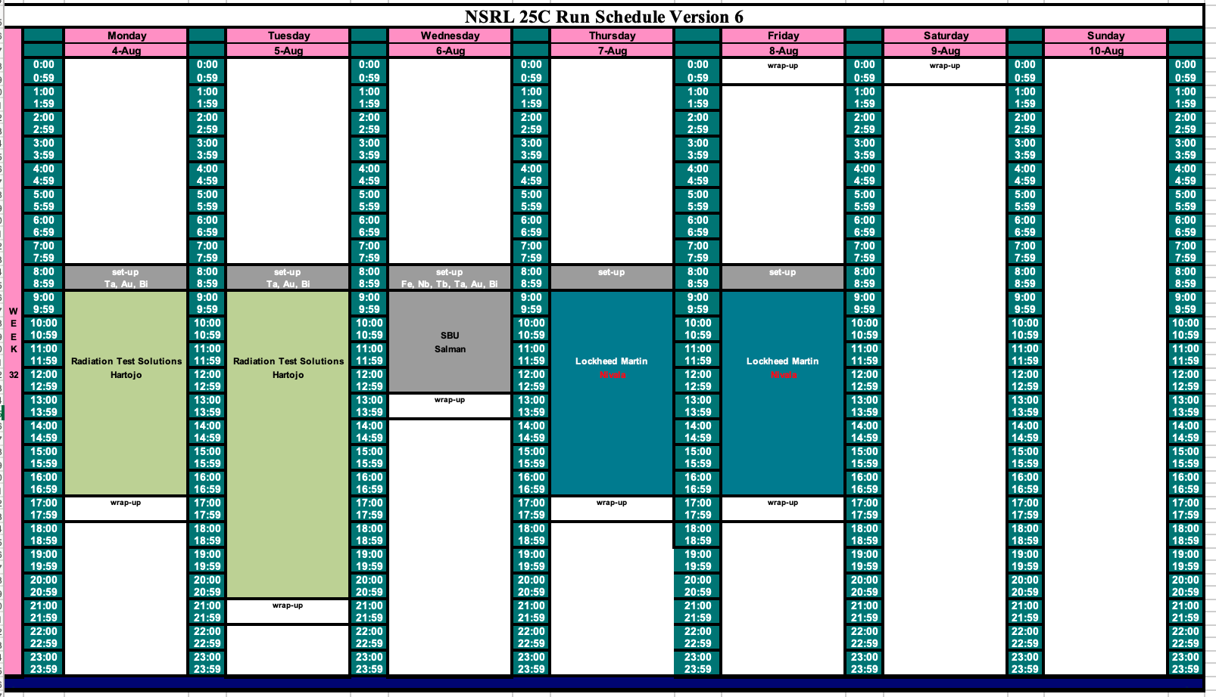
Schedule for next week

Slide 4
Future Schedule
We finished today with our only researchers for the week: CACI.
Need to run Fe @ 600 MeV/n for a summer student project on Wednesday.
Lockheed Martin scheduled for 6 August needs high intensity protons from LINAC. They are postponing their beamtime until LINAC is back.
The rest of this week is open for EBIS development of Au for RHIC.
Heavy ion beams required all next week.

