Slide 1
Data courtesy C. Naylor

Slide 2
Data courtesy C. Naylor

Slide 4
Data courtesy C. Naylor

Slide 5
Data courtesy C. Naylor

Slide 6
Data courtesy C. Naylor

Slide 7
Data courtesy C. Naylor

Slide 8
Data courtesy C. Naylor

Slide 9
Data courtesy C. Naylor

Slide 10
Data courtesy C. Naylor

Slide 11
Operations for BLIP
No BLIP
this past week
BLIP remains in shutdown.
Linac off since 8 July.
Notes:
BLIP plot from LogView /MCR/PerformanceStats/timeMeetingBLIP.lvdisp
Avail calc on nsrl time Excel sheet

Slide 12
NSRL activity past week: 7/22-29/2025 (as of 0800)
NSRL running continues.
Various user time and beam development continuing.
ions only (7: Si, Fe, Nb, Ag, Tb, Tandem Au, Bi) delivered to NSRL.
Run 25-C began 30 June; 25-C schedule posted, updates forthcoming through 1 October.
Availability: 84.7%
Notes:
Graph and avail calc from nsrl time.xlsx

Slide 13
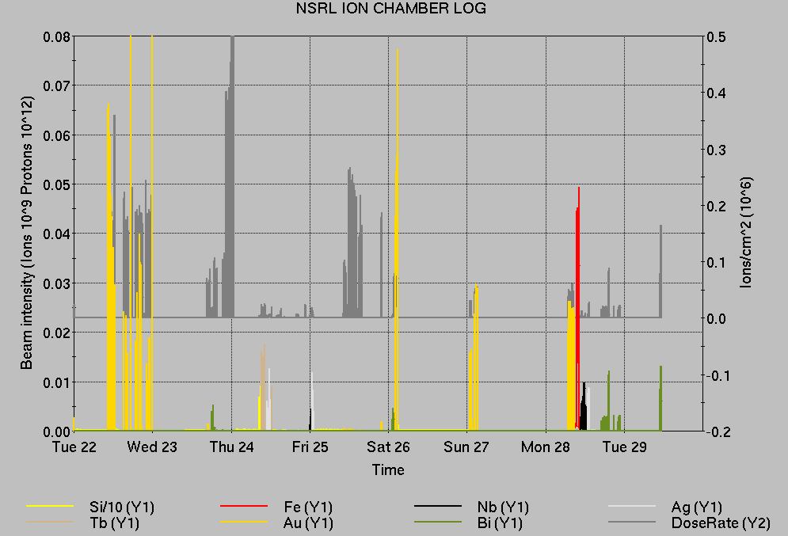
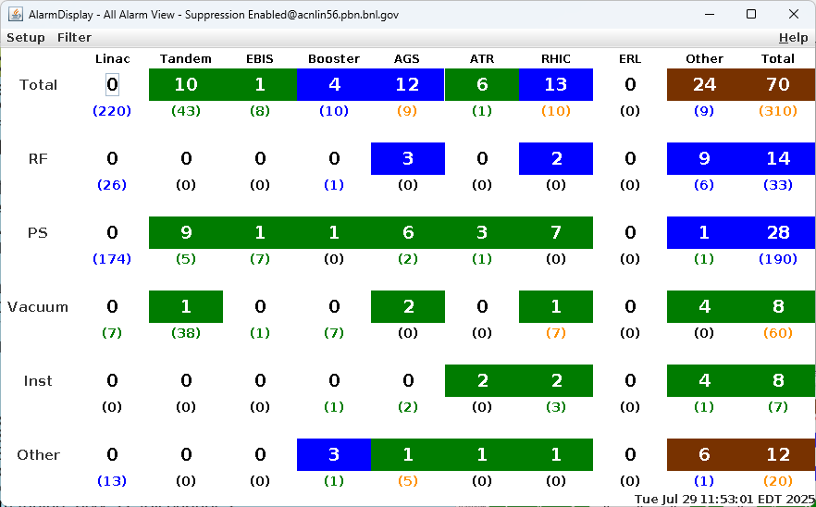
Notes from Operations
Notable failures (>1 hr)
AGS Main Magnet PS trip on flow rate, pump and
solenoid replaced
Beam abort, NQBPS and QLI for yi6-qd2
overtemp fault
Beam abort, 9A alcove communication/FEC
failures
STAR access (2x); trigger system, EMCal issues
Yellow QLI, y05-qd1-ps buffer card replaced
56MHz permit/beam abort (3x), access for chiller
repair. Cryo heat at FPC; system remains off
yarc90-ps failure, blower motor fuse replaced
Stand-down for severe weather; ensuing power
dips, flooding, and recovery of issues site-wide
Tandem beamstop issues
Beam abort, NQBPS (2x); 1 possible power dip, 1 undiagnosed
Beam abort, Cryo lead flow. Sector 5 PLC supply replaced
AGS G10 kicker PS stability issues, ongoing
Other notes
AGS G09C extraction BLW PS remains in local control only
BLM abort (2x); BA1 RF trip, yellow beam lost tune lock
RF group work on AGS stations KL, K, B, DE, L
cfe-h10-corr1 failure, replaced processor
Other various trips, resets
Over 57 hours CeC shifts with beam; additional injector beam for
Au setup, Operator training (when injector systems are available)
Notes:
NSRL plot from LogView /MCR/PerformanceStats/timeMeetingNSRL.lvdisp, select Dose Rate and ion species in use
Screenshot of AlarmSummary

Slide 14
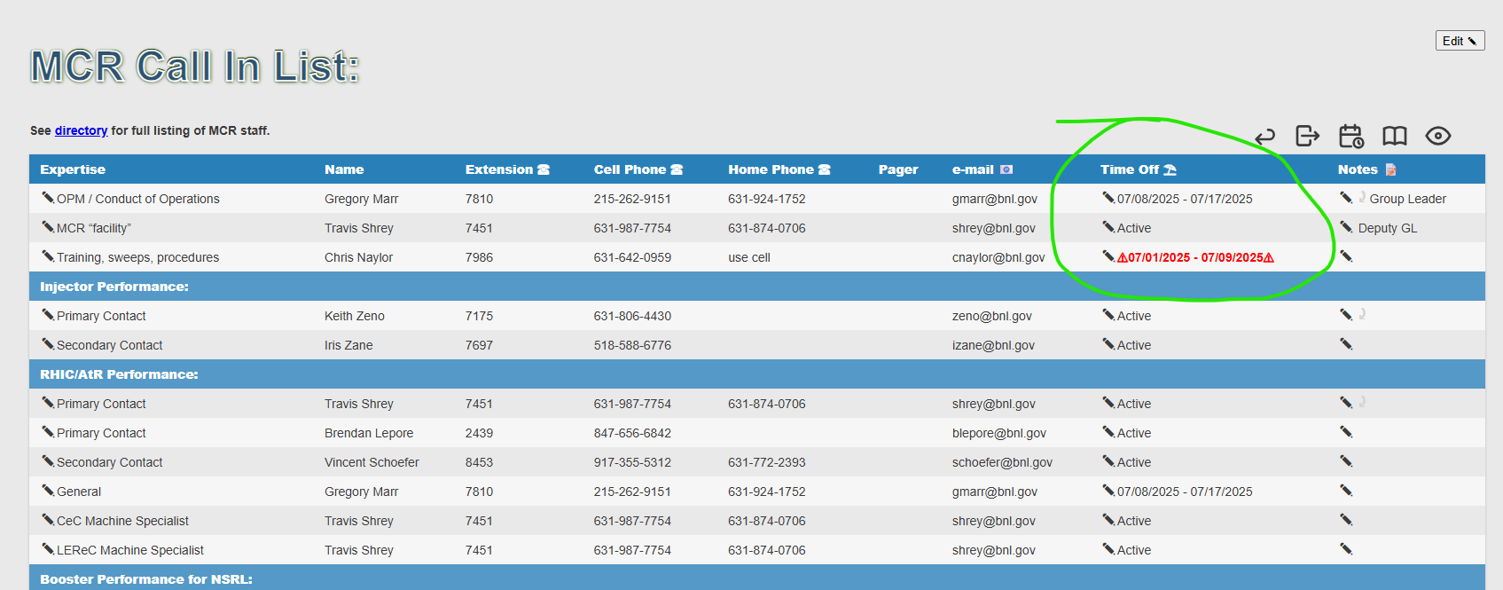
Reminder from Operations
MCR beam operations continue
  RHIC physics running continues
    Tandem remains sole provider of Au31 for RHIC
  Operator/OC shifts continue for NSRL users, 1 shift/2 days this week, 5 days/2 shifts next.
    Au31 from Tandem for higher intensity; no proton beams; Ion beams from EBIS.
  AGS tuning, other studies to continue behind stores as time allows.
  MCR on duty 24/7.
Changes? Time to update is now.
Expect calls at all hours.
  Alarm response instructions: need updates
  http://directory.pbn.bnl.gov/ CHECK AND EDIT
  YOUR OWN CONTACT INFO
  https://www.cadops.bnl.gov/Operations/personnel/call_in_lists/
    CHECK YOUR CALLIN LIST: expect contact off-hours
    Summer is vacation time! Make sure your list is accurate

Slide 15
Keytree notes
Remote keytree systems require a database lookup to validate and authorize distribution of keytokens. The Keytrak system’s database is available for lookup functionality, but can no longer be modified in any way to add or edit qualified personnel.
Personnel affected:
New employees, experimenters arriving after 12/1/2024 could not be enrolled in database
Existing employees & experimenters, not already enrolled, cannot be added or modified in database
Remote keytrees affected:
Iris scan @NSRL
BNLID scan @AGS South gate, North Conjunction Gate
Iris scan @RHIC STAR, sPHENIX, IP12, IP4
Keytrees NOT affected:
BNLID scan @Linac, Booster
BNLID scan @RHIC IP2
MCR keytrees

Slide 16
Keytree notes, continued
Mitigation:
Choose entrants that are currently enrolled to perform the work in the enclosure under Controlled Access (CA).
Obtain CA keys from MCR for remote gate watch
Arrange for local gate watch using other tokens for entrants.
Arrange for Restricted Access, and allow for delays incurred to sweep areas.
CAUTION
Follow procedures. Gate Watch staff will remain vigilant.
  No “piggy-backing” – one key/token per entrant.
  Access keys are not candy! Authenticated entrant retains possession.
Radiological Controls and the Access Controls System are not to be circumvented. This is (has been) enforced with disciplinary action (dismissal).

Slide 18
Notes:
Reliability comparisons to previous runs

Slide 19
Notes:
Reliability comparisons to previous runs

Slide 20
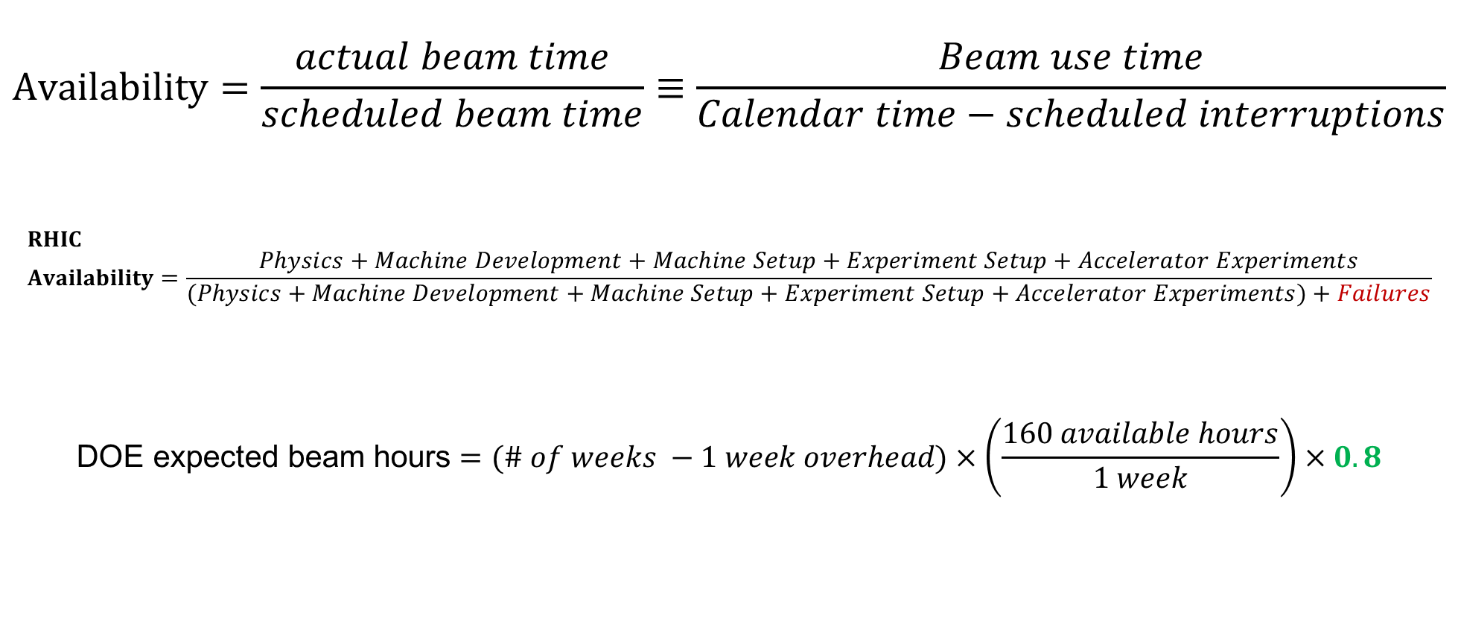
Availability, expected beam hours
$$Availability=\frac{actual beam time}{scheduled beam time}≡\frac{Beam use time}{Calendar time−scheduled interruptions}$$
$$RHIC \\ Availability=\frac{Physics+Machine Development+Machine Setup+Experiment Setup+Accelerator Experiments}{(Physics+Machine Development+Machine Setup+Experiment Setup+Accelerator Experiments)+Failures}$$
$$\text{DOE} \text{expected} \text{beam} \text{hours}=(\# of weeks −1 week overhead)×\left(\frac{160 available hours}{1 week}\right)×0.8$$
Notes:
Normally hidden. Explains how the 85% from DOE comes in to play, & general availability metrics

