Slide 1

Time Meeting
Accelerator Operations Support

Slide 2

Maintenance Tomorrow: 0600-1400hrs
LINAC Z1 and Z2 remain in RA (Shutdown), Z3 and Z4 Opened am
Booster and AGS: Controlled Access
RHIC: early AM Restricted Access to most areas
Early Sweeps and Physics restoration

Slide 3
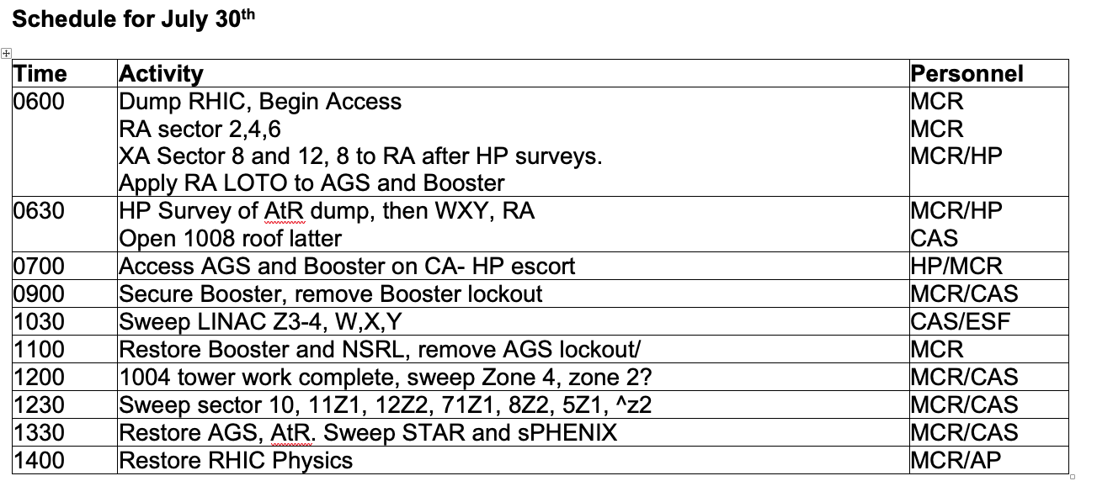

Slide 4

Planning and scheduling
Here and streaming
at 3pm
Anyone with work – send a representative

