Slide 1
APEX Report
Time Meeting, July 29, 2025

Slide 2
July 23 Session
Planned APEX time:
9am-11pm, totally 14 + 1 hours, 1 hour for back-to-physics.
Actual time:
1) Started at 9am and ended at 4:30pm, totally 7.5 hours
2) We had a quench at the end of experiment.
3) Back to physics was tough after APEX
Main activities this session
1) Second fill ( 35828): 28 bunches, initially 0.8e9/bunch.
2) With stochastic cooling, 13:1 emittance ratio was obtained.
3) 11:1 emittance ratio was maintained on acceleration 31->100GeV.
4) 11:1 emittance ratio was maintained at store for almost 2 hours with ramp tunes (0.238, 0.212) and HSR collision tunes (0.228, 0.210).
5) measured dQmin and coupling angles at store.
6) quench happened when doing resonance stop-band measurement.

Slide 3
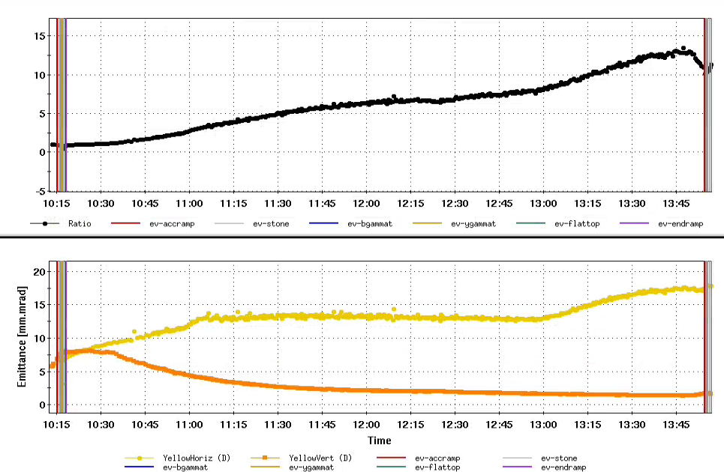
Cooling Au beam to 13:1 emittance Ratio
Strategy I: using low bunch intensity 0.8e9/bunch, vertical cooling faster
Strategy II: using H stochastic cooling to blow up horizontal emittance
Emittance ratio gain mainly from horizontal emittance increase
Emittance ratio gain mainly from vertical emittance decrease

Slide 4
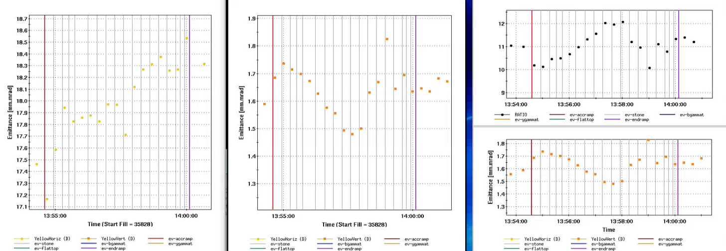
Accelerating Flat Beam from 31->100GeV
Horizontal
Emittance
Vertical
Emittance
Emittance
Ratio
Vertical
Emittance

Slide 5
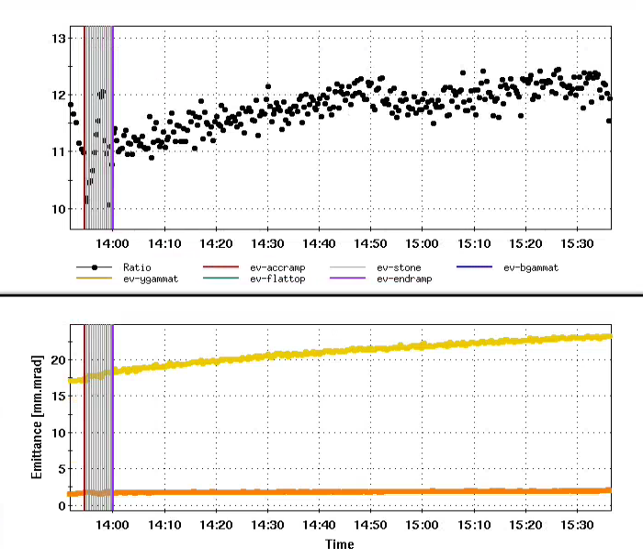
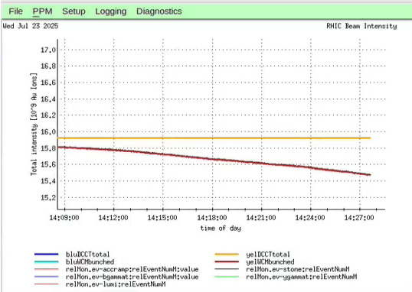
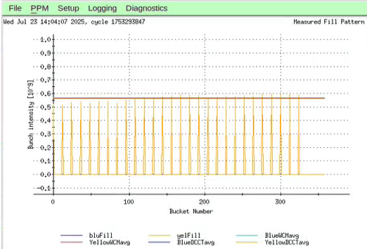
Observing at Store for about 1 hour 45 mins
Debunched beam
Tunes (0.238,0.212)
Tunes (0.228,0.210)
0.56e9/bunch

Slide 6
