Slide 1
Preinjector Status
D. Raparia
Time Meeting
August 05, 2025

Slide 2
Tandem
MP7- RHIC support
Summer Sunday at Tandem was very successful , 800 visitors and came back quickly to fill RHIC
Track to replace terminal foils next week
- MP6 –External User
providing ions for external users this week
Au similar intensity were extracted from AGS
Start Au beam for Booster on Thursday- Friday

Slide 3
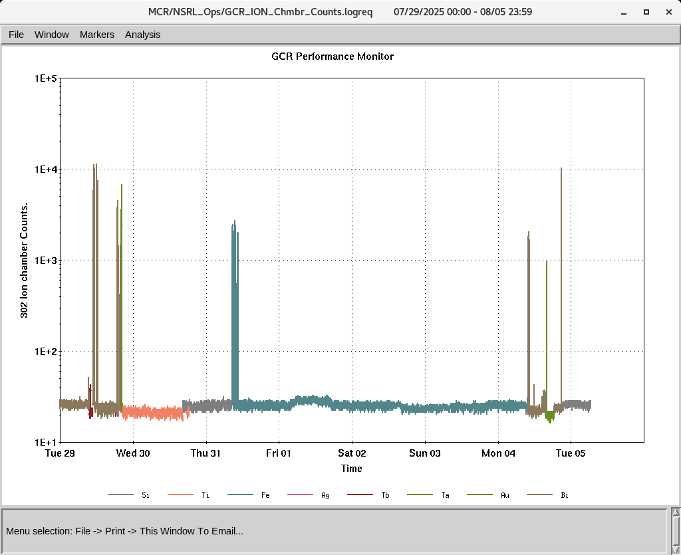
EBIS
Electronics testing continues
Vacuum issues were resolved over the weekend
Worked on Au develop gold beams
Working on USI for H₂⁺, H₃⁺
IONS to NSRL
Si^{+11 ,}Ti⁺¹⁷, Fe⁺²⁰ , Ag⁺²⁹, Ta^{+38,} Au^{+31,43}, Bi⁺⁴⁷

