Slide 1
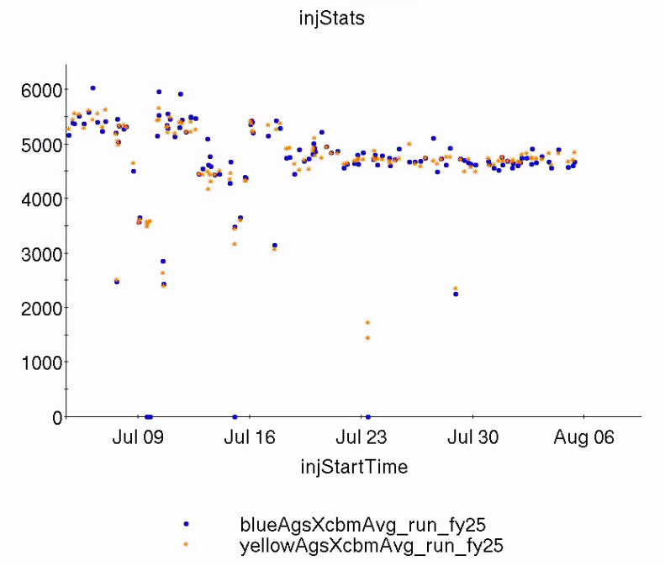
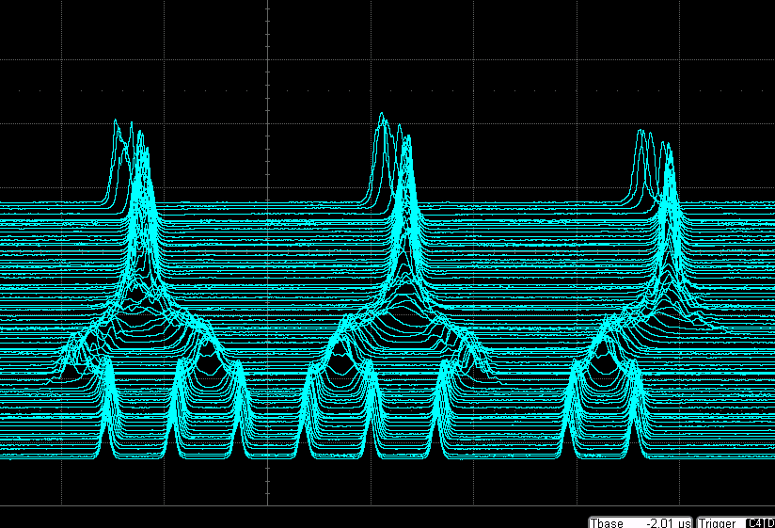
Injector Status: Time meeting 8/5/25
AGS delivering well for RHIC stores: ~2.3x10⁸/bunch in two bunches/AGS cycle.
Modified Booster/AGS merge scheme
3 Booster bunches → 1 AGS bunch
Results in 3 bunches per AGS cycle
Minimize IBS blowup, debunching at RHIC injection
Third AGS bunch is only from 2 Booster bunches: Tandem source pulse can be increased to even out per bunch intensity
Used for fill #35888 (8/4 ~1600)
AGS Extraction Intensity by Fill
Intensity (10⁶)
AGS merges

