Slide 1
sPHENIX Status
Kin Yip
sPHENIX Director of Operations
Time Meeting
Aug. 5, 2025

Slide 2
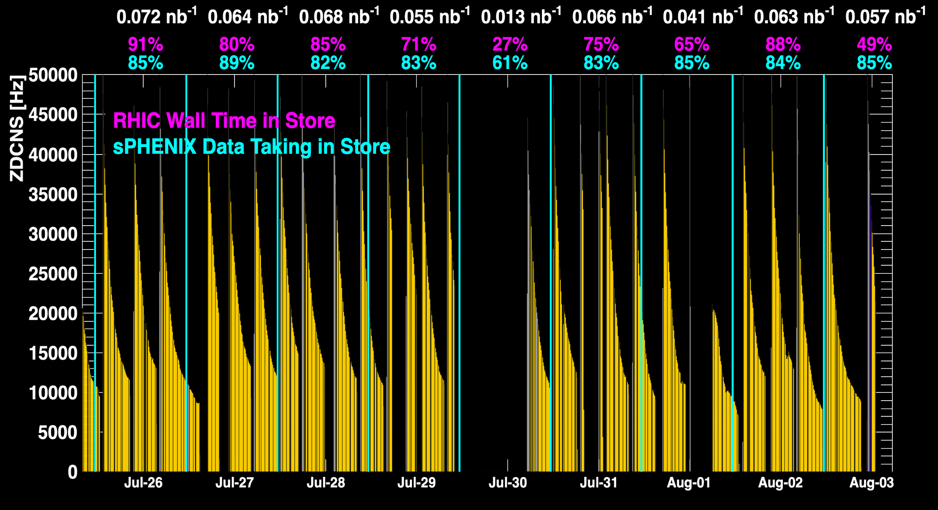
sPHENIX Status & Performance
July 26 was one of the best days yet !
When all sPHENIX detectors were being operated.

Slide 3
sPHENIX Status & Performance (cont.)
sPHENIX continues to make efficient use of the available beam time.
Optimization of data migration from sPHENIX to SDCC: July 31, our DAQ expert declared that all back-logged transfers were cleared.
Maintaining high throughput data taking (>30GB/s) while transferring to SDCC, our DAQ experts are still making small adjustment from time to time.
Detector experts are also finding ways to make operation more efficient. E.g. TPC/INTT experts are looking for way(s) to speed up their high-voltage ramping at the beginning of a store.

Slide 4
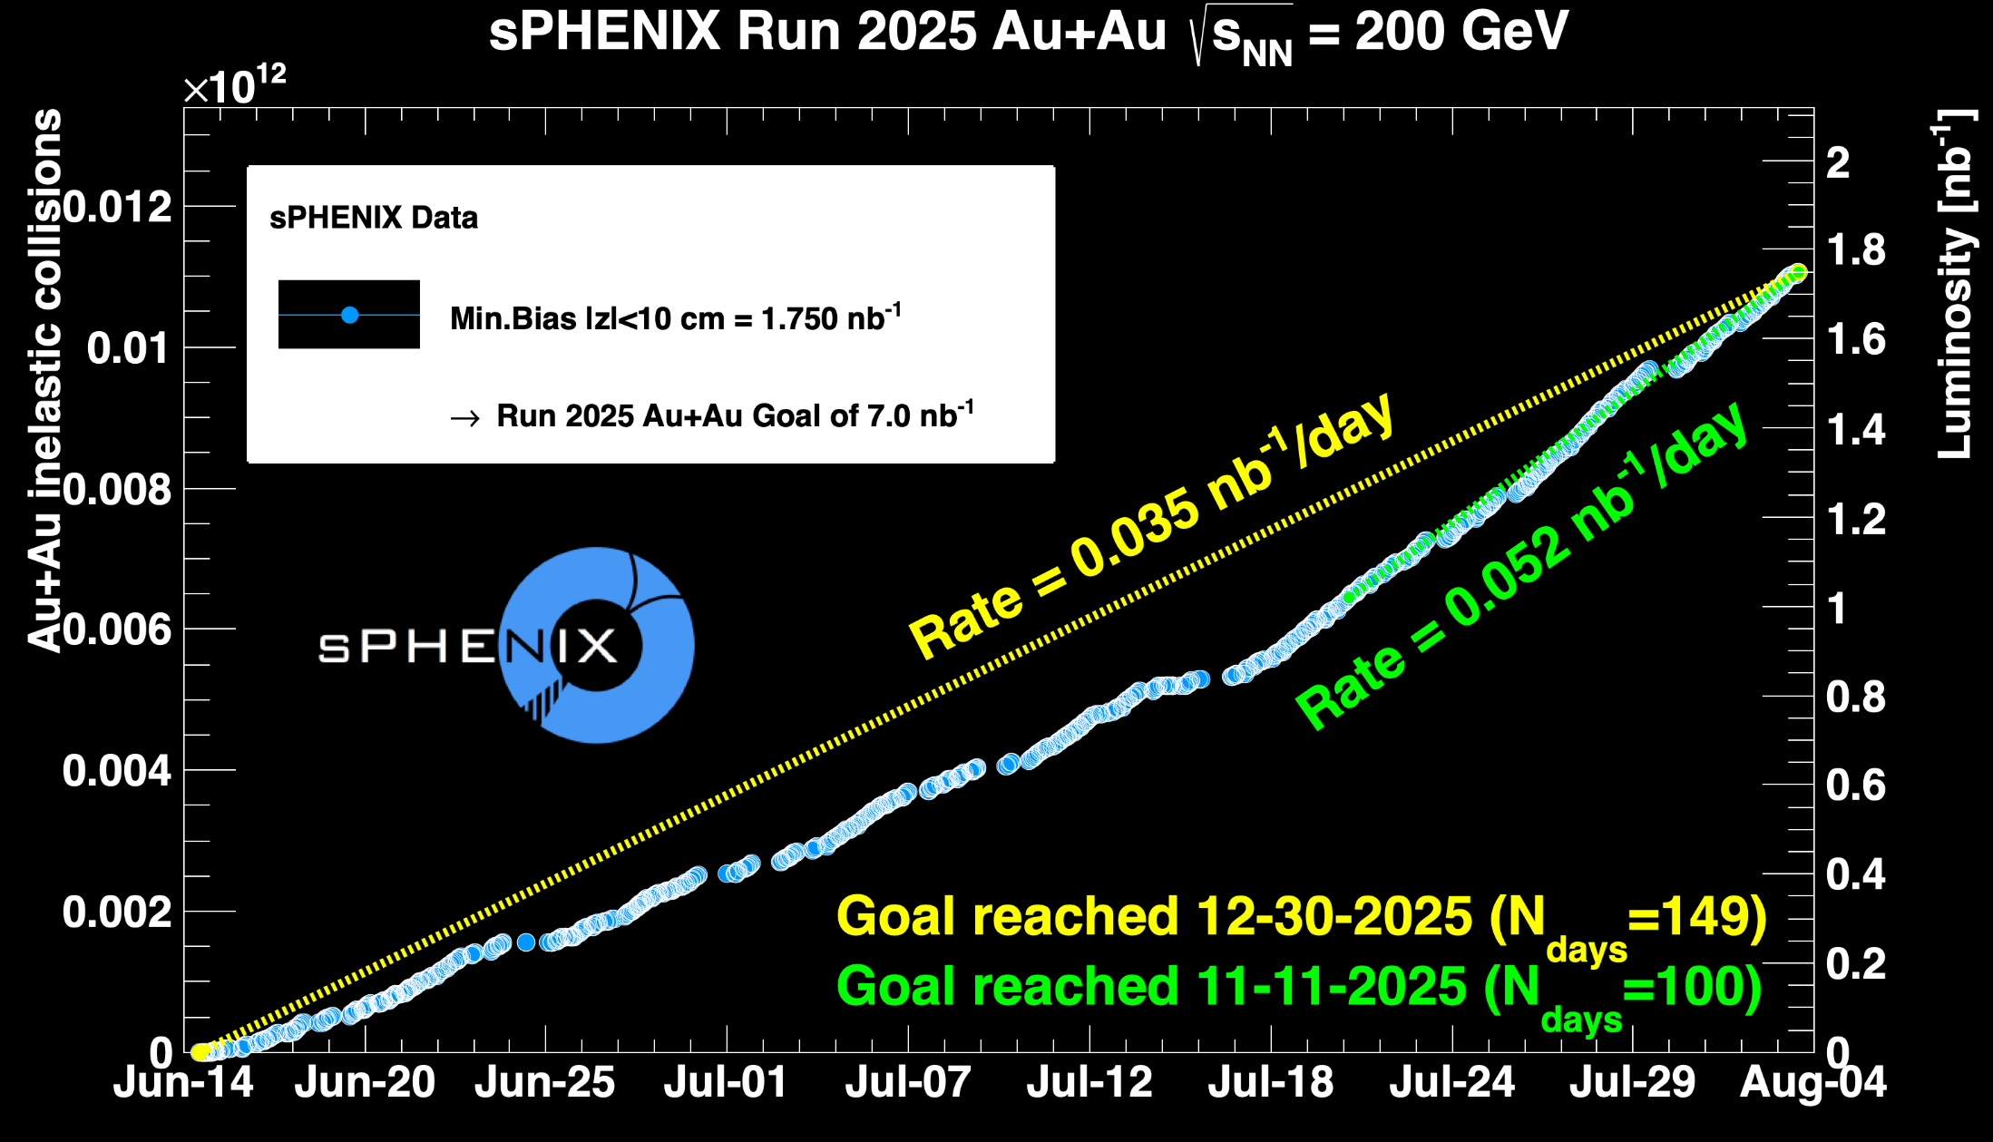
sPHENIX Status & Performance (cont.)

