Slide 1
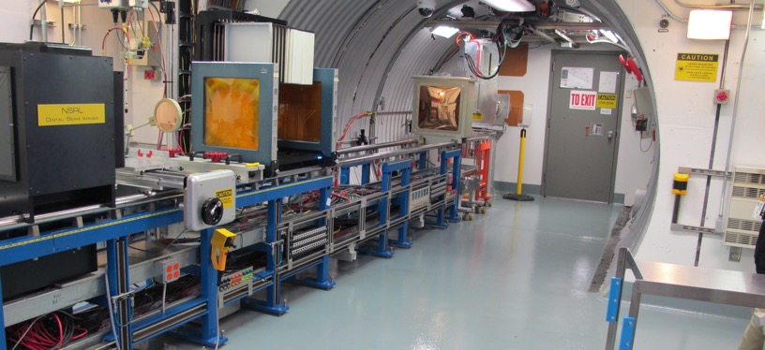
NSRL Time Meeting Report
5 August 2025
Michael Sivertz

Slide 2
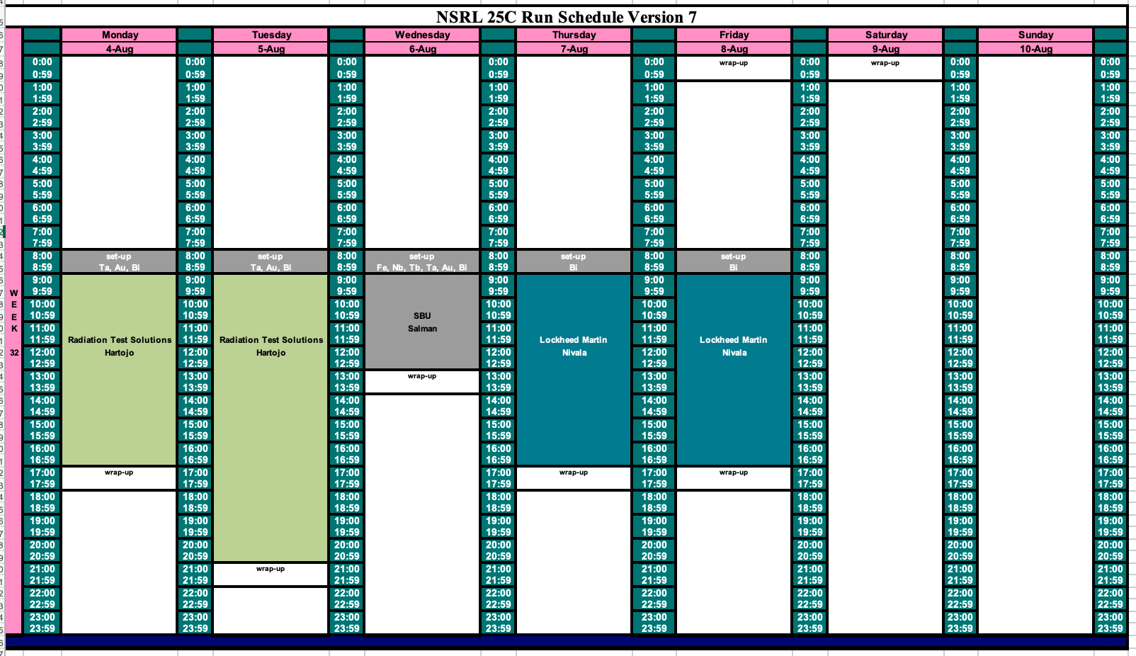
Schedule for this week

Slide 3
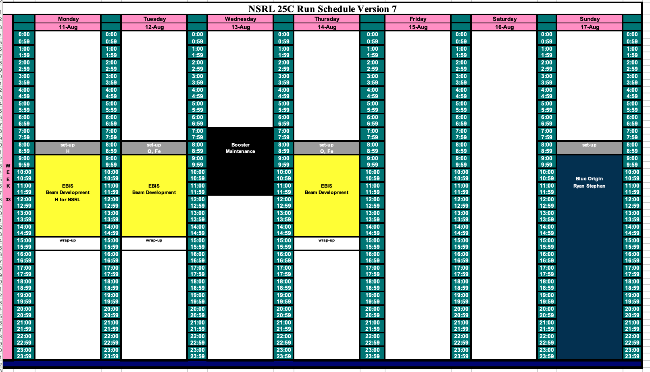
Schedule for next week

Slide 4
Future Schedule
We are running Ta, Au and Bi for Radiation Test Solutions this week.
Wednesday we have a wide variety of ions, Fe, Nb, Tb, Ta, Au, and Bi for Stony Brook studying the impact of heavy ion LET on Artificial Intelligence.
Thursday and Friday we require only Bi for Lockheed-Martin.
Next week is available to EBIS for beam development of Au for RHIC and beam studies for NSRL using Oxygen and Iron.
Sunday 17 August begins a week-long run of 16-hour days for Blue Origin.

