Slide 1
Data courtesy C. Naylor

Slide 2
Data courtesy C. Naylor

Slide 3
Data courtesy C. Naylor

Slide 5
Data courtesy C. Naylor

Slide 6
Data courtesy C. Naylor

Slide 7
Data courtesy C. Naylor

Slide 8
Data courtesy C. Naylor

Slide 9
Data courtesy C. Naylor

Slide 10
Data courtesy C. Naylor

Slide 11
Data courtesy C. Naylor

Slide 12
Data courtesy C. Naylor

Slide 13
Operations for BLIP
No BLIP
this past week
BLIP remains in shutdown.
Linac off since 8 July.
Notes:
BLIP plot from LogView /MCR/PerformanceStats/timeMeetingBLIP.lvdisp
Avail calc on nsrl time Excel sheet

Slide 14
NSRL activity past week: 7/29-8/5/2025 (as of 0800)
NSRL running continues.
Various user time and beam development continuing.
8 species (H Si, Ti, Fe, Ag, Ta, Au, Bi) logged to NSRL.
Run 25-C began 30 June; 25-C schedule posted, updates forthcoming through 1 October.
Availability: 92.4%
Notes:
Graph and avail calc from nsrl time.xlsx

Slide 15
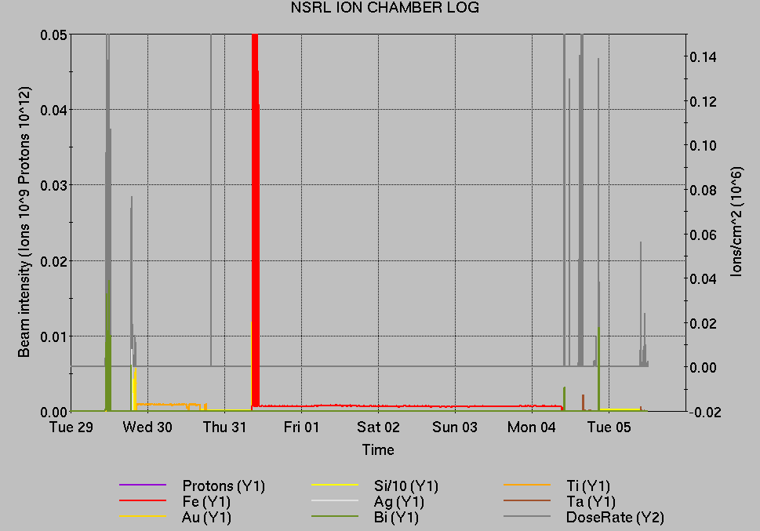
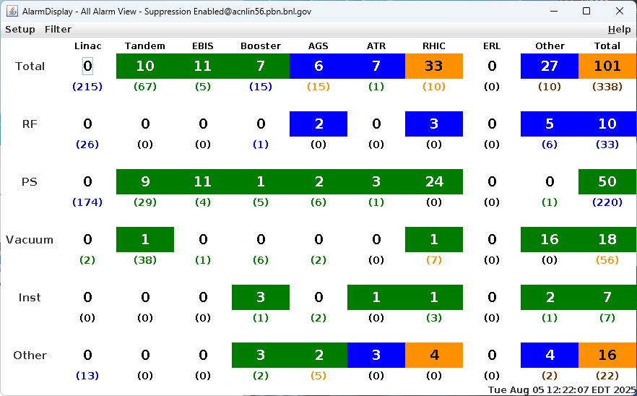
Notes from Operations
Notable failures (>1 hr)
bi5-tq4 trip on gas cooled lead, cooling coefficients
changed
yo1-octd-ps failed after maintenance, replaced 2x
Tandem source failure, focusing lens replaced
Weather stand down, included power dip affecting
various systems
bi5-qf9-ps failure/beam abort; regulator cards
replaced
Power dip, not storm related
BLM abort at rebucketing, Blue storage cavity
issues
Yellow abort kicker failure, f/o transmitter replaced
Vacuum beam abort, fuse assembly repaired
EBIS collector trip, recovery tape unsuccessful.
Other notes
BLM abort, loss monitor failed, masked until repair
G10 kicker thyratron issues, addressed in maintenance
Booster D6 septum temperature issues
Other various trips, resets
Over 78 hours CeC shifts gun conditioning; additional injector beam for
Au setup, Operator training (when injector systems are available)
Notes:
NSRL plot from LogView /MCR/PerformanceStats/timeMeetingNSRL.lvdisp, select Dose Rate and ion species in use
Screenshot of AlarmSummary

Slide 16
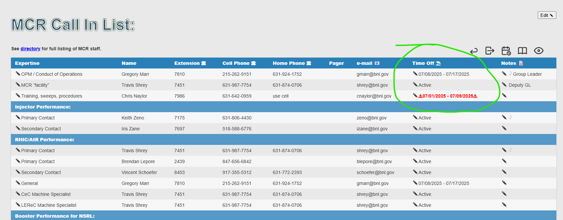
Reminder from Operations
MCR beam operations continue
  RHIC physics running continues
    Tandem remains sole provider of Au31 for RHIC
  Operator/OC shifts continue for NSRL users, 5 days/1-2 shifts this week; MD only next.
    Au31 from Tandem for higher intensity; no proton beams; Ion beams from EBIS.
  AGS tuning, other studies to continue behind stores as time allows.
  MCR on duty 24/7.
Changes? Time to update is now.
Expect calls at all hours.
  Alarm response instructions: need updates
  http://directory.pbn.bnl.gov/ CHECK AND EDIT
  YOUR OWN CONTACT INFO
  https://www.cadops.bnl.gov/Operations/personnel/call_in_lists/
    CHECK YOUR CALLIN LIST: expect contact off-hours
    Summer is vacation time! Make sure your list is accurate

Slide 17
Keytree notes
Remote keytree systems require a database lookup to validate and authorize distribution of keytokens. The Keytrak system’s database is available for lookup functionality, but can no longer be modified in any way to add or edit qualified personnel.
Personnel affected:
New employees, experimenters arriving after 12/1/2024 could not be enrolled in database
Existing employees & experimenters, not already enrolled, cannot be added or modified in database
Remote keytrees affected:
Iris scan @NSRL
BNLID scan @AGS South gate, North Conjunction Gate
Iris scan @RHIC STAR, sPHENIX, IP12, IP4
Keytrees NOT affected:
BNLID scan @Linac, Booster
BNLID scan @RHIC IP2
MCR keytrees

Slide 18
Keytree notes, continued
Mitigation:
Choose entrants that are currently enrolled to perform the work in the enclosure under Controlled Access (CA).
Obtain CA keys from MCR for remote gate watch
Arrange for local gate watch using other tokens for entrants.
Arrange for Restricted Access, and allow for delays incurred to sweep areas.
CAUTION
Follow procedures. Gate Watch staff will remain vigilant.
  No “piggy-backing” – one key/token per entrant.
  Access keys are not candy! Authenticated entrant retains possession.
Radiological Controls and the Access Controls System are not to be circumvented. This is (has been) enforced with disciplinary action (dismissal).

Slide 20
Notes:
Reliability comparisons to previous runs

Slide 21
Notes:
Reliability comparisons to previous runs

Slide 22
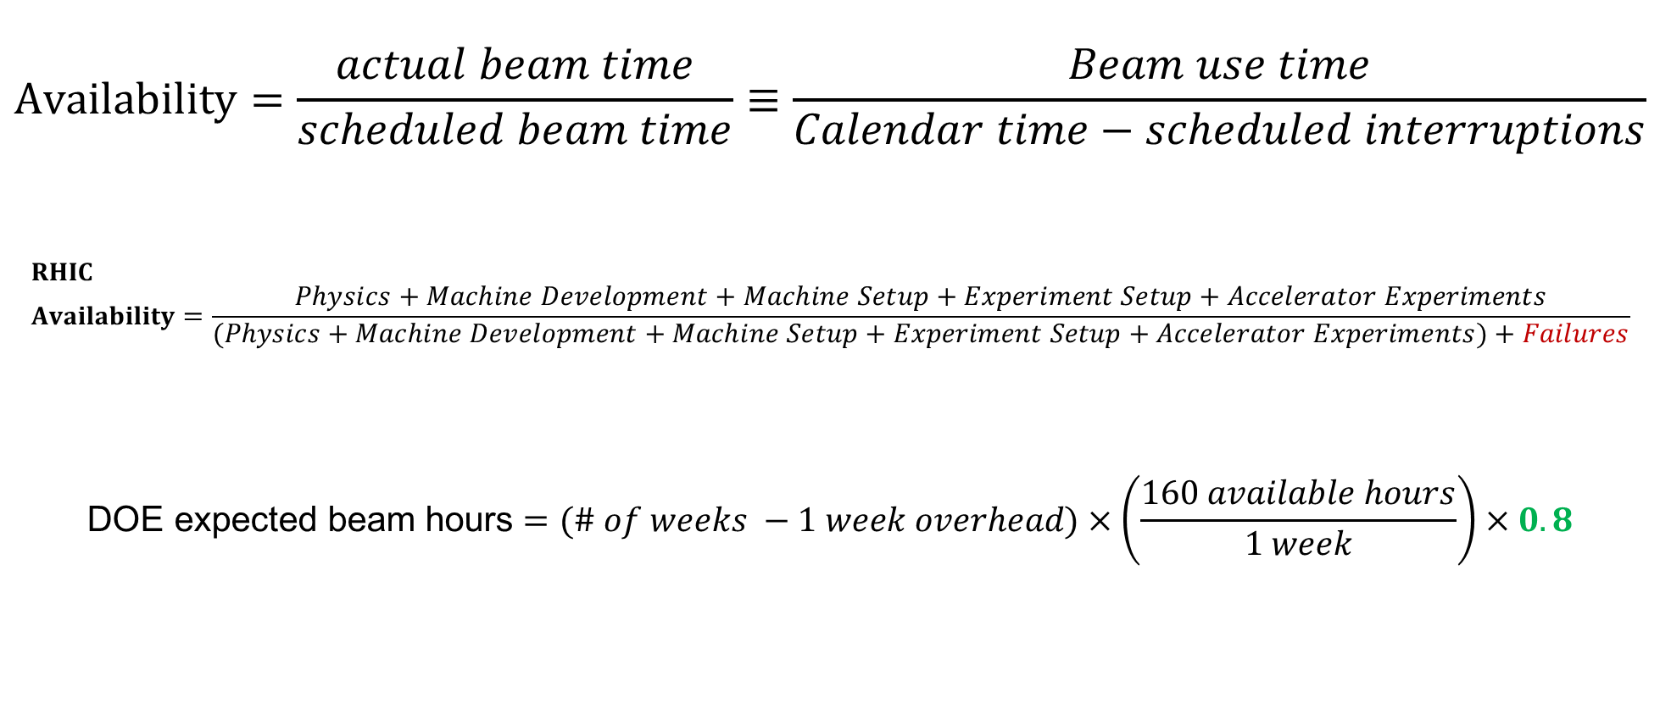
Availability, expected beam hours
$$Availability=\frac{actual beam time}{scheduled beam time}≡\frac{Beam use time}{Calendar time−scheduled interruptions}$$
$$RHIC \\ Availability=\frac{Physics+Machine Development+Machine Setup+Experiment Setup+Accelerator Experiments}{(Physics+Machine Development+Machine Setup+Experiment Setup+Accelerator Experiments)+Failures}$$
$$\text{DOE} \text{expected} \text{beam} \text{hours}=(\# of weeks −1 week overhead)×\left(\frac{160 available hours}{1 week}\right)×0.8$$
Notes:
Normally hidden. Explains how the 85% from DOE comes in to play, & general availability metrics

