Slide 1
TAKE FIVE for Safety-
Legionella
Frank Craner
August 12, 2025

Slide 2
What is Legionella?
Legionnaires' disease is caused by a type of bacteria called Legionella.
The Legionella bacteria are found naturally in the environment, usually in water. The bacteria grow best in warm water, like the kind found in hot tubs, cooling towers, hot water tanks, large plumbing systems, and decorative fountains that are not properly maintained.
People get Legionnaires' disease when they breathe in a mist or vapor (small droplets of water in the air) containing the bacteria.

Slide 3
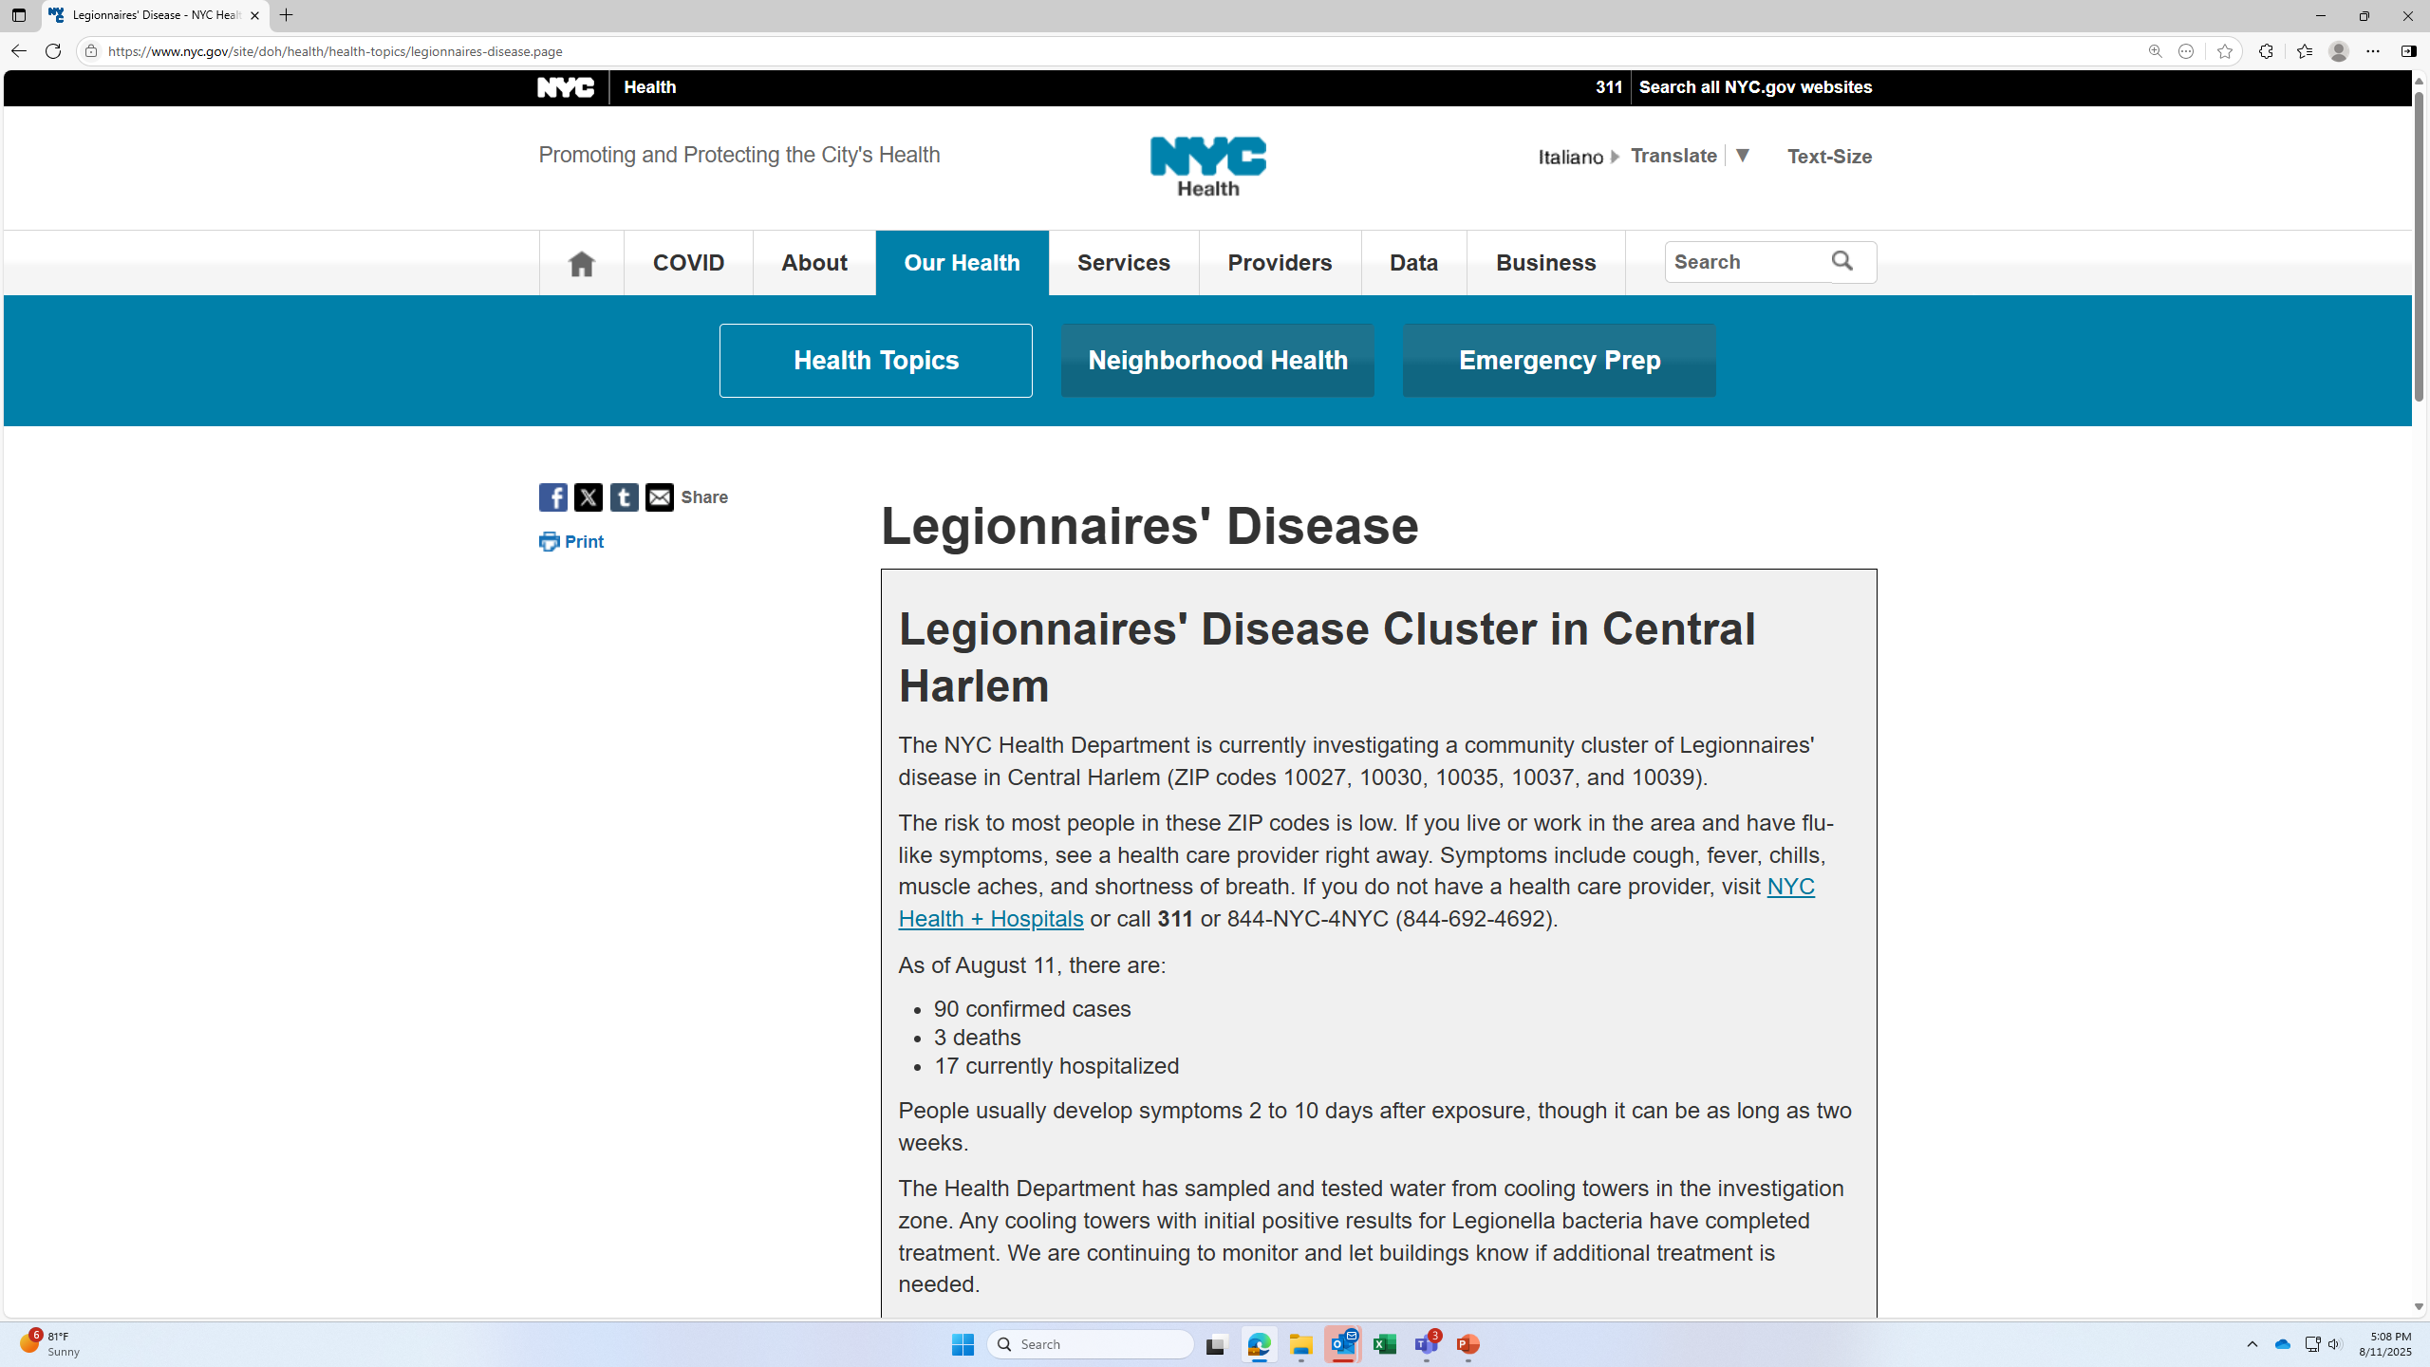
Press Release from NYC Department of Health

Slide 4
Q&A
(NYS Health Department)
Q. How do you get Legionnaires' disease?
A: People can get Legionnaires' disease if they breathe in mist or vapor containing the bacteria. The bacteria are not spread from one person to another person. A person diagnosed with Legionnaires' disease is not contagious.
Patients in health care settings with very weak immune systems may also get Legionnaire's disease when they breathe in water containing the bacteria.
Q. What are my chances for getting Legionnaire's disease if I live in a neighborhood or spend time near a building that tests positive for Legionella?
A: Healthy people, including children, are not likely to get Legionella from being near a cooling tower that tests positive. Legionella is so common in the environment that most people probably have been exposed in the past and not become ill.
People at higher risk of getting sick are those 50 years of age or older, current or former smokers, those with a chronic lung disease (like COPD or emphysema), those with a weak immune system from diseases like cancer, diabetes, or kidney failure, and people who take drugs that suppress (weaken) the immune system (like after a transplant operation or chemotherapy). If you are concerned about your health, you should speak with your health care provider. Symptoms of Legionnaire's Disease may include cough, shortness of breath, high fever, muscle aches, and headaches within 2-10 days after a potential exposure.
Q. Why are cooling towers tested for Legionella?
A: Cooling towers are tested for Legionella bacteria to assess the effectiveness of routine disinfection and maintenance. Legionella is common in the environment and many cooling towers test positive. Certain types of tests may also indicate the presence of organisms that are no longer active.
Sometimes testing is part of an investigation into existing cases of Legionnaire's disease to see if the illnesses are associated with a particular cooling tower. A positive result in a cooling tower does not necessarily mean that people will be exposed to the bacteria in the water of the cooling tower or become ill.
Q. What happens if a cooling tower tests positive?
A: As many as half of the cooling towers are likely to test positive for legionella. A positive test does not mean that people in the vicinity will get sick. In fact, sampling results are a poor indicator of the public health impact of legionella. Positive sampling results mean the owner needs to take corrective measures to decontaminate and disinfect the cooling tower in order to meet industry standards. They then need to retest to confirm that the problem has been addressed.
Q. Do building owners have to report if they have cooling towers?
A: Yes. Under a new state regulation, all owners of cooling towers are required to register their towers, test their towers for bacteria, clean and disinfect after testing, and have a regular maintenance program. Every cooling tower needs to be registered – whether it is at a school, residential building, office building or business. Registration of cooling towers in New York State enables health officials to respond rapidly to outbreaks of Legionnaire's disease and monitor inspections, annual certification, maintenance plans, sample collection and culture testing.

Slide 5
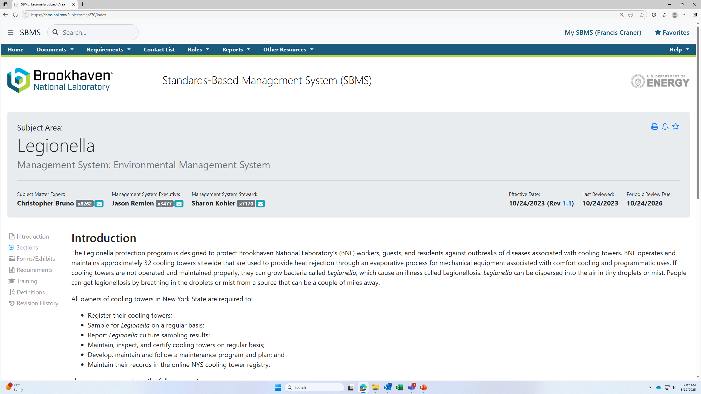
BNL Implementation
SBMS Legionella Subject Area

Slide 6
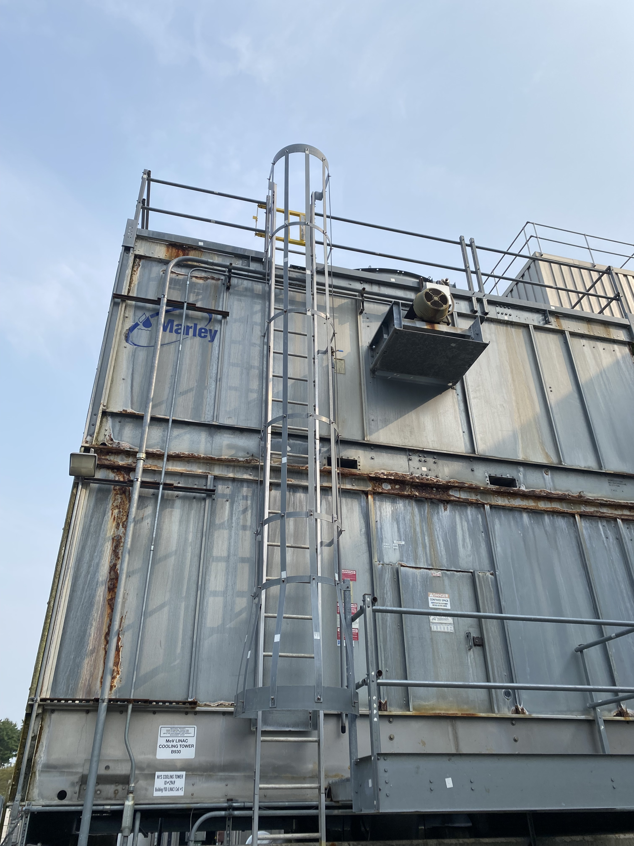
Work Planning/ Worker Safety and Health
Chemical Safety
Confined Space
Hazardous Energy Control
Ladder Safety
Potential Work at Heights
Legionella

Slide 7
Environmental Requirements associated with Chemicals
Chemical Storage Tanks- Article 12
Wastewater Discharges- Wastewater Discharge Limits (“SPDES”)
Pesticide Use Requirements

Slide 8
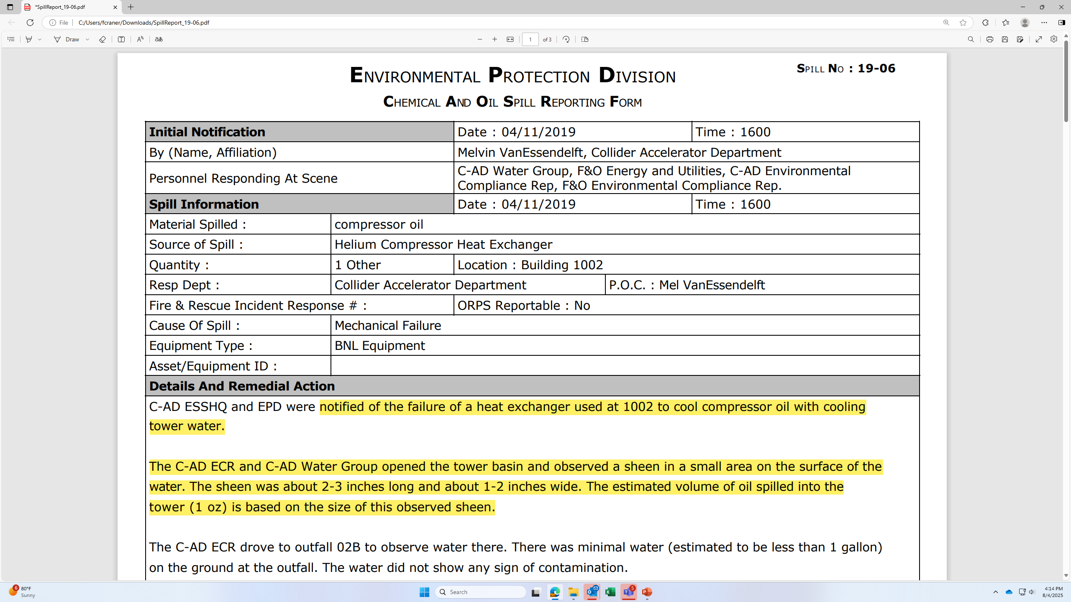
Other Concerns with Chemical Use- Corrosion

