Slide 1
Preinjector Status
J. Ritter/D. Raparia
Time Meeting
August 12, 2025

Slide 2
Tandem
MP7- RHIC support
Running well
Track to replace terminal foils wednesday
- MP6 –External User
Provided a RHIC fill on last Friday
Worked on source
Now sufficient intensity beam at end of TTB ,
Still working on stability

Slide 3
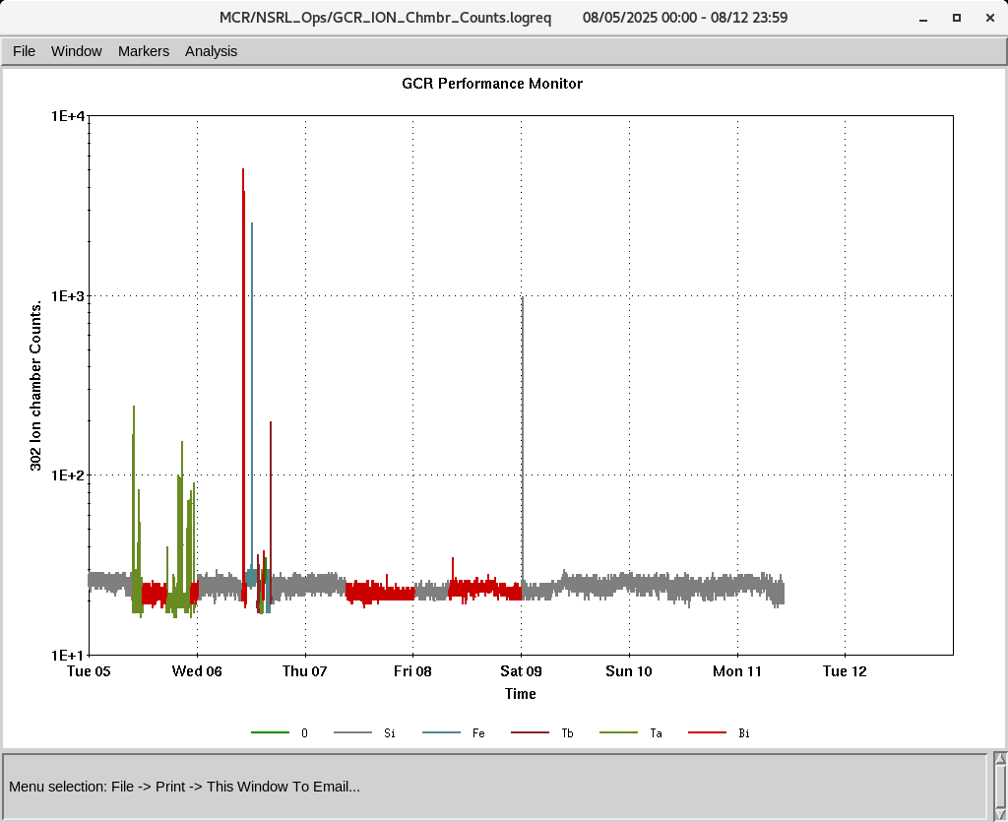
EBIS
Electronics testing continues
Working on proton and H₂⁺
H₂⁺ was seen at end of EtB
Continue to work Proton in booster
IONS to NSRL
O⁺⁵ Si^{+11 ,} Fe⁺²⁰ , Tb⁺³⁵ Ta^{+38,} Bi⁺⁴⁷

