Slide 1
sPHENIX Status
Kin Yip
sPHENIX Director of Operations
Time Meeting
Aug. 12, 2025

Slide 2
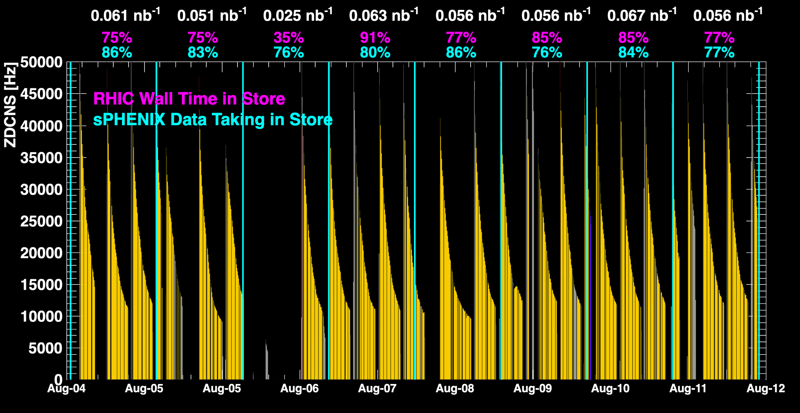
sPHENIX Status & Performance
July 26 was one of the best days yet !
When all sPHENIX detectors were being operated.

Slide 3
sPHENIX Status & Performance (cont.)
sPHENIX continues to make efficient use of the available beam time.
Maintain high throughput data taking (>30GB/s): by adjusting various data paths between the event servers and buffer-boxes.
Fringe field measurements outside sPHENIX Detector/Magnet :
~ beam height/hole around beampipe At the bottom of magnet/HCAL (~z=0)
To be done again on Wed. (Aug. 13)

Slide 4
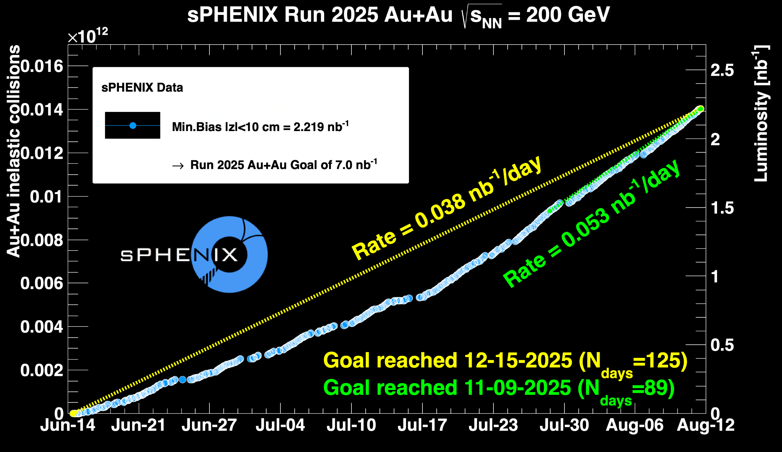
sPHENIX Status & Performance (cont.)

