Slide 1
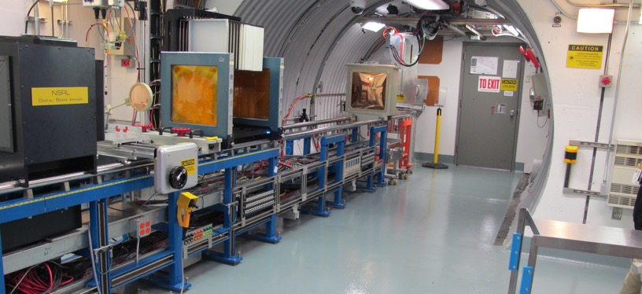
NSRL Time Meeting Report
12 August 2025
Michael Sivertz

Slide 2
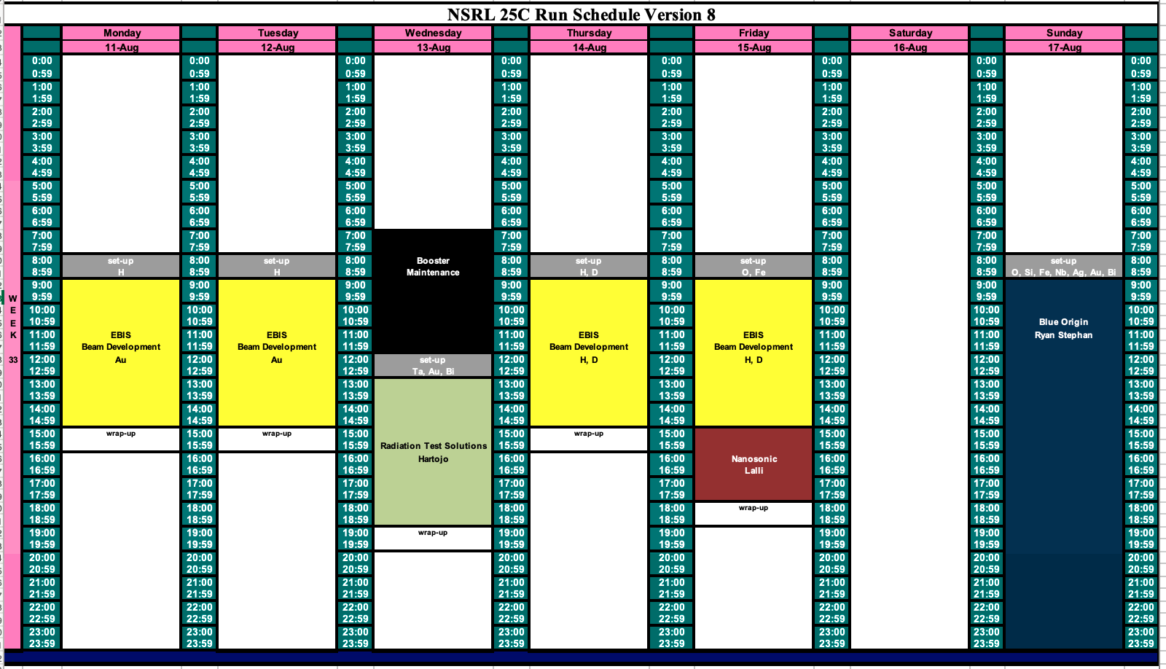
Schedule for this week

Slide 3
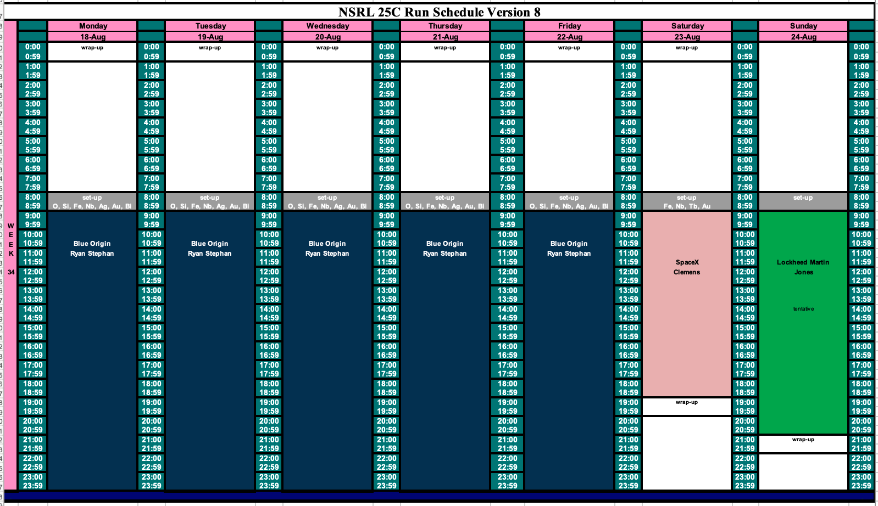
Schedule for next week

Slide 4
Future Schedule
This week we are working with EBIS and Booster for beam development of protons from H⁺ and H₂⁺ as well as Deuterium.
Tomorrow (Wednesday) we have Radiation Test Solutions using Ta, Au, and Bi.
Friday we have a Nanosonic using Fe @ 1000 MeV/n and beam development using both Oxygen and Fe beam.
Sunday 17 August begins a week-long run of 16-hour days for Blue Origin using O, Si, Fe, Nb, Ag, Au and Bi.
We run through the following weekend with SpaceX and Lockheed Martin.

