Slide 1
Data courtesy C. Naylor

Slide 2
Data courtesy C. Naylor

Slide 3
Data courtesy C. Naylor

Slide 5
Data courtesy C. Naylor

Slide 6
Data courtesy C. Naylor

Slide 7
Data courtesy C. Naylor

Slide 8
Data courtesy C. Naylor

Slide 9
Data courtesy C. Naylor

Slide 10
Data courtesy C. Naylor

Slide 11
Data courtesy C. Naylor

Slide 12
Data courtesy C. Naylor

Slide 13
Operations for BLIP
No BLIP
this past week
BLIP remains in shutdown.
Linac off since 8 July.
Notes:
BLIP plot from LogView /MCR/PerformanceStats/timeMeetingBLIP.lvdisp
Avail calc on nsrl time Excel sheet

Slide 14
NSRL activity past week: 8/5-12/2025 (as of 0800)
NSRL running continues. Various user time and beam development continuing.
6 species (O, Si, Fe, Tb, Ta, Bi) logged to NSRL; H in Booster.
Run 25-C began 30 June; 25-C schedule posted, updates forthcoming through 1 November.
Availability: 81.2%
Notes:
Graph and avail calc from nsrl time.xlsx

Slide 15
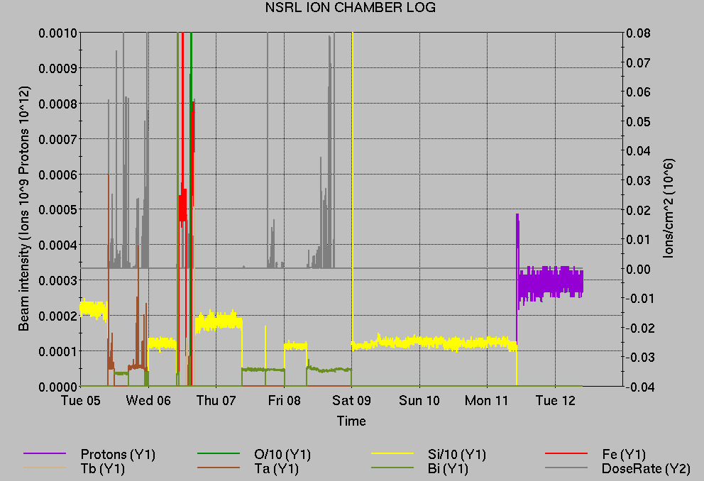
Notes from Operations
Notable failures (>1 hr)
NSRL air compressor trip, misused valve, and subsequent investigation of ACS reachbacks
RF access, storage cavity repairs (2x)
Booster C7 inj kicker PS failure, resistor replaced
Booster D1 inj kicker PS failure (3x), resistor replaced
G10 kicker PS failure forcing single-bunch fills; trigger board replaced
Booster D6 septum PS repairs for heat load issues
EBIS LEBT solenoid PS failure, undiagnosed
EBIS RFQ fault, reset
Other notes
Yellow QLI, beam induced by debunched beam
Lead flow interlock, Cryo input card replaced
Vacuum interlock, 24V PS replaced
BPM abort (3x), likely 9A alcove radiation upset
NQBPS abort, mild power fluctuations
Other various trips, resets, tuning, foil changes
additional injector beam for Au setup, Operator training (when injector systems are available)
Alarm Statistics | FY 2025
Total control points in database | 2,701,735
Total alarm DB entries | 1,739,886
Total alarms set as new | 873,561
Total distinct parameters which alarmed | 16,951
Total operator actions on alarms | 14,306
qfg.ak08-tv-ps:ioErrorM | 72525
ulrClkDsk.2a-bbbdamp.b:lockStatusAlarmM | 42791
lhn-d182-ps.watch:alarmM | 34523
permit.958-vme.A:upstreamFailedM | 28750
eba-cp-03:tempM | 26893
ebs-dt6-ps:ioErrorM | 18665
eba-cp-01:tempM | 14514
QP02-R01B04-bi1-sxf1-qp:statusM | 13537
gpm.lrm.21_hebt7-avg:dataM | 11979
gpm.lrm.20_hebt6-avg:dataM | 11109
nmr20Gaussmeter:lockStatusAlarmM | 10632
es3-ion.probe.src-ps:ioErrorM | 9464
qfg.ae18-th-ps:ioErrorM | 9197
power.uq2:trackingM | 6478
rbpm.yo8-bv5:bpmStatusM | 6193
ebs-dt12-ps:ioErrorM | 5930
gpm.B_DipoleDcctDiffAtStore:dataM | 5271
Notes:
NSRL plot from LogView /MCR/PerformanceStats/timeMeetingNSRL.lvdisp, select Dose Rate and ion species in use
Screenshot of AlarmSummary

Slide 16
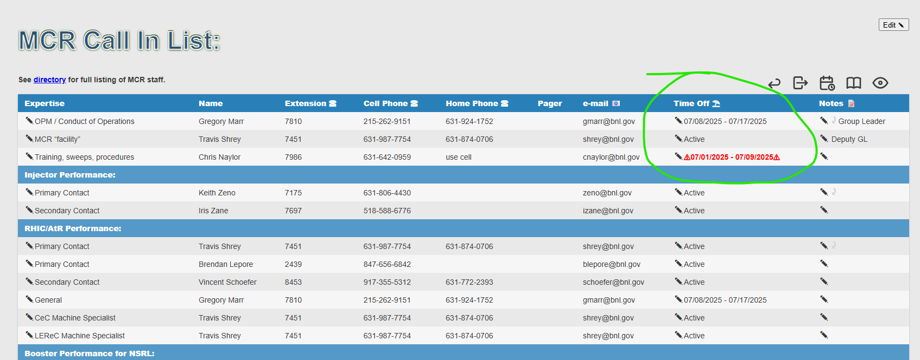
Reminder from Operations
MCR beam operations continue
RHIC physics running continues
Tandem remains sole provider of Au31 for RHIC
Transiting MP7->MP6->MP7 for foil maintenance.
Operator/OC shifts continue for MD of light ions and users, 6-7 days/1-2 shifts this week and next.
Au31 from Tandem for higher intensity; no proton beams until November; Ion beams from EBIS.
AGS tuning, other studies to continue behind stores as time allows.
MCR on duty 24/7.
Changes? Time to update is now. Expect calls at all hours.
Alarm response instructions: need updates
http://directory.pbn.bnl.gov/ CHECK AND EDIT YOUR OWN CONTACT INFO
https://www.cadops.bnl.gov/Operations/personnel/call_in_lists/
CHECK YOUR CALLIN LIST: expect contact off-hours
Summer is vacation time! Make sure your list is accurate

Slide 17
Keytree notes
Remote keytree systems require a database lookup to validate and authorize distribution of keytokens. The Keytrak system’s database is available for lookup functionality, but can no longer be modified in any way to add or edit qualified personnel.
Personnel affected:
New employees, experimenters arriving after 12/1/2024 could not be enrolled in database
Existing employees & experimenters, not already enrolled, cannot be added or modified in database
Remote keytrees affected:
Iris scan @NSRL
BNLID scan @AGS South gate, North Conjunction Gate
Iris scan @RHIC STAR, sPHENIX, IP12, IP4
Keytrees NOT affected:
BNLID scan @Linac, Booster
BNLID scan @RHIC IP2
MCR keytrees

Slide 18
Keytree notes, continued
Mitigation:
Choose entrants that are currently enrolled to perform the work in the enclosure under Controlled Access (CA).
Obtain CA keys from MCR for remote gate watch
Arrange for local gate watch using other tokens for entrants.
Arrange for Restricted Access, and allow for delays incurred to sweep areas.
CAUTION
Follow procedures. Gate Watch staff will remain vigilant.
No “piggy-backing” – one key/token per entrant.
Access keys are not candy! Authenticated entrant retains possession.
Radiological Controls and the Access Controls System are not to be circumvented. This is (has been) enforced with disciplinary action (dismissal).

Slide 20
Notes:
Reliability comparisons to previous runs

Slide 21
Notes:
Reliability comparisons to previous runs

Slide 22
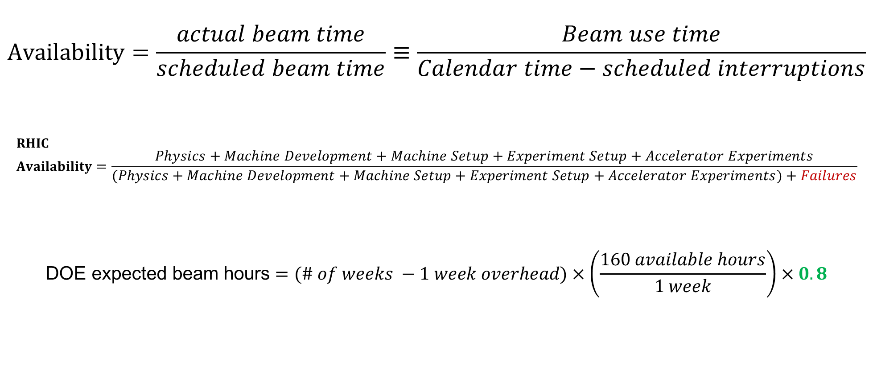
Availability, expected beam hours
$$Availability=\frac{actual beam time}{scheduled beam time}≡\frac{Beam use time}{Calendar time−scheduled interruptions}$$
$$RHIC \\ Availability=\frac{Physics+Machine Development+Machine Setup+Experiment Setup+Accelerator Experiments}{(Physics+Machine Development+Machine Setup+Experiment Setup+Accelerator Experiments)+Failures}$$
$$\text{DOE} \text{expected} \text{beam} \text{hours}=(\# of weeks −1 week overhead)×\left(\frac{160 available hours}{1 week}\right)×0.8$$
Notes:
Normally hidden. Explains how the 85% from DOE comes in to play, & general availability metrics

