Slide 1

Time Meeting
Accelerator Operations Support

Slide 2
Maintenance Tomorrow
TTB Sector 28 Opened all day for sump work
LINAC Zone 3 access am
Booster until 10am
AGS, AtR and W,X,Y; Restricted Access until 11am
RHIC: CA sector 10, XA sector 12
RHIC RA elsewhere
Sweeps for RHIC start at 1300

Slide 3
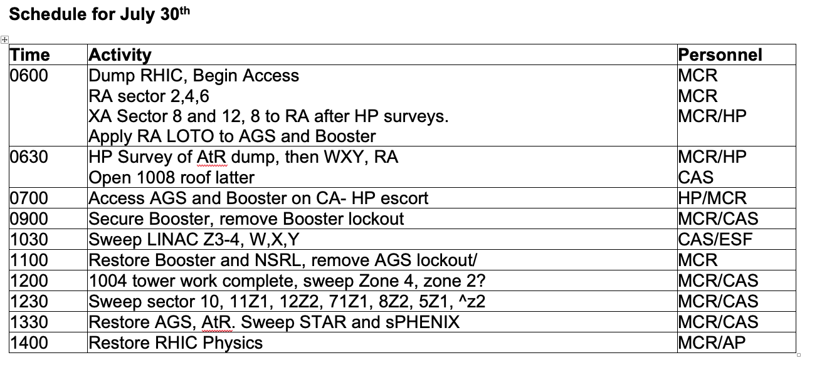
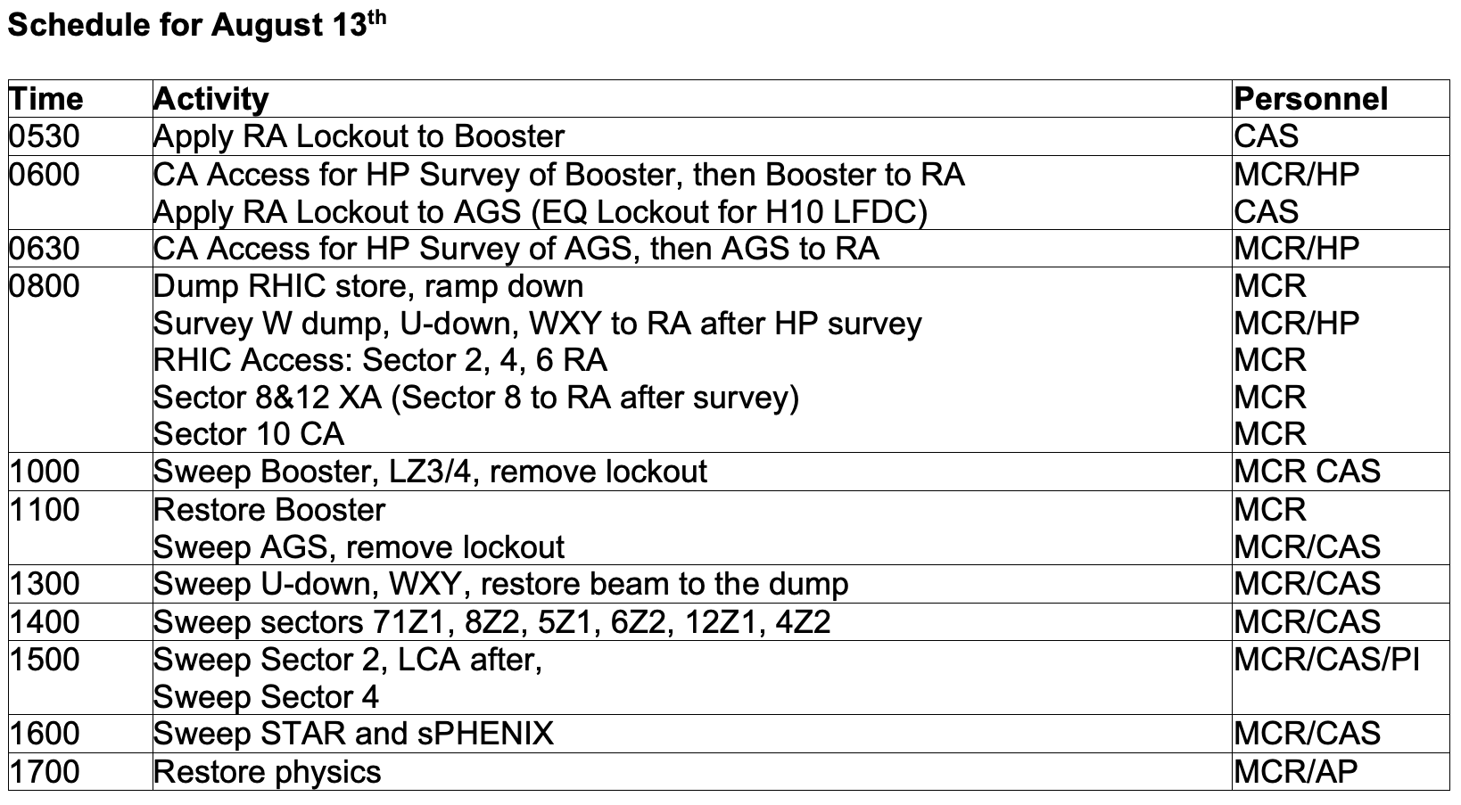

Slide 4

Planning and scheduling
at 3pm
In person preferred
Streaming
ANYONE doing work – send a representative

