Slide 1
APEX Report
RHIC Time Meeting
August 12, 2025

Slide 2
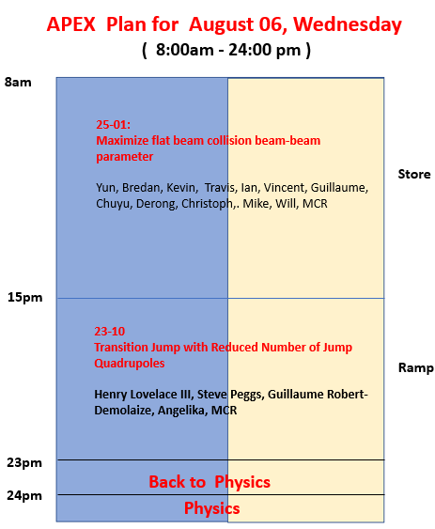
APEX went on very well.
Planned 15 hours of beam time, we used 15 hours. Excellent!!!

Slide 3
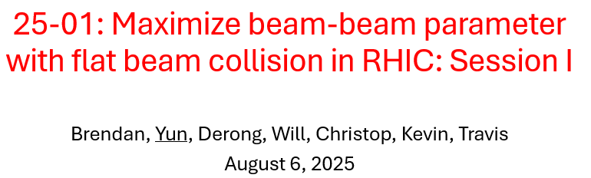
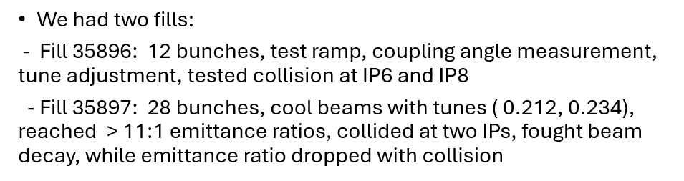
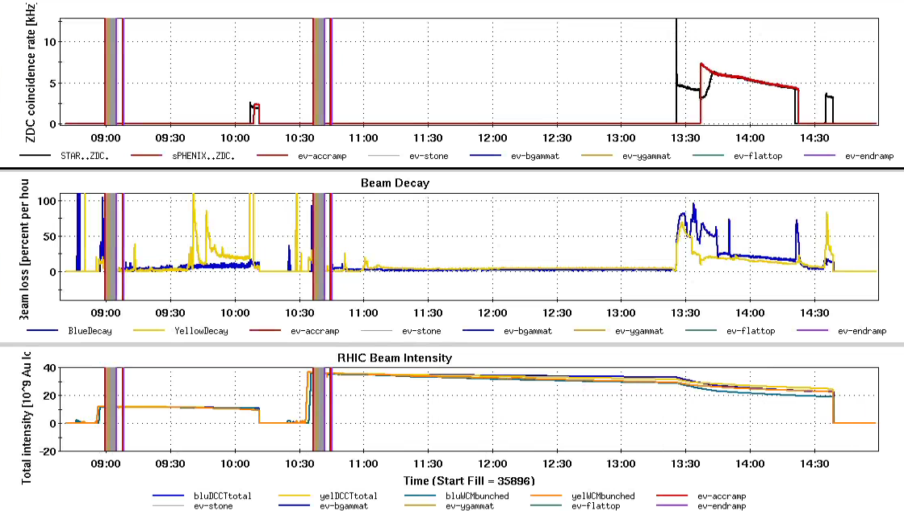

Slide 4
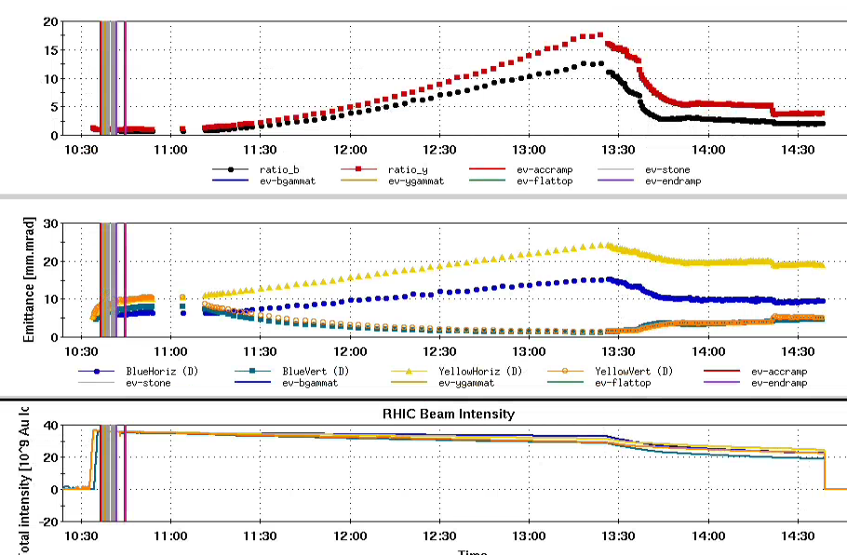
Fill 35897: Cooling
28 bunches bunch intensity about 1.2e9. ( We need 0.8e9 with cooled beam.)
The tune setting for cooling: (0.211, 0.234), tune split > 0.02
Reported Emittanc ratio: Yellow 17:1 Blue 12:1
IPM beta needs calibration, especially Yellow ring

Slide 5
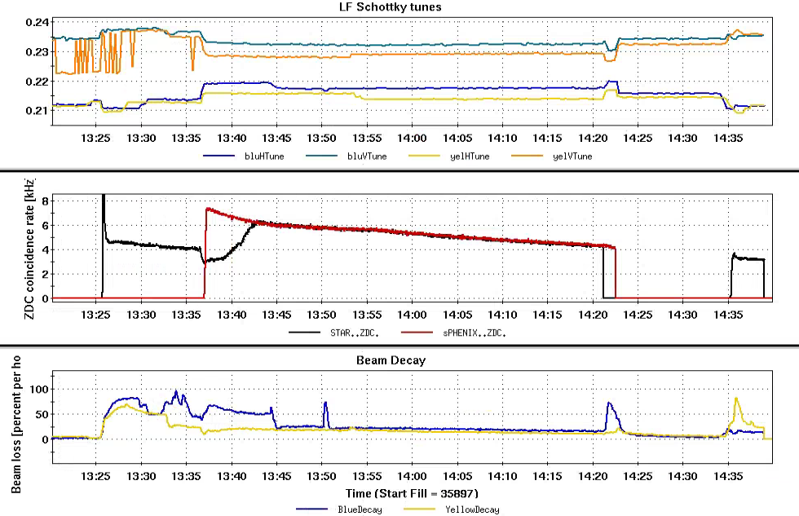
Fill 35897: Collision
13:26pm: collisions at IP6 ; 13:37pm: collisions at IP6 andIP8; 13:56pm: vertical cooling off

Slide 6
Plan for August 20
1) no test fill, right away for AP experiment
- 28*28 bunches or 12*12 bunches, 1.1e9 bunch intensity
- putting beams into collision right away at the beginning
- cooling vertical beam emittances
- if needed, un-cog beams to remove collision
2) When reached 11:1 emittance ratio ( beams in collision )
- switch off all cooling, observe for 2 hours

Slide 7

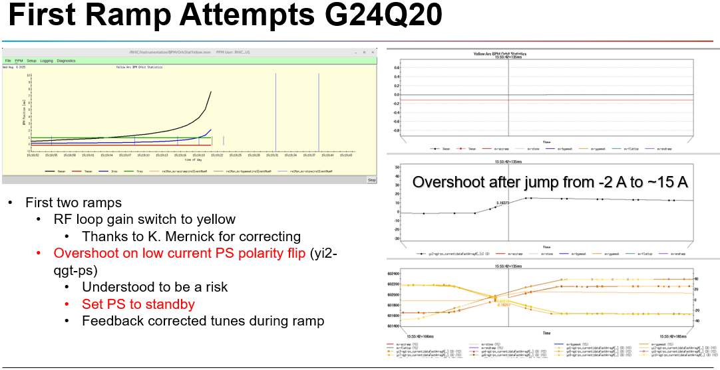
@Steve Peggs

Slide 8
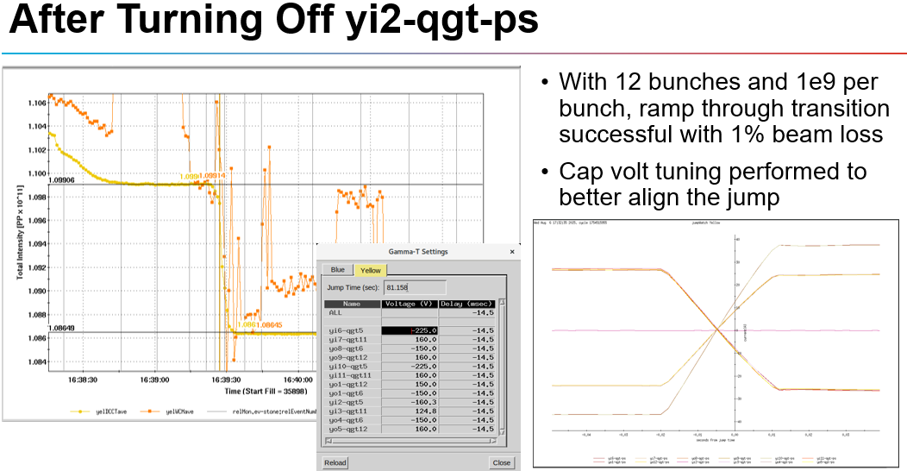
Synchronized qama-t qudrupole jumping times

Slide 9
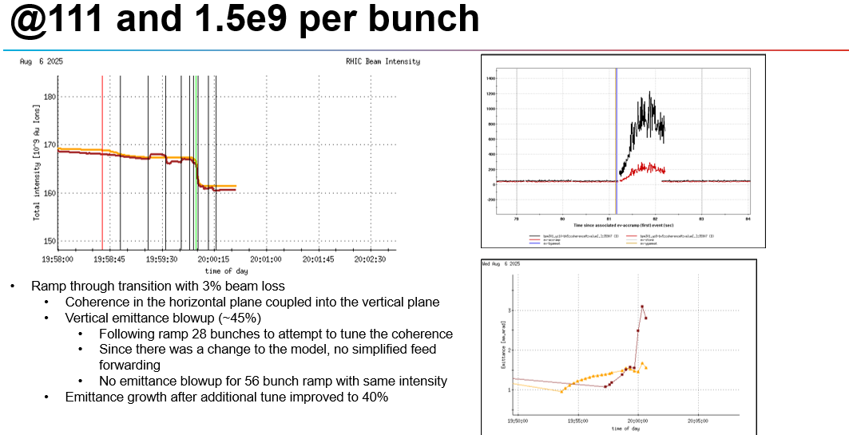
< 5 % beam intensity loss
Emittance blow-up

Slide 10
Plan for August 20, 8 hours, needs to be consolidated:
1) continue tests with 20 Q-families as August 8 ?
2) or go with 16 Q-family jump quad tests ?
Are ramp files ready for 16-Q families ?

Slide 11
