Slide 1
TAKE FIVE for Safety-
Noise and Hearing Loss
Frank Craner
August 19, 2025

Slide 2
Background Information from CDC
The Center for Disease Control (CDC) estimates that 22 million workers are exposed to potentially damaging noise at work each year.
Noise levels are measured in decibels, and exposure over 85 decibels can damage your hearing.
  If you need to raise your voice to speak to someone 3 feet away, noise levels might be over 85 decibels (dBA).
  There are several types of instruments available to measure the noise levels in a workspace. These include sound level meters, noise dosimeters, octave band analyzers, and apps for phones.
Noise is likely a problem in your workplace if you:
  Hear ringing or humming in your ears when you leave work.
  Have to shout to be heard by a coworker an arm's length away.
  Experience temporary hearing loss when leaving work.

Slide 3
OSHA Standards
OSHA requires employers at general industry, maritime, and longshoring worksites to implement a hearing conservation program when employee noise exposures equal or exceed 85 decibels (dBA) as an 8-hour time-weighted average (TWA).
Hearing conservation programs strive to prevent initial occupational hearing loss, preserve and protect remaining hearing, and equip workers with the knowledge and hearing protection devices necessary to safeguard themselves.
In addition, engineering or administrative controls (which may include elimination and substitution of noise sources) are required when noise exposure is above 90 dBA as an 8-hour TWA.

Slide 4
Hearing Loss
Exposure to loud noise can damage and kill hearing receptor cells in our inner ear. The result is permanent hearing loss that cannot be corrected through surgery or with medicine.
Noise-induced hearing loss limits your ability to hear high frequency sounds and understand speech, seriously impairing communication. Hearing aids may help, but they do not restore your hearing to normal.

Slide 5
Hierarchy of Controls for Noise
The hierarchy of controls for noise can be summarized as:
Eliminate or minimize noise exposure by installing equipment that produces less noise (e.g., buy-quiet programs),
Prevent or contain the escape of noise at its source (engineering controls),
Control exposure by:
  changing work schedules to reduce the amount of time any one worker spends in the high noise area (administrative controls); or
  changing practices such as distancing from noise-producing equipment (work practice controls),
Control the exposure with hearing protection (PPE).

Slide 6
Hearing Conservation Program
Step 1 | The Supervisor completes the Occupational Medicine Clinic (OMC) Job Assessment Form and indicates “Noise” for personnel with the potential for exposure in areas above 85 dBA.
Step 2 | The supervisor (with assistance from the Environmental, Safety & Health Representative [ESHR]) completes the OMC Additional Medical Surveillance Form as soon as possible after staff have their first occupational noise exposure at or above the 85 dBA 8-hr time weighted average on any day. The form must be completed annually for staff who continue to be exposed at or above 85 dBA 8-hr time weighted average.
Step 3 | The OMC schedules and performs a baseline audiogram in response to the Additional Medical Surveillance Form request.
Step 4 | If an audiogram shows a Standard Threshold Shift (STS), then the individual is retested within 30 days.
Step 5 | If the retest audiogram confirms an STS, then OMC refers the individual for an evaluation by an otolaryngologist.
Step 6 | The OMC reviews the otolaryngologist’s evaluation and notifies the OSHA Recordkeeper if OMC determines that the STS is noise-induced.
Step 7 | The Occupational Injury/Illness Coordinator requests that the ESHR conduct an evaluation of the individual's operations and/or workplaces for excessive noise exposure.
Step 8 | The ESHR conducts the evaluation and submits a formal report to the Occupational Injury/Illness Coordinator, Line Management, and the individual.
Step 9 | The Occupational Injury/Illness Coordinator records the STS as caused or aggravated by BNL occupational noise exposure, if indicated by the medical evaluation and STS evaluation.
Step 10 | Line Management ensures that the following steps are taken when a work-related STS occurs and potential exposure at or above the 85 dBA 8-hr time weighted average continues: Staff not using hearing protection are fitted with hearing protectors, trained in their use and care, and required to use them. Staff already using hearing protectors are refitted and retrained in the use of hearing protectors and provided with hearing protectors offering greater attenuation if necessary.

Slide 7
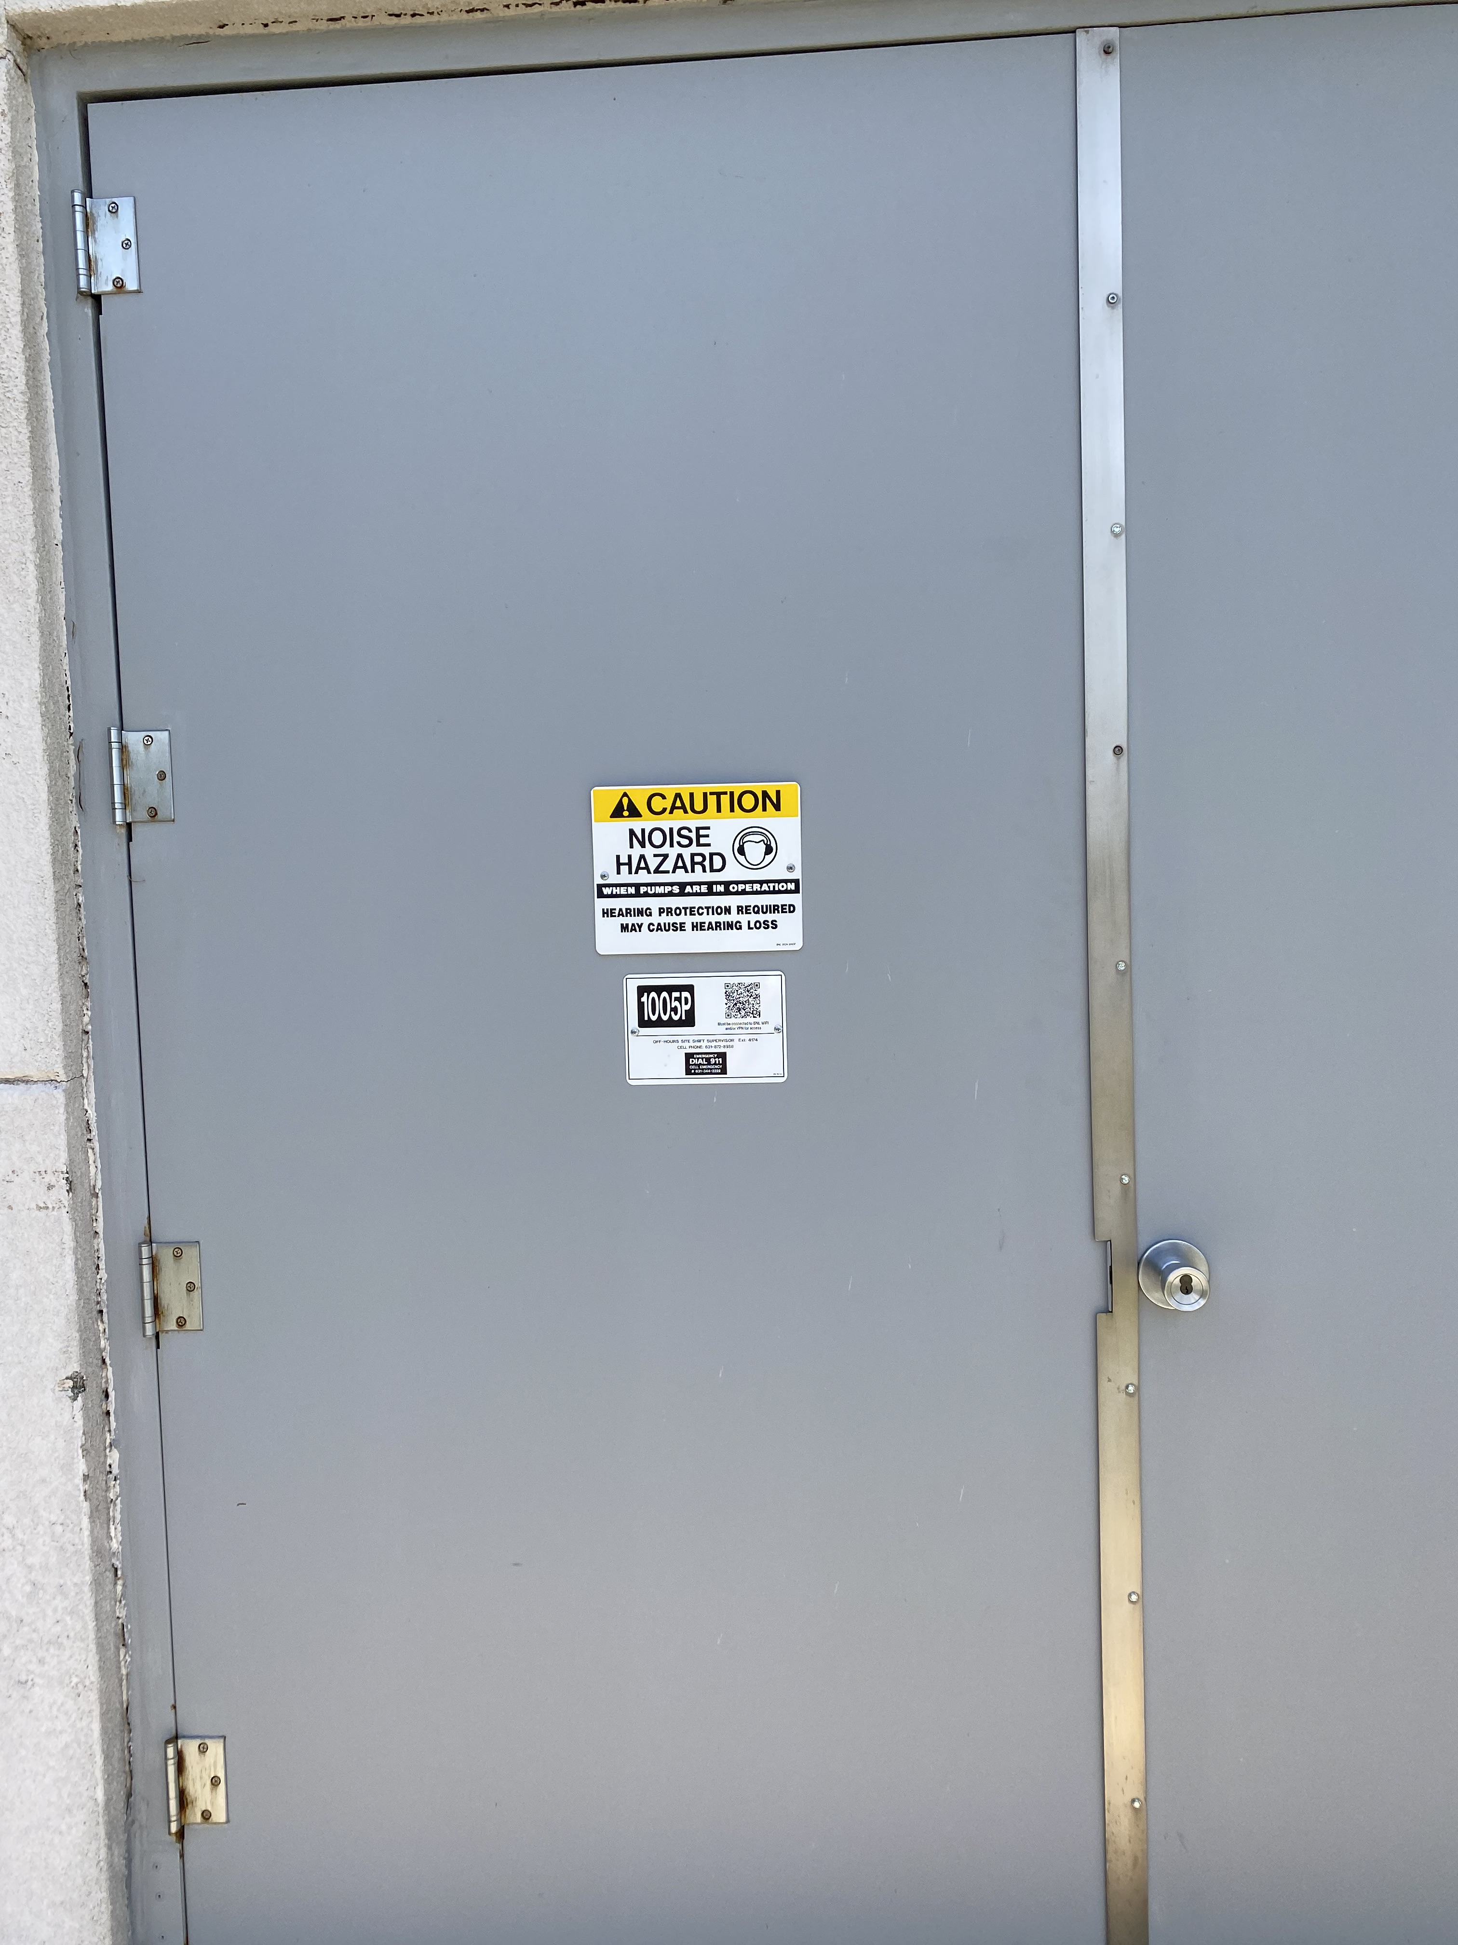
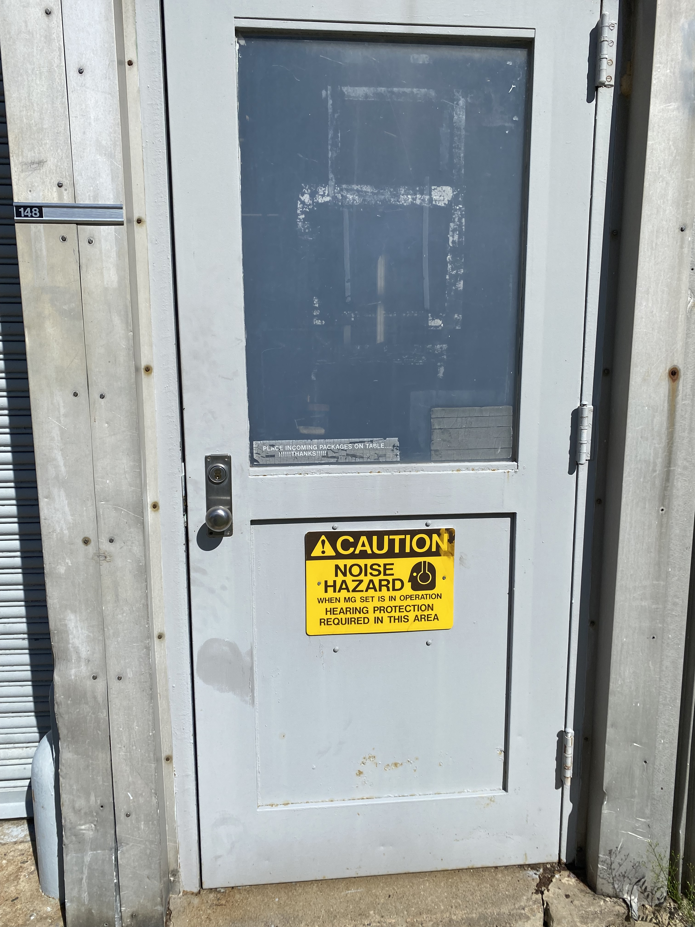
Noise Sign Examples

Slide 8
Reminder about August Safety Theme- Work Planning and Time Pressure
All group leaders and division heads to have discussions in their usual group meetings focusing on “Work Planning is required for all work and that schedule pressure cannot override safety measures.”
Please send the results of what was discussed to Shawn Fitzgerald who will collect them.
Please turn them in by Friday August 22, 2025.
Some suggestions for the discussion:
  Causes of schedule pressure in your group
  What can be done to speed up parts of the job without taking shortcuts
  Are there better ways to do certain jobs that don’t take so much time
  Times the group felt pressured to complete a job more quickly
  Was there a time that an incident was avoided because a short cut was not taken
  Examples of where skipping steps, rushing, or taking shortcuts wound up taking longer.
We will collect this information and make it available. Where we can, we should all make improvements in our areas.

